Slide 1

April 2018
Mastermind
Event
Melbourne
Michael Tiemens
VIC State Coach

Slide 2
Event Outline -
6:00 – 6:30 Networking
6:30 - Start
6:30 – 6:45 Introductions
6:45 – 8:00 Accountability
8:00 – 8:30 Networking Break
8:30 – 10:00 Multi Unit Development

Slide 3

Workshop Format
Use microphone
Involve everyone in the conversation
Be supportive

Slide 4

The Goldilocks Phenomenon
Notes:
Read the story and when finished click to next slide

Slide 5
Let Me Read
You A Story!!

Slide 6
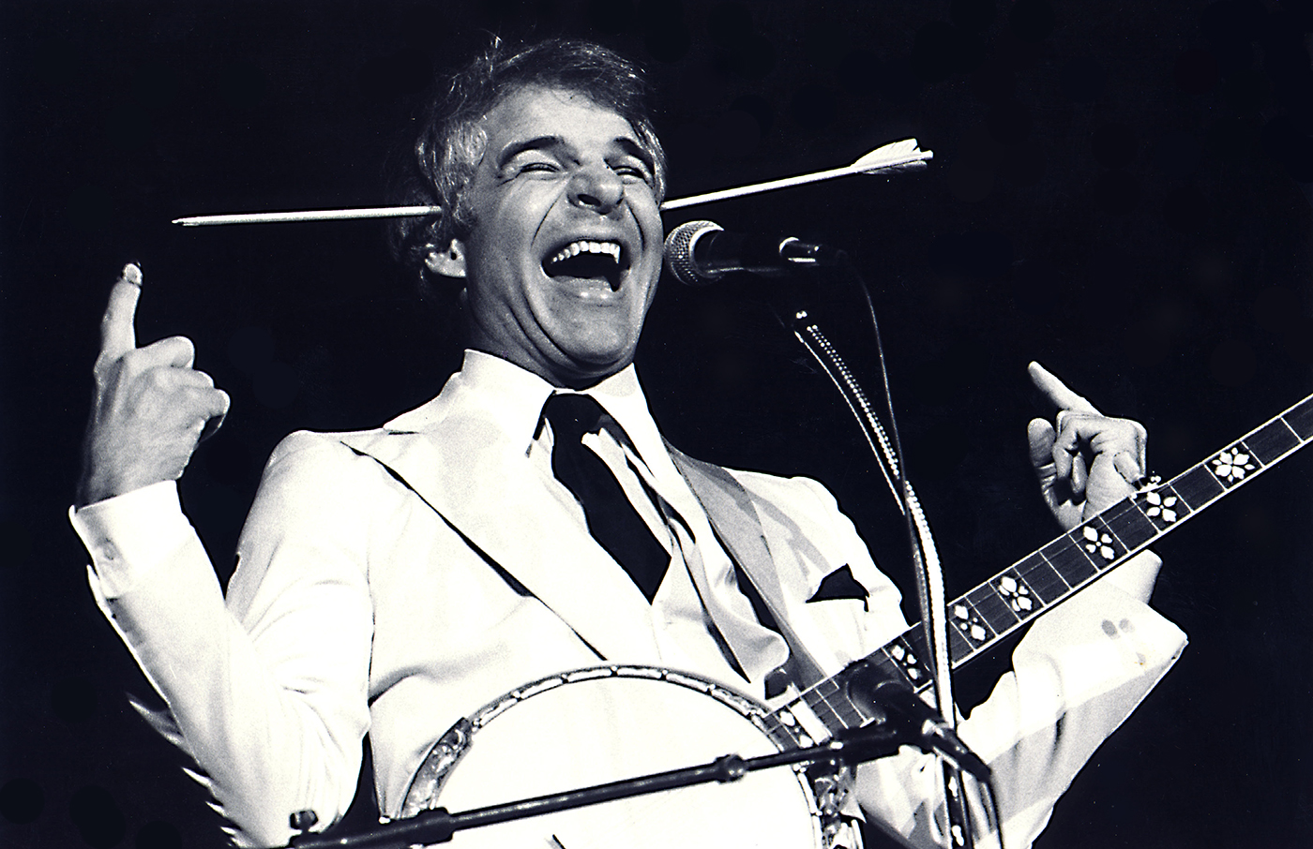

Slide 7
Why do we stay motivated to reach some goals, but not others?
Why do we say we want something, but give up on it after a few days?
What is the difference between the areas where we naturally stay motivated and those where we give up?
Steve Martin worked at it for 18 years. In his words, “10 years spent learning, 4 years spent refining, and 4 years spent in wild success.” His story offers a fascinating perspective on motivation, perseverance, and consistency.
Steve’s autobiography is “Born Standing Up”

Slide 8
Scientists have been studying motivation for decades. While there is still much to learn, one of the most consistent findings is that perhaps the best way to stay motivated is to work on tasks of
“just manageable difficulty.”
This concept is called the Goldilocks Rule

Slide 9

For example, imagine you are playing tennis. If you try to play a serious match against a four-year-old, you will quickly become bored. The match is too easy. On the opposite end of the spectrum, if you try to play a serious match against a professional tennis player like Roger Federer or Serena Williams, you will find yourself demotivated for a different reason. The match is too difficult.
Compare these experiences to playing tennis against someone who is your equal. As the game progresses, you win a few points and you lose a few points. You have a chance of winning the match, but only if you really try. Your focus narrows, distractions fade away, and you find yourself fully invested in the task at hand. The challenge you are facing is “just manageable”. Victory is not guaranteed, but it is possible. Tasks like these, science has found, are the most likely to keep us motivated in the long term.

Slide 10

Tasks that are significantly below your current abilities are boring. Tasks that are significantly beyond your current abilities are discouraging. But tasks that are right on the border of success and failure are incredibly motivating to our human brains. We want nothing more than to master a skill just beyond our current horizon.
We call this phenomenon The Goldilocks Rule. The Goldilocks Rule states that humans experience peak motivation when working on tasks that are right on the edge of their current abilities. Not too hard. Not too easy. Just right.

Slide 11
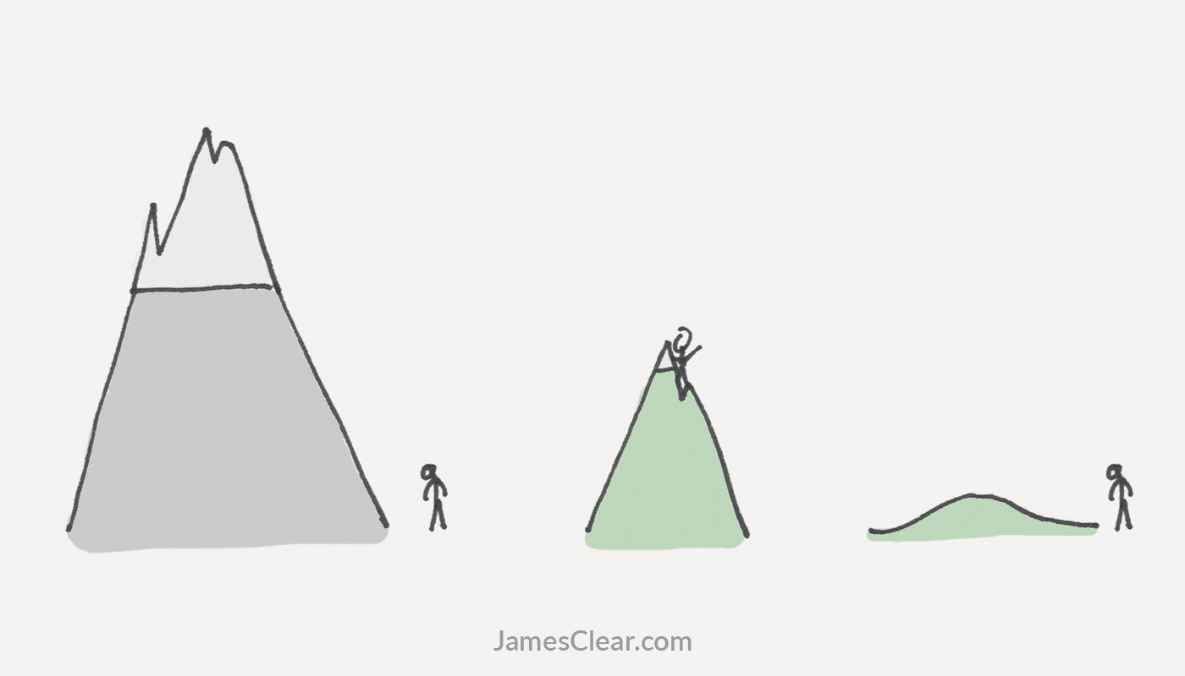

Slide 12
Steve Martin’s comedy career was a perfect example of what The Goldilocks Rule looks like in the real world. Each year, the length of his comedy routines expanded, but only by a minute or two. He was always adding new material, but he also kept a few jokes that were guaranteed to get laughs. There were just enough victories to keep him motivated and just enough mistakes to keep him working hard.
This is why when setting your 2 year plans you shouldn’t jump to a big deal too soon. Taking time to grow into your portfolio and strengths has a lot of merit.

Slide 13

Measure Your Progress
The second piece of the motivation puzzle that is crucial is to achieve that perfect blend of hard work and happiness.
Working on challenges of an optimal level of difficulty has been found to not only be motivating, but also to be a major source of happiness.
This blend of happiness and peak performance is sometimes referred to as flow, which is what athletes and performers experience when they are “in the zone.”
Flow is the mental state you experience when you are so focused on the task at hand that the rest of the world fades away.
The third motivation essential is seeing yourself make progress in the moment.

Slide 14

Two Steps to Consistent Motivation
1) Stick to The Goldilocks Rule and work on tasks of just manageable difficulty.
2) Measure your progress and receive immediate feedback whenever possible.
Wanting to improve your life is easy. Sticking with it is a different part!
If you want to stay motivated for good, then 1) start with a challenge that is just manageable, 2) measure your progress, and 3) repeat the process.

Slide 15
Inspirational Video for Consistent Motivation
Insert video

Slide 16

Two Steps to Consistent Motivation
What are you going to do differently tomorrow to stay motivated? Write it down.
Share with your neighbor.

Slide 17
Accountability
Monthly Goals

Slide 18

Multi-Unit Developments
Selling is an essential skill of an active investor!
Selling to a) Purchaser &/or b) Tenant
Multi-units = More product to SELL
      1) Selling the Finished End Product
      2) Selling Off The Plan
Notes:
Intro slides – outline the topic. We are going to focus on 2 aspects tonight 1) Selling the end product & 2) Selling off the Plan

Slide 19

1) Selling the Finished End Product

Slide 20
Aspects of Selling
1) Photographs – Selection, order, money shot
2) Advertisement Copywriting – Written add on internet listing, sign board, fliers, newspaper, agents window etc.
3) Pricing – Set price, range, offers over, auction, tender, submit all offers
4) Selling Method – Listing, Auction vs Transparent Negotiation
Notes:
Outline whats important to consider and what we will cover tonight

Slide 21

Photographs
Photo Selection
The Money Shot
Photo Order
Notes:
Intro of topics to cover

Slide 22
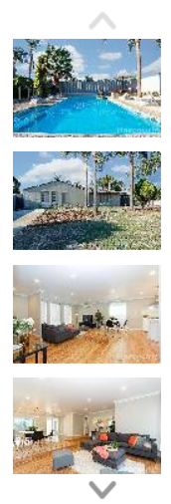
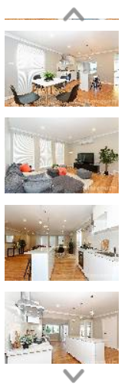
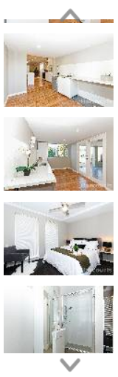
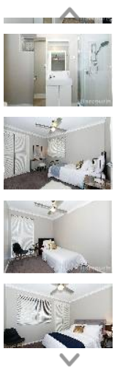
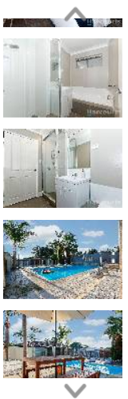
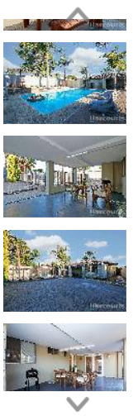
Agents Original Photo Selection & Order
Notes:
Students recent reno deal and Realestate agents original photo selection & order

Slide 23
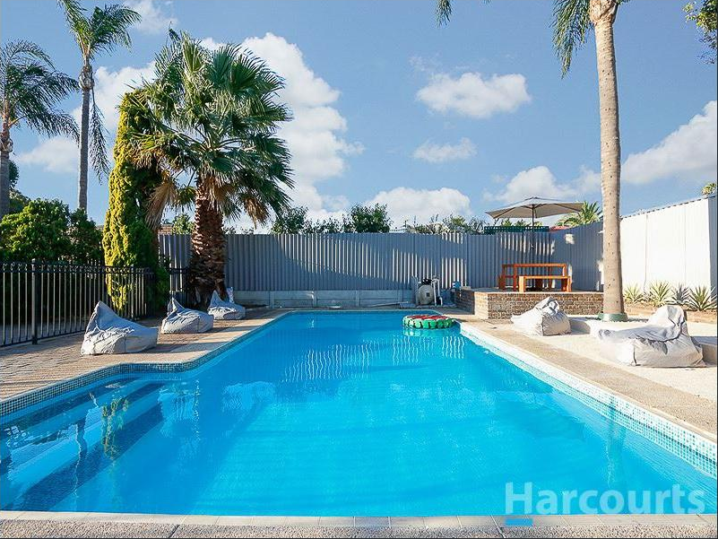
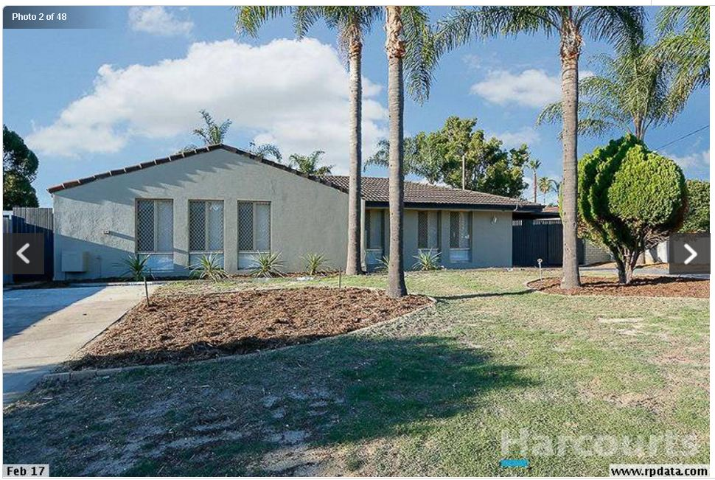
Original Photo Selection & Order
Notes:
Briefly scroll through photos on screen first – agents order and selection

Slide 24
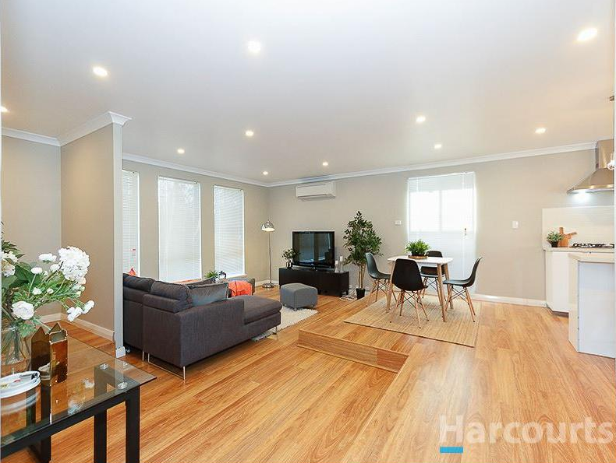
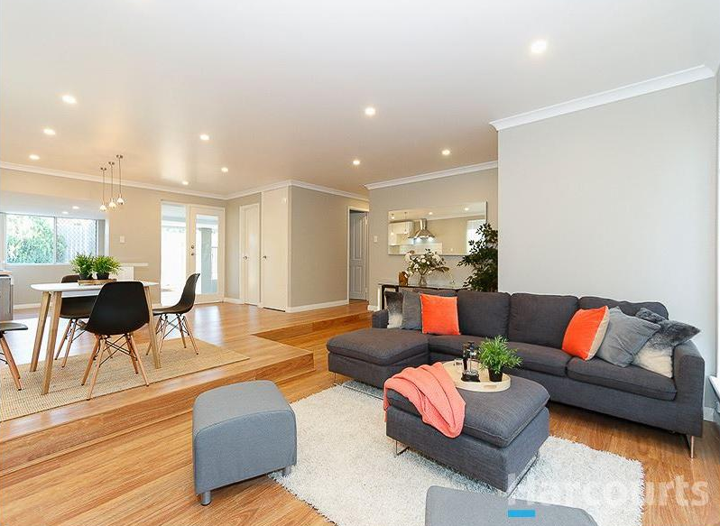
Original Photo Selection & Order
Notes:
5 min

Slide 25
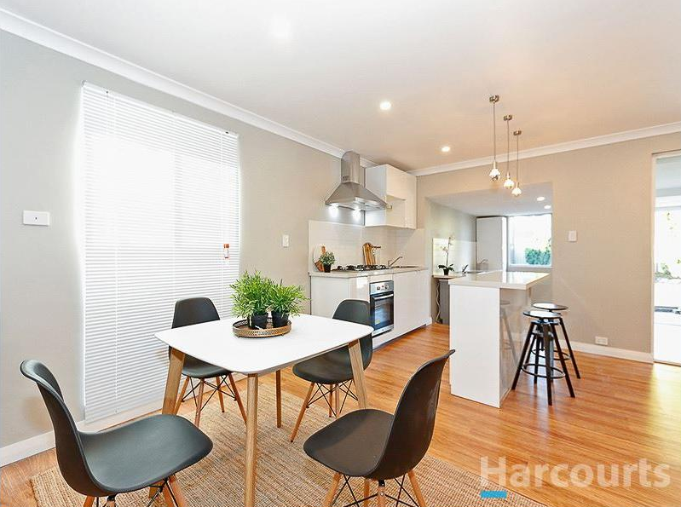
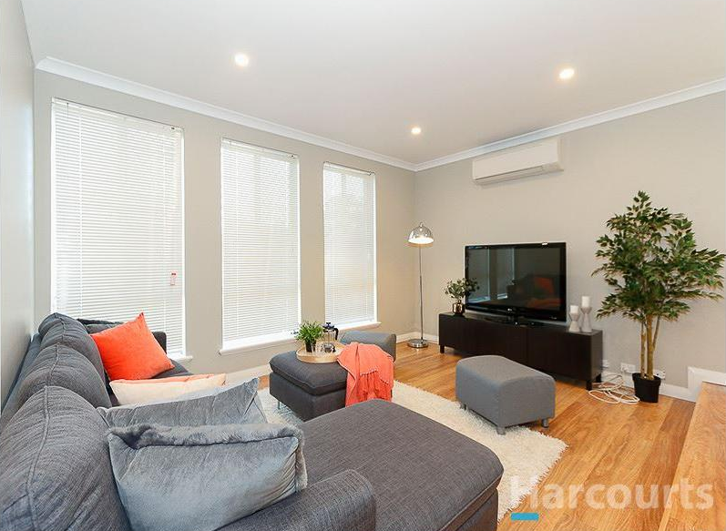
Original Photo Selection & Order
Notes:
5 min

Slide 26
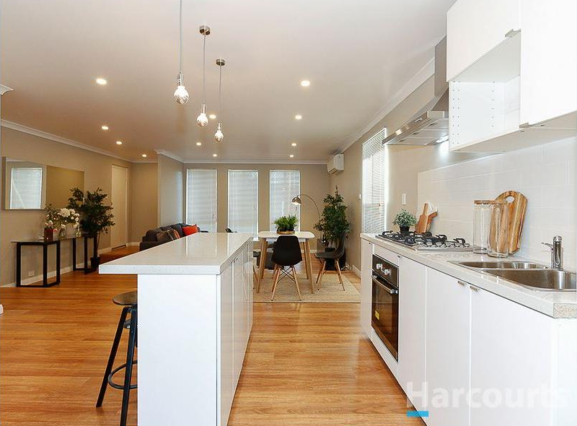
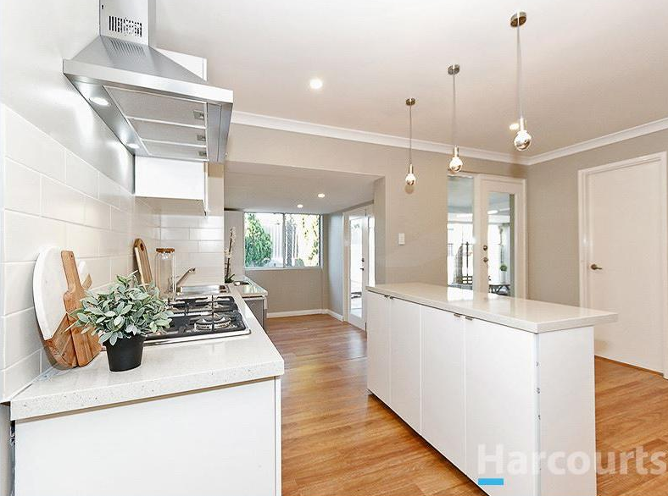
Original Photo Selection & Order
Notes:
5 min

Slide 27
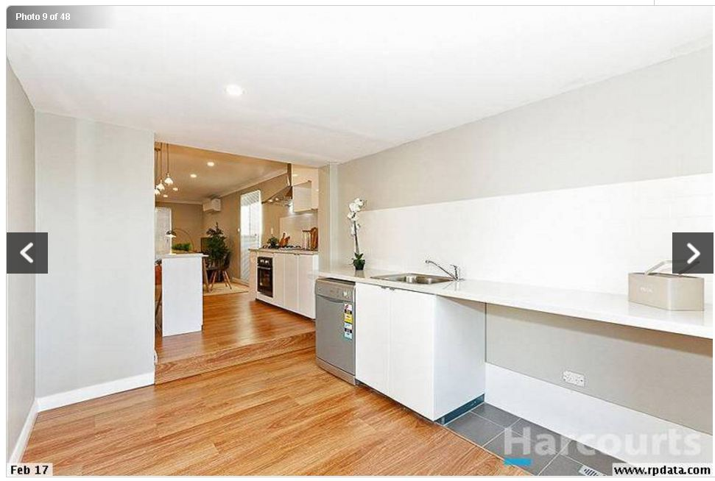
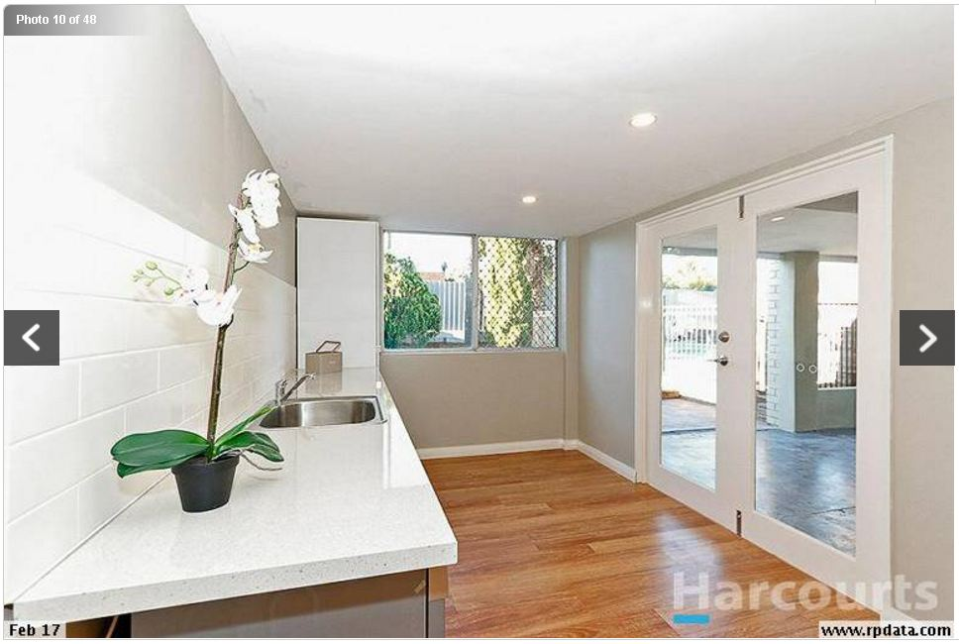
Original Photo Selection & Order
Notes:
5 min

Slide 28
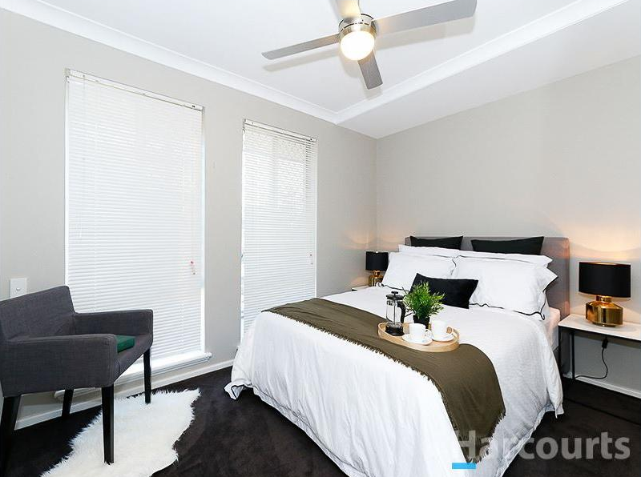
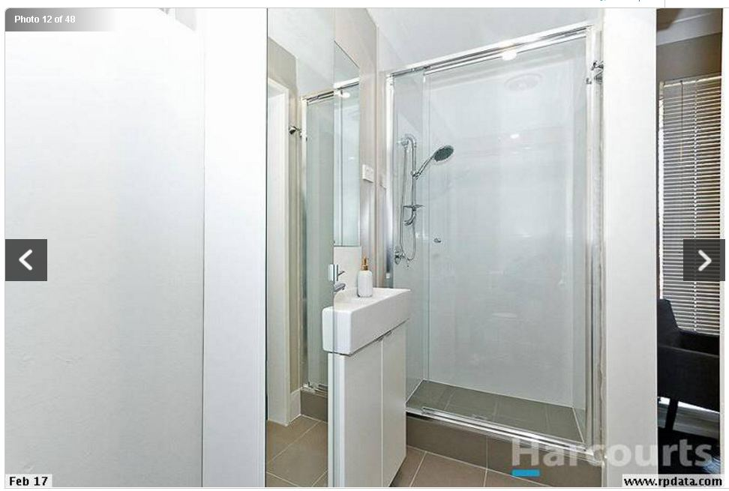
Original Photo Selection & Order
Notes:
5 min

Slide 29
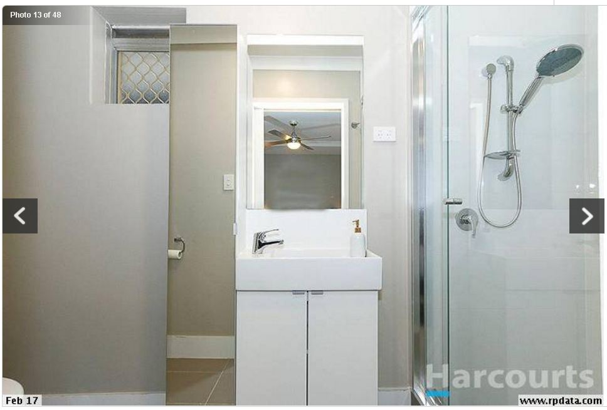
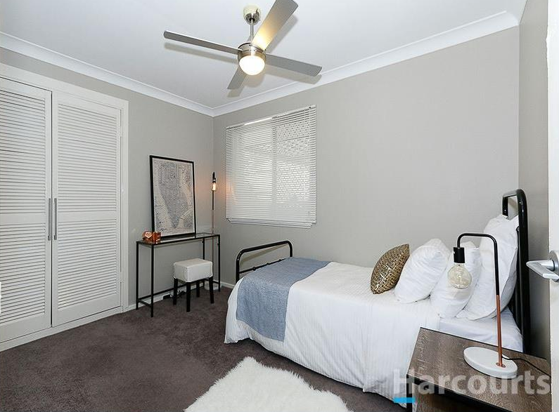
Original Photo Selection & Order
Notes:
5 min

Slide 30
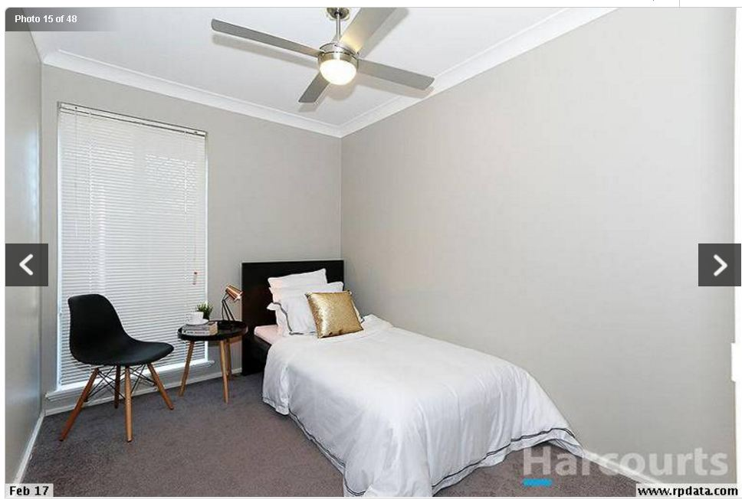
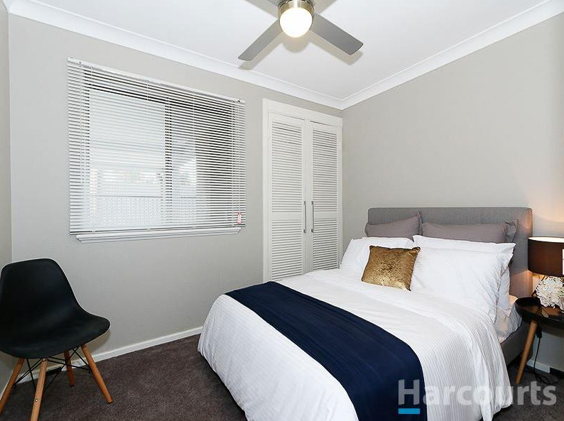
Original Photo Selection & Order
Notes:
5 min

Slide 31
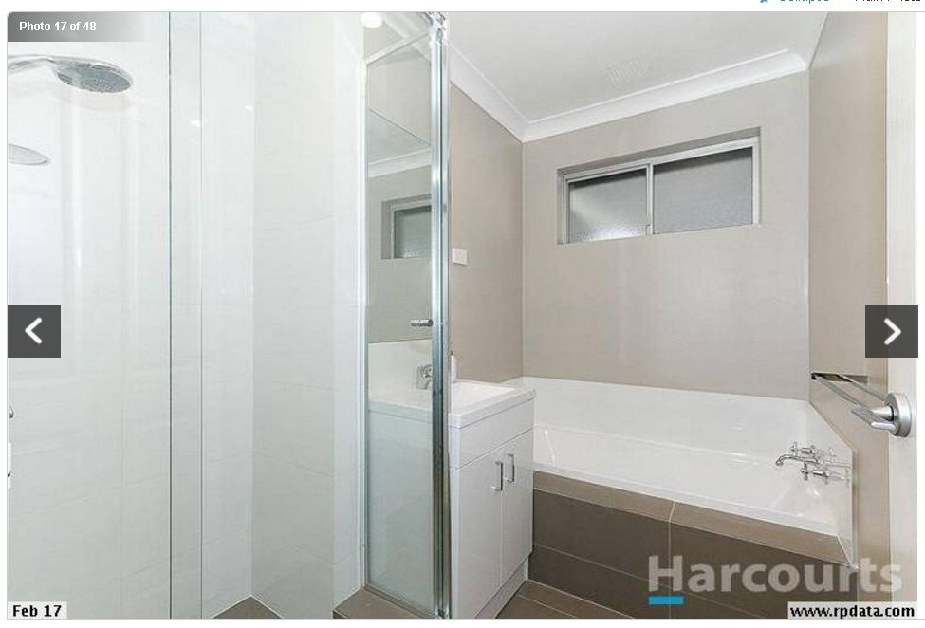
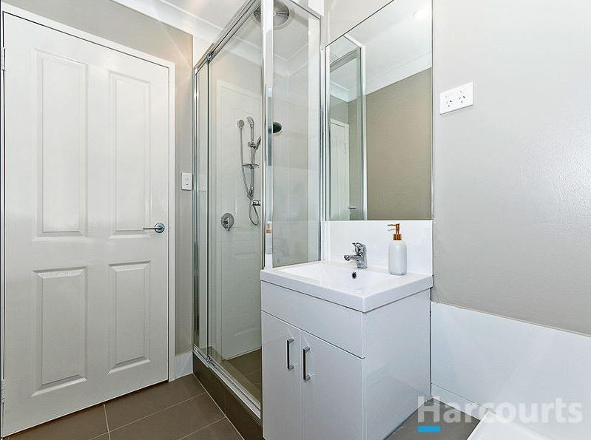
Original Photo Selection & Order
Notes:
5 min

Slide 32
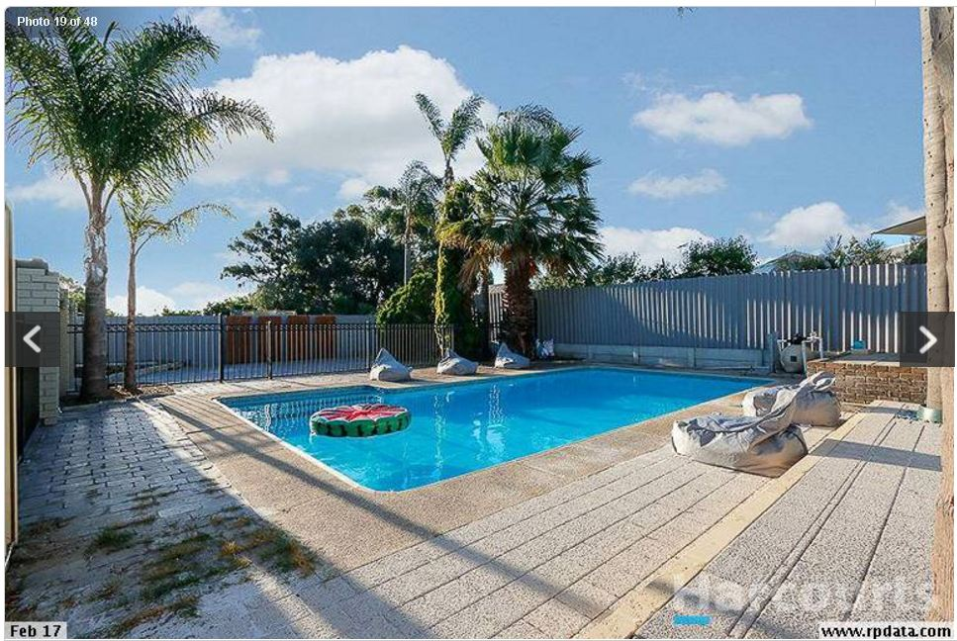
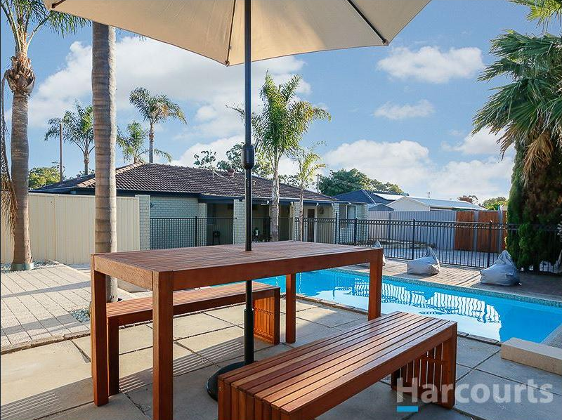
Original Photo Selection & Order
Notes:
5 min

Slide 33
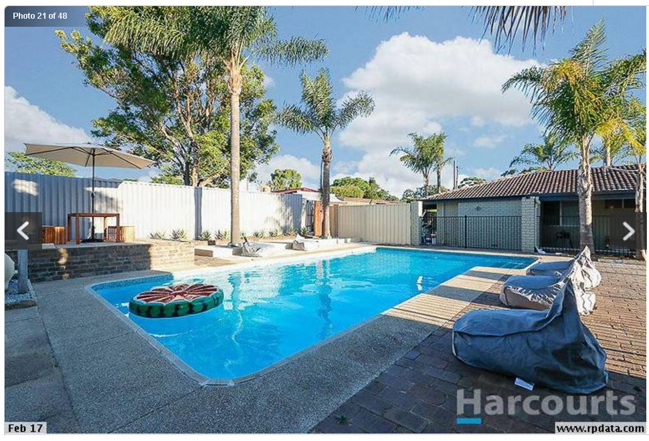
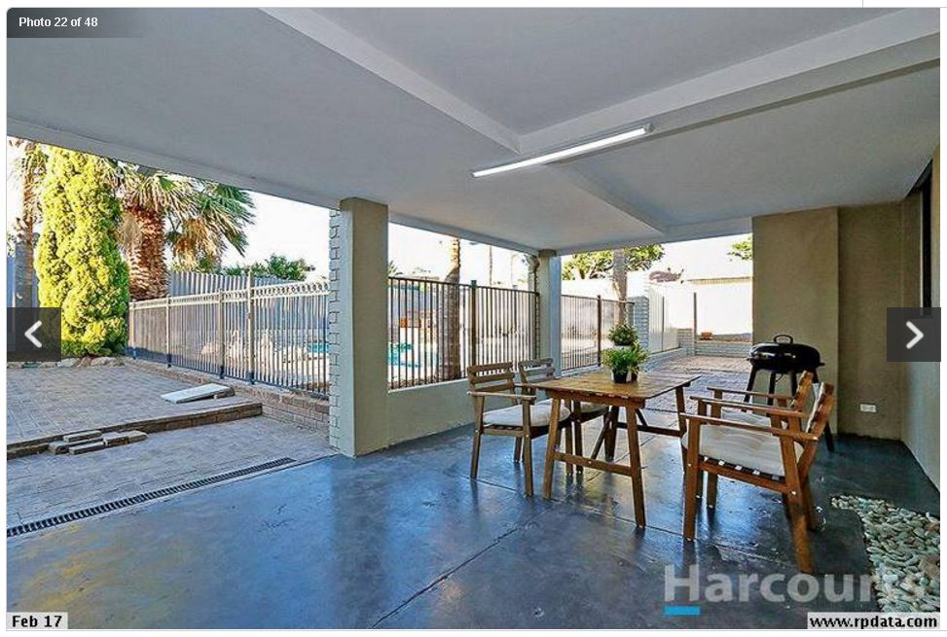
Original Photo Selection & Order
Notes:
5 min

Slide 34
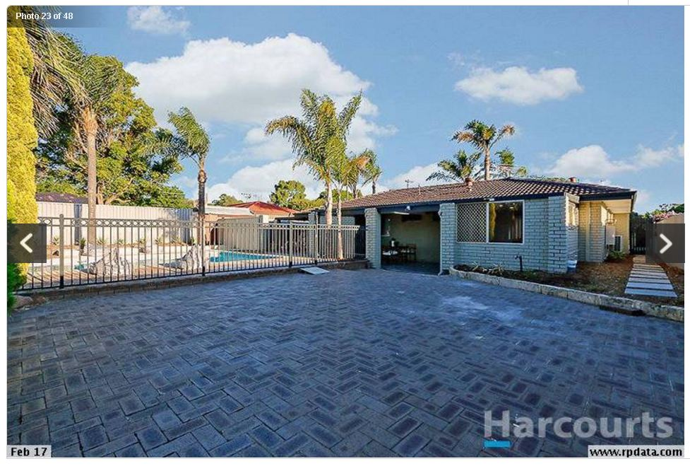
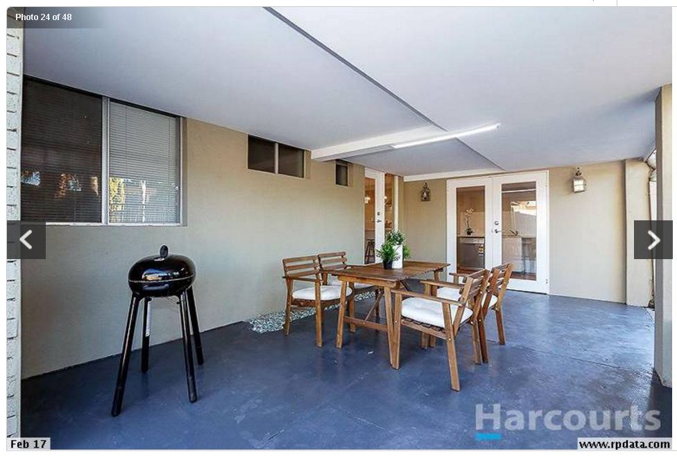
Original Photo Selection & Order
Notes:
5 min

Slide 35

Activity –
On your table - select the photos to keep & those to remove (tip – group lounge/dinning, kitchen/laundry, bedrooms, bathrooms, outside)
Discuss which photos to keep and which to remove & why
Group feedback on photo selection
Notes:
Activity – hand out photo cards – tip is to group photos, then for each group discuss which photos to keep and which to remove and why. Open to group to confirm which photos are being removed and why

Slide 36

Photo Selection -
Less is More - Better to leave out a photo than have it turn the buyer off so they decide not to inspect.
Notes:
5 min

Slide 37
Deleted Photos
Notes:
Suggested photos to delete and why

Slide 38
Deleted Photos
2
23
Unflattering
Patchy grass
Sparse garden
Unflattering aspect – house & yard
Detracts from other photos
Notes:
Run through suggested deleted photos and why

Slide 39
Deleted Photos
19
21
Weeds in pavers
Detracts from photo # 1
Unflattering aspect
Detracts from photo # 1
Doesn’t add anything

Slide 40
Deleted Photos
22
24
Plain looking
Unflattering aspect
Doesn’t add anything
Plain looking
Closed in feel
Doesn’t add anything

Slide 41
Deleted Photos
9
10
OK photo but doesn’t really add anything
Include ?? – butlers pantry?
OK photo but doesn’t really add anything

Slide 42
Deleted Photos
13
12
Reflection in tall mirror cabinet messes with perspective = distracting! Looks like narrow door next to vanity???
Reflection in tall mirror cabinet messes with perspective
Makes ensuite look very narrow
Notes:
5 min

Slide 43
Deleted Photos
17
15
Makes room look very narrow
Other bedroom photos = better
OK – but photo #18 better
Notes:
5 min

Slide 44
Final Photo Selection & Order
Notes:
5 min

Slide 45

Order of Photos
Order is important – want most impactful first – need to keep peoples attention. Group photos e.g. lounge/dining/kitchen, bedrooms, outside.
Agent had no order to the pics
Decide on the money shot!!!
Notes:
Intro slide

Slide 46

Activity –
On your table – select the money shot & decide on the photo order
Group feedback
Notes:
Group activity and feedback

Slide 47
Final Selection & Order
1
Money Shot!
Resort Feel!!!!
Notes:
5 min

Slide 48
Final Selection & Order
4
3
Most impressive pics first
Notes:
5 min

Slide 49
Final Selection & Order
5
6
Notes:
5 min

Slide 50
Final Selection & Order
7
8
Aesthetic first then function
Notes:
5 min

Slide 51
Final Selection & Order
11
16
Master first then next largest etc.
Notes:
5 min

Slide 52
Final Selection & Order
14
18
Walk through order
Notes:
5 min

Slide 53
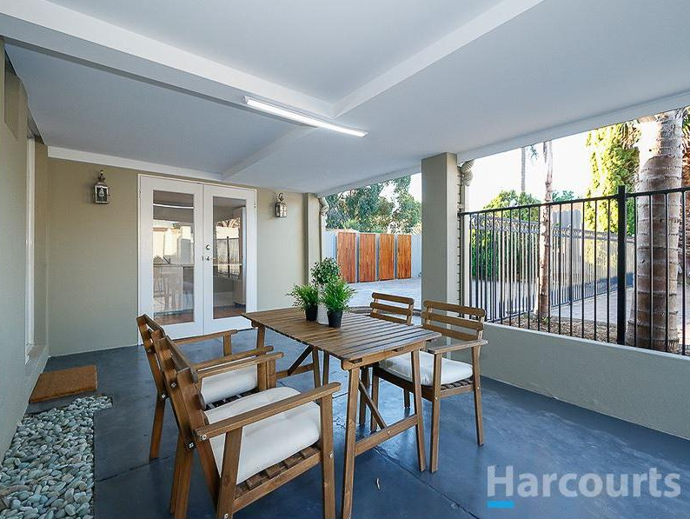
Final Selection & Order
20
New
Finish on a high – pool shot!
Notes:
5 min

Slide 54
Photo Tips -
Have indoor & outside plants in photo – feels alive & softens effect – should have put a pot plant at front door, plus in the pebble of the alfresco area. Use the palm frond effect.
Swish the water in the pool!
View the photos as the photographer is taken them to ensure you are happy – make suggestions …………… you know the property best!!
Notes:
5 min

Slide 55

Advertisement Copy Writing
The words to go with the photos!!!
Notes:
Intro of topics to cover

Slide 56
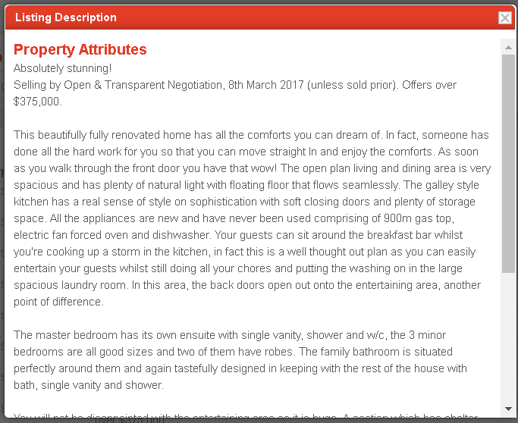
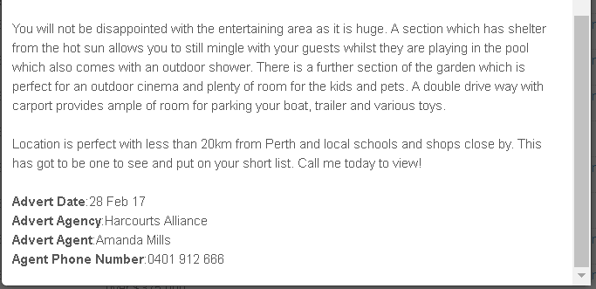
Activity –
Read original add copy that went with the agents photos
Share thoughts on table
Share with group
Notes:
Activity – read add in workbook and share thoughts on table then then get groups feedback – brief review

Slide 57
Principals of Good Copywriting -
1) Features Tell ………and..……. Benefits Sell – highlight the benefits!
2) Sculpt your copy to a target persona e.g. Mum of a young family first home buyer
3) Expand on the benefits & describe the positive impact on the target persona’s life ………….. Plant the seeds
4) Tell them what they will loose if they don’t act e.g. properties like this rarely come on the market, so don’t be kicking yourself if you miss out on this gem!
5) Call to action – tell the reader what to do next – make it simple, direct and don’t make them have to think!! E.g. Pick up the phone and call now.
Notes:
Reflect on principals of copywriting

Slide 58
Activity –
Re-read original add copy relative to
Share thoughts on table
Share with group
Notes:
Re-read add now you know the principals of copywriting and give your verdict

Slide 59
Feedback -
AVERAGE
Notes:
Groups overall feedback

Slide 60

Feedback -
Headline (Hook) = Weak (not attention grabbing)
Body Text = Poor – describes the features not the benefits – makes the reader have to work to think of their own positive benefits = RISKY!!
      Feature = Location is perfect with local schools and shops near by
      Benefit / Emotion = Kids can easily walk to school freeing up your valuable time.
Notes:
Summarise the feedback findings

Slide 61

Feedback -
    Wasted Words = Most features can be seen from the symbols on the add & photos – don’t waste words on it. e.g.
          Ensuite with single vanity, shower and w/c;
          Master bedroom has its own ensuite
Avoid Negatives = Don’t draw attention to negatives e.g.
      Entertain guests while still doing your chores & putting washing on …..
What’s Trending = Incorporate if possible what’s trending e.g. Master Chef……. Become your own Master Chef in your new designer kitchen
Notes:
Summarise the feedback findings

Slide 62
Feedback -
Layout = Too wordy & written in paragraphs. Dot points best!
Call to Action = Weak - Only call to action was to put it on your shortlist – we want them to buy it not short list it!!
Missing Critical Info =
    Subdivision & granny flat potential - Agent dismissed idea that property could be subdivided and a grannyflat could be added and so didn’t include it in add – she said the market was first home buyers and they are not interested in that!!!! Agent has no right to make this assumption for buyers
    Butlers pantry
Notes:
5 min

Slide 63

Activity –
Highlight the features described in the add
Share with the group
Notes:
Activity – with highlighter pen circle the features described in the add, then call out in the group to summarise peoples findings

Slide 64
Features
Features
Beautifully renovated
Open plan living & dinning very spacious
Galley style kitchen with sense of style & storage
Put the washing on in the large laundry room
Back doors open out to entertaining area
Master bedroom has own ensuite ………..
Bathroom with bath, single vanity & shower
Entertaining area is huge
Pool also comes with outdoor shower
Section of garden perfect for outdoor cinema
Carport provides ample room for parking boat …
Location is perfect - local schools, shops close by
Notes:
Answer Slide that summarises the groups findings

Slide 65

Activity –
Pair up & re-write feature as a benefit
Ask Questions to Define the Benefit:
      How will the feature benefit me?
      What’s the positive impact on my daily living?
      How will the feature positively affect my daily life?
      Why is this feature worth including?
EXAMPLE:
      Feature = Beautifully renovated
      Benefit = Nothing left to do but sit back and enjoy
Notes:
Activity – have people pair up and re-write the features as benefits!! Use the table in the workbook provided

Slide 66
Activity – Convert Feature into Benefit
Features | Benefits
Beautifully renovated
Open plan living & dinning very spacious
Galley style kitchen with sense of style & storage
Put the washing on in the large laundry room
Back doors open out to entertaining area
Master bedroom has own ensuite ………..
Bathroom with bath, single vanity & shower
Entertaining area is huge
Pool also comes with outdoor shower
Section of garden perfect for outdoor cinema
Carport provides ample room for parking boat …
Location is perfect - local schools, shops close by
Notes:
Activity

Slide 67
Activity – Convert Feature into Benefit
Features | Benefits
Beautifully renovated | Nothing left to do but sit back and enjoy
Open plan living & dinning very spacious | Be wowed every day as you come home to your expansive light filled open plan living area
Galley style kitchen with sense of style & storage | Become your own Master Chef in your designer
Put the washing on in the large laundry room | The impeccable design doesn’t stop at the laundry with this area perfectly located as a butlers pantry ………
Back doors open out to entertaining area | Alfresco dinning will become a daily ritual as you capitalize on the huge under roofed entertaining area adjacent to the pool
Master bedroom has own ensuite ……….. | Enjoy the sanctuary of your master bedroom …
Bathroom with bath, single vanity & shower | Relax with a bubble bath
Entertaining area is huge
Notes:
Example Answers shared by the group

Slide 68
Activity – Convert Feature into Benefit
Features | Benefits
Pool also comes with outdoor shower | Imagine weekends frolicking in the pool with family and friends
Section of garden perfect for outdoor cinema | Host movie nights in your own outdoor cinema
Carport provides ample room for parking boat … | Room for all the toys
Location is perfect - local schools, shops close by | Kids can walk to school
Energy efficient lighting, solar etc. | Save on bills
Subdivision potential | Choose to sell and pay down your personal loan or keep for cash flow and growth in the future
Granny flat potential | Have someone else pay off your mortgage
Notes:
Example Answers shared by the group

Slide 69
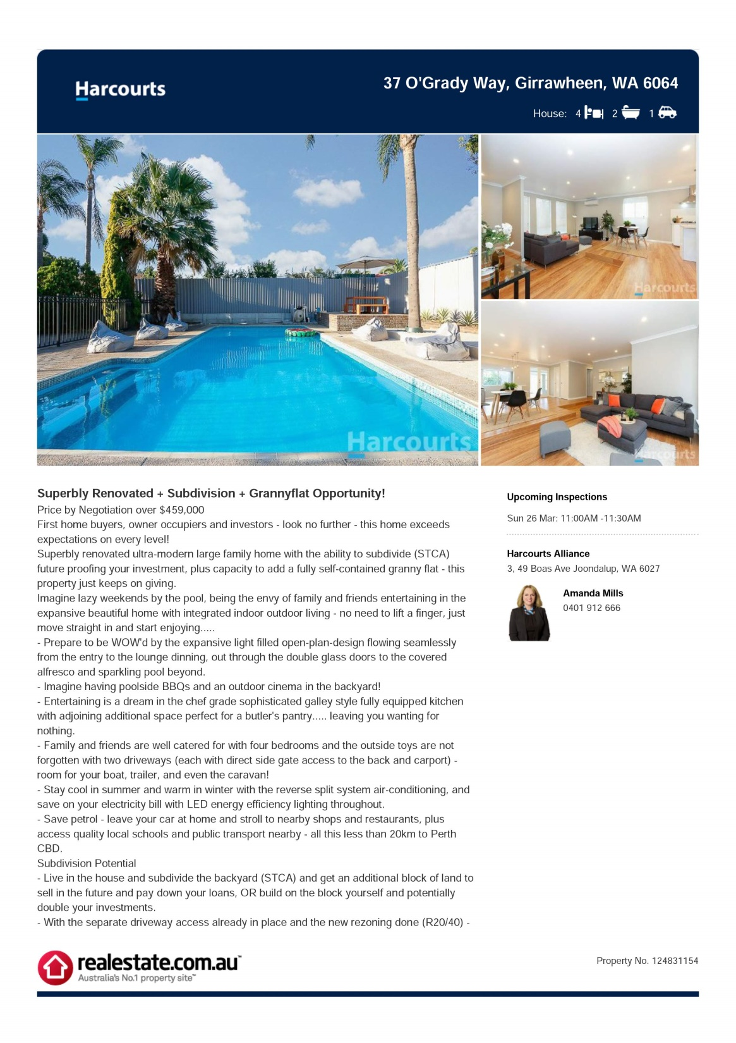
Activity –
Final Copy
Read final copy
Share thoughts on table
Share with group
Notes:
Activity – read final copy and give opinion

Slide 70
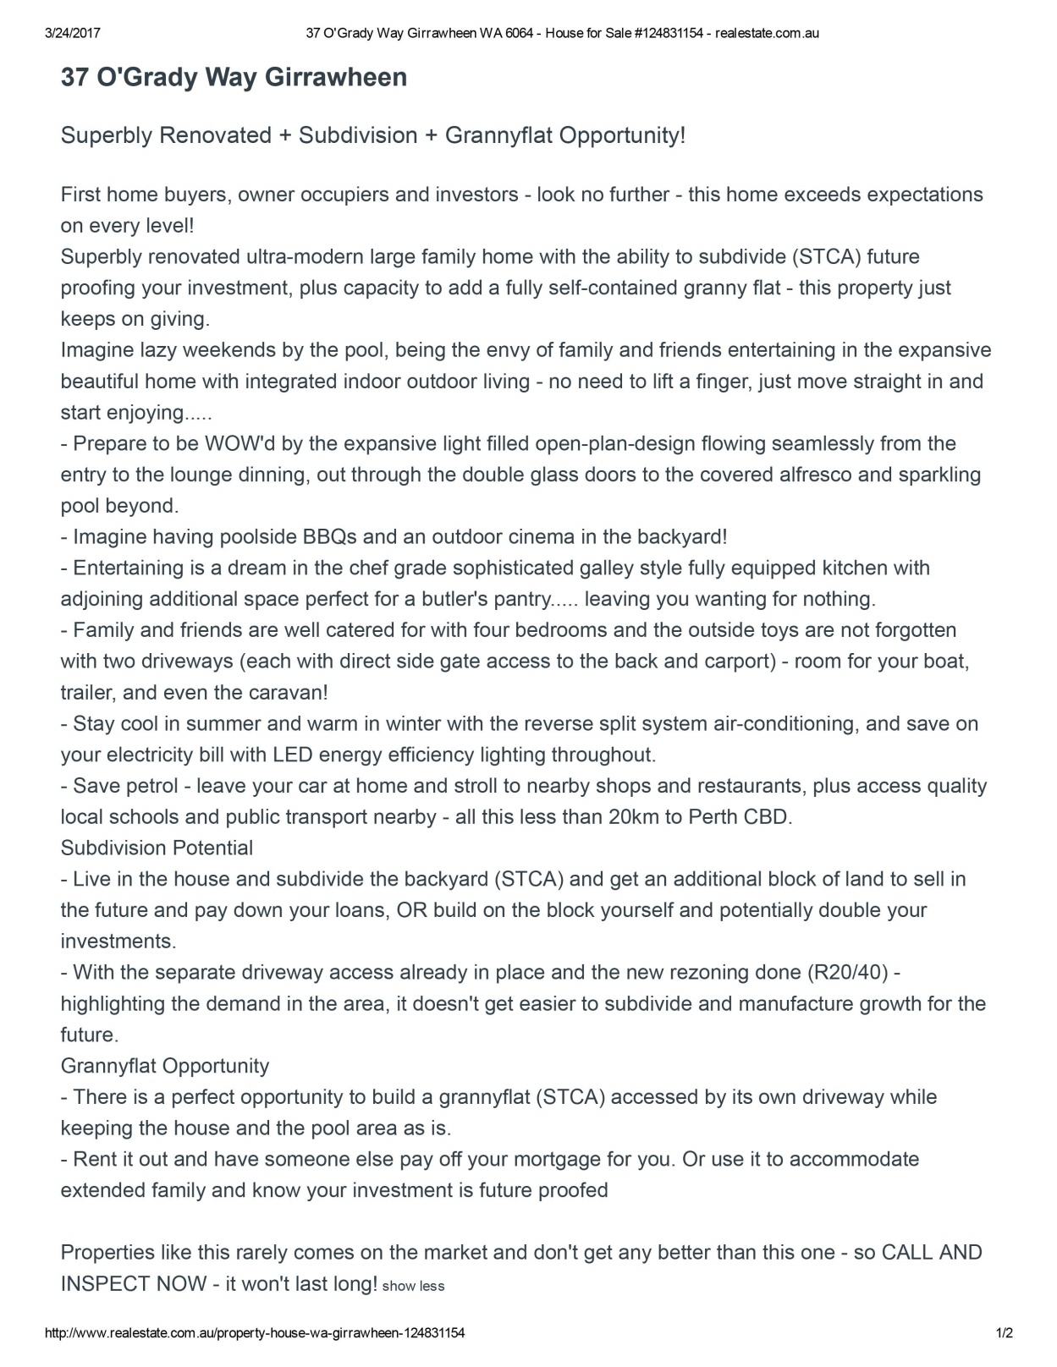
Final Copy
Notes:
Read

Slide 71
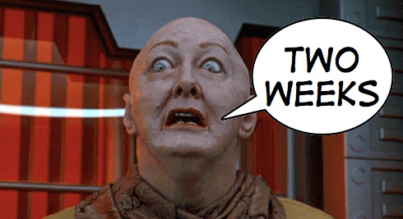
Pricing & Selling Method
Agent had it under transparent negotiation but started $100k less than what they would take – too big a gap
Agent only gave 2 weeks of opens before doing live phone negotiation – needs to be at least 4-6wks like an auction campaign
Agent amended to - Price by Negotiation $459k - $489k. Suggest removing the upper limit ……………..make it Offers Over ………..
Notes:
General discussion

Slide 72

Supporting Info For Agent
Make agents job easy – don’t rely on them to do anything!!
Subdivision Potential – provide agent with mud map of where block could be subdivided, include dot point summary e.g. recently re-zoned (zoning map image) potential block size, features e.g. keep driveway, services well positioned (include DBYD??), stage by doing grannyflat first then subdivide off??
Granny Flat Potential - provide agent with mud map of where granny flat could be built and highlight features e.g. block size required and hence you comply, size and number of bedrooms, own driveway access, house and pool retained.
Notes:
Discuss

Slide 73
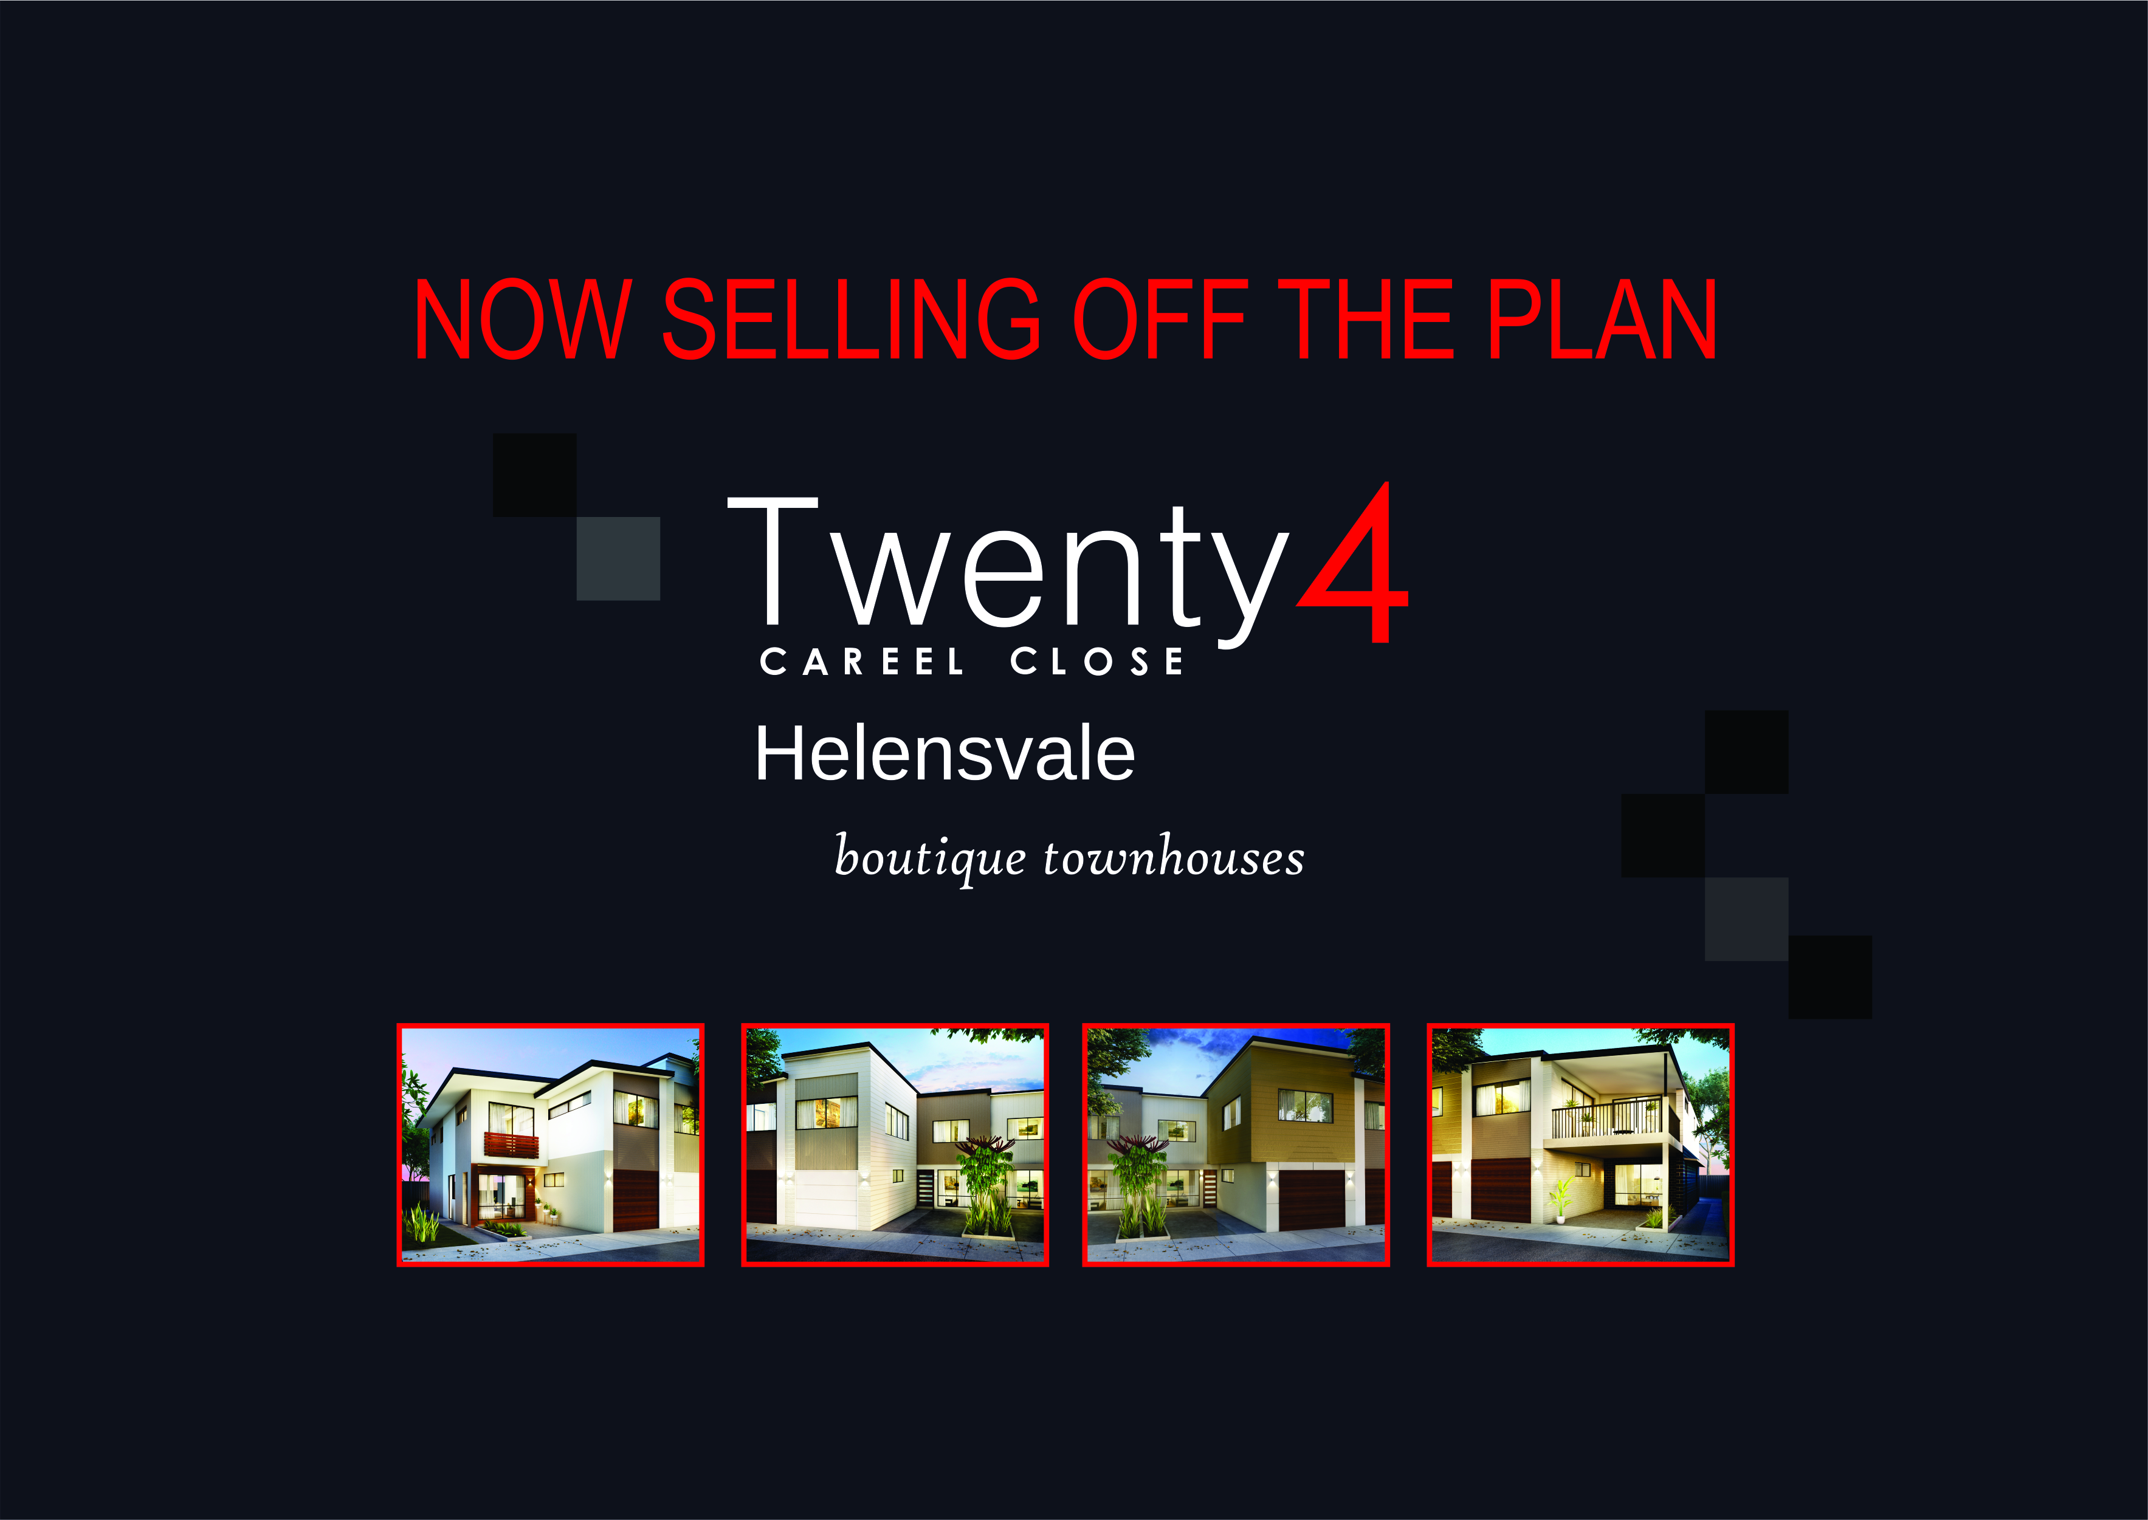
2) Selling Off The Plan

Slide 74
Off The Plan Sales Document / IM -
Presentation is key - First impressions count!
Attention to detail important
Straight to the point

Slide 75
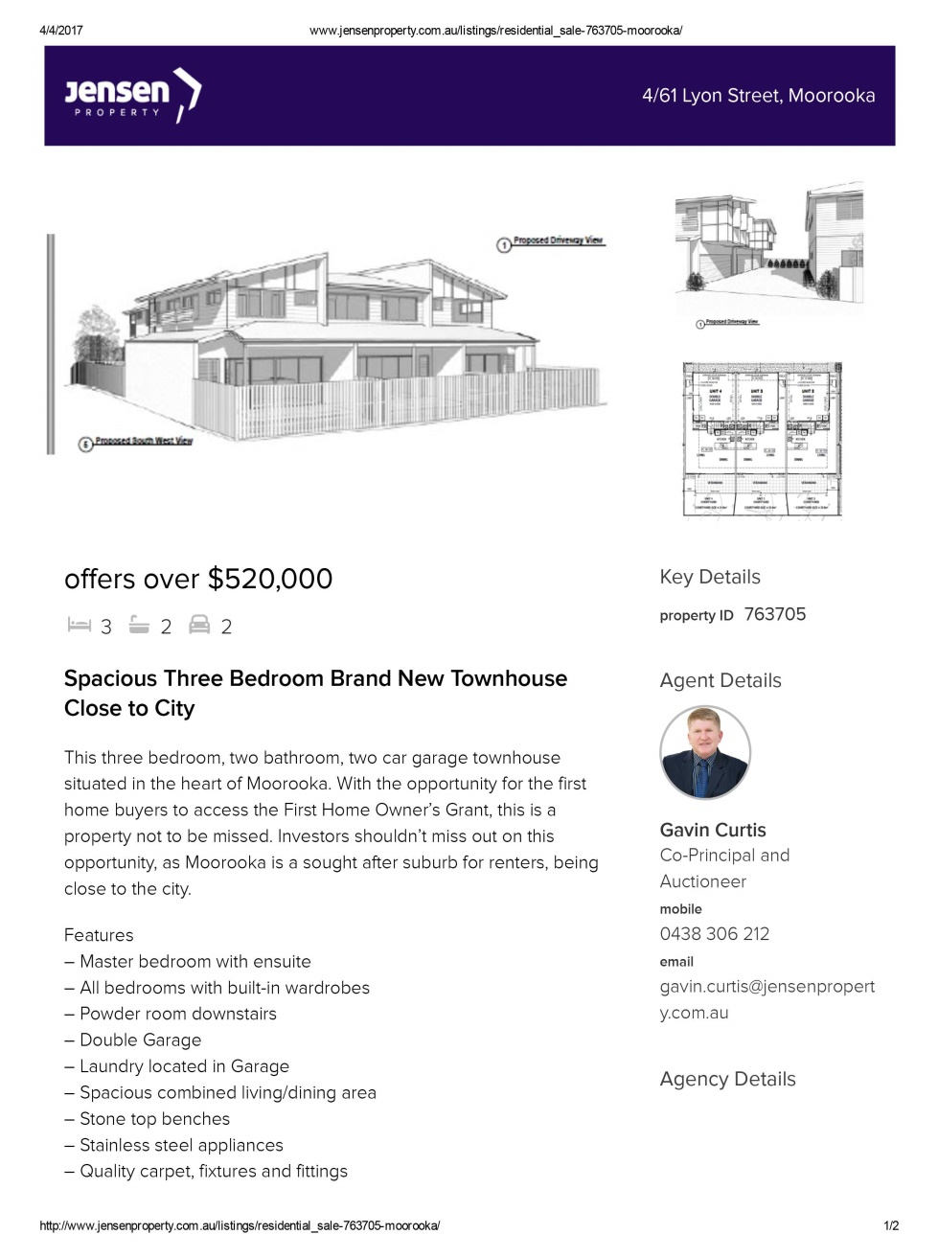

Example
A
Notes:
Poor Example

Slide 76
Activity – Share Feedback on Your Table
______________________
______________________
______________________
______________________
______________________
______________________
Notes:
2 min

Slide 77
Activity – Group Reflection
______________________
______________________
______________________
______________________
______________________
______________________
Notes:
5 min

Slide 78
Example A - Reflection
No artist impressions
Hard to read floor plans
Poor written copy – lists features only
Basic inclusions list
Basic location information
No branding
Underwhelming
Notes:
5 min

Slide 79
Example A – Verdict?
POOR
Notes:
5 min

Slide 80

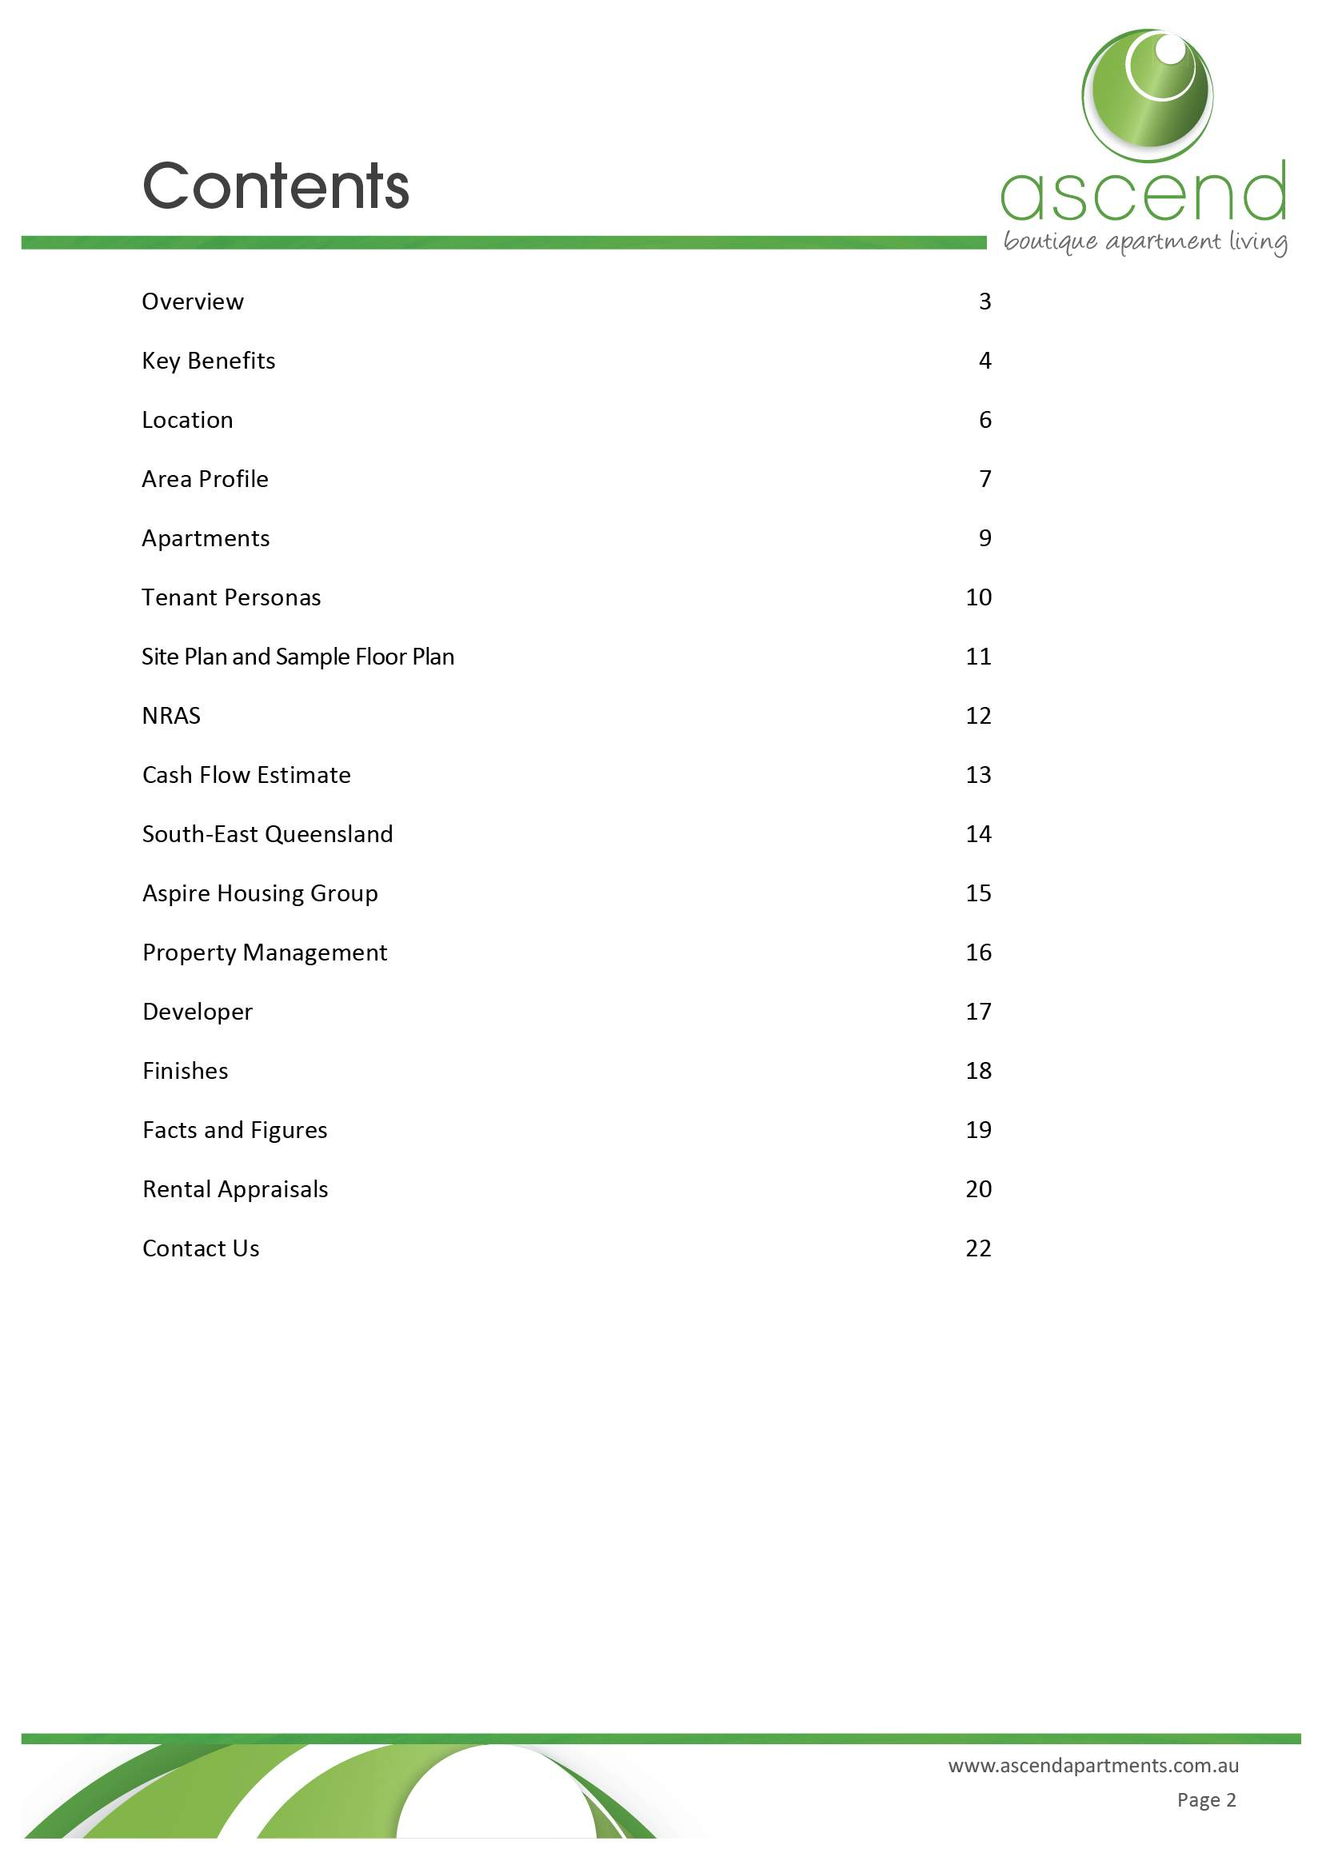
Example
B
Notes:
Good EXAMPLE – 10 min

Slide 81
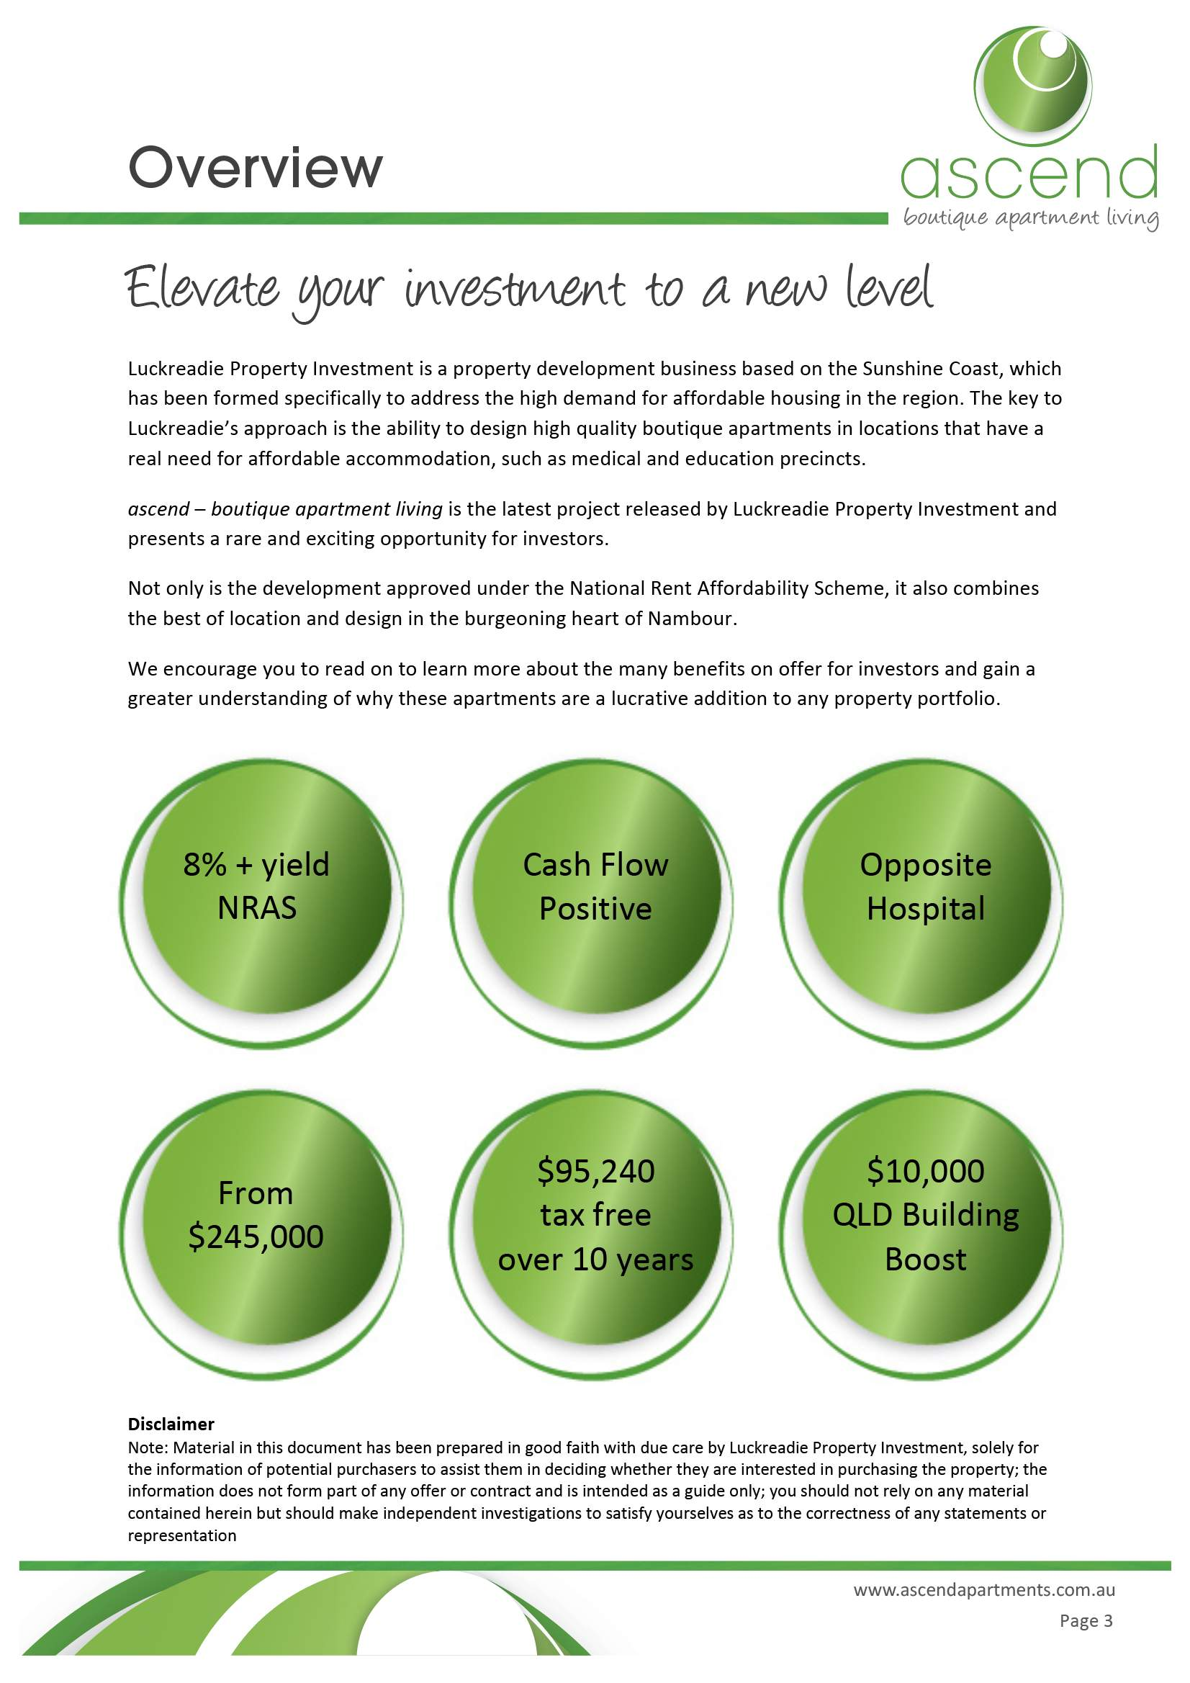

Example
B

Slide 82
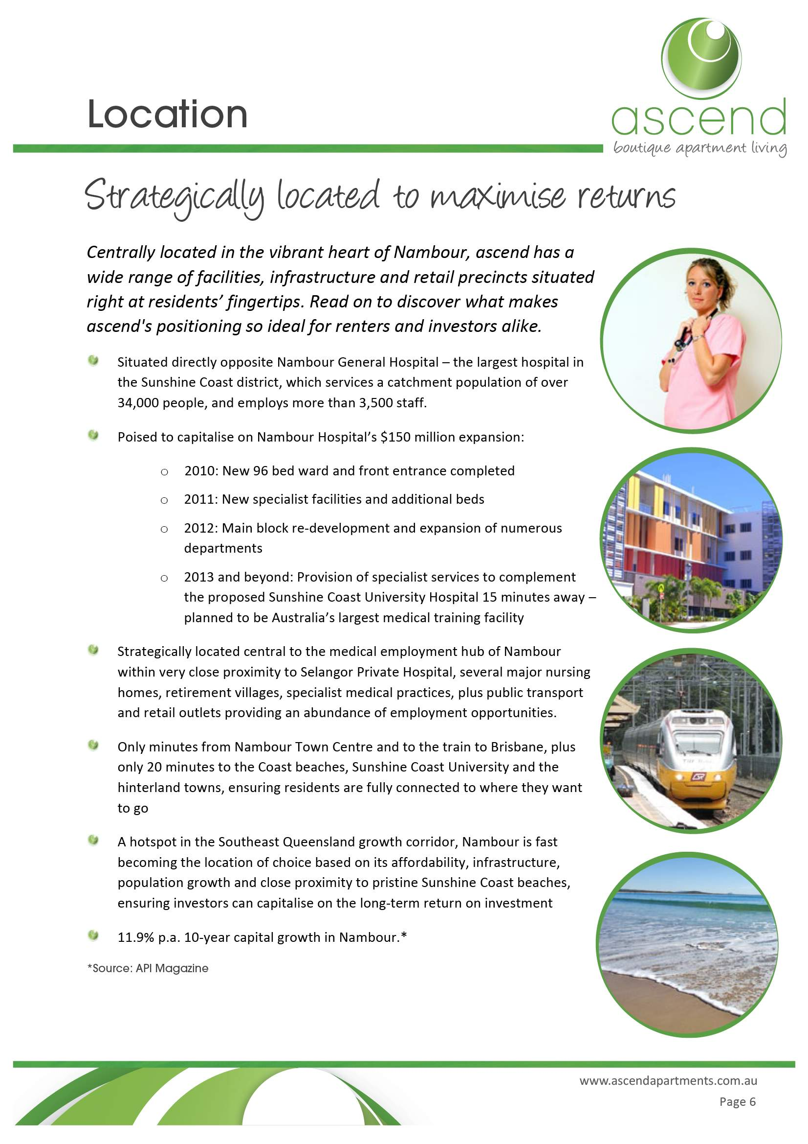
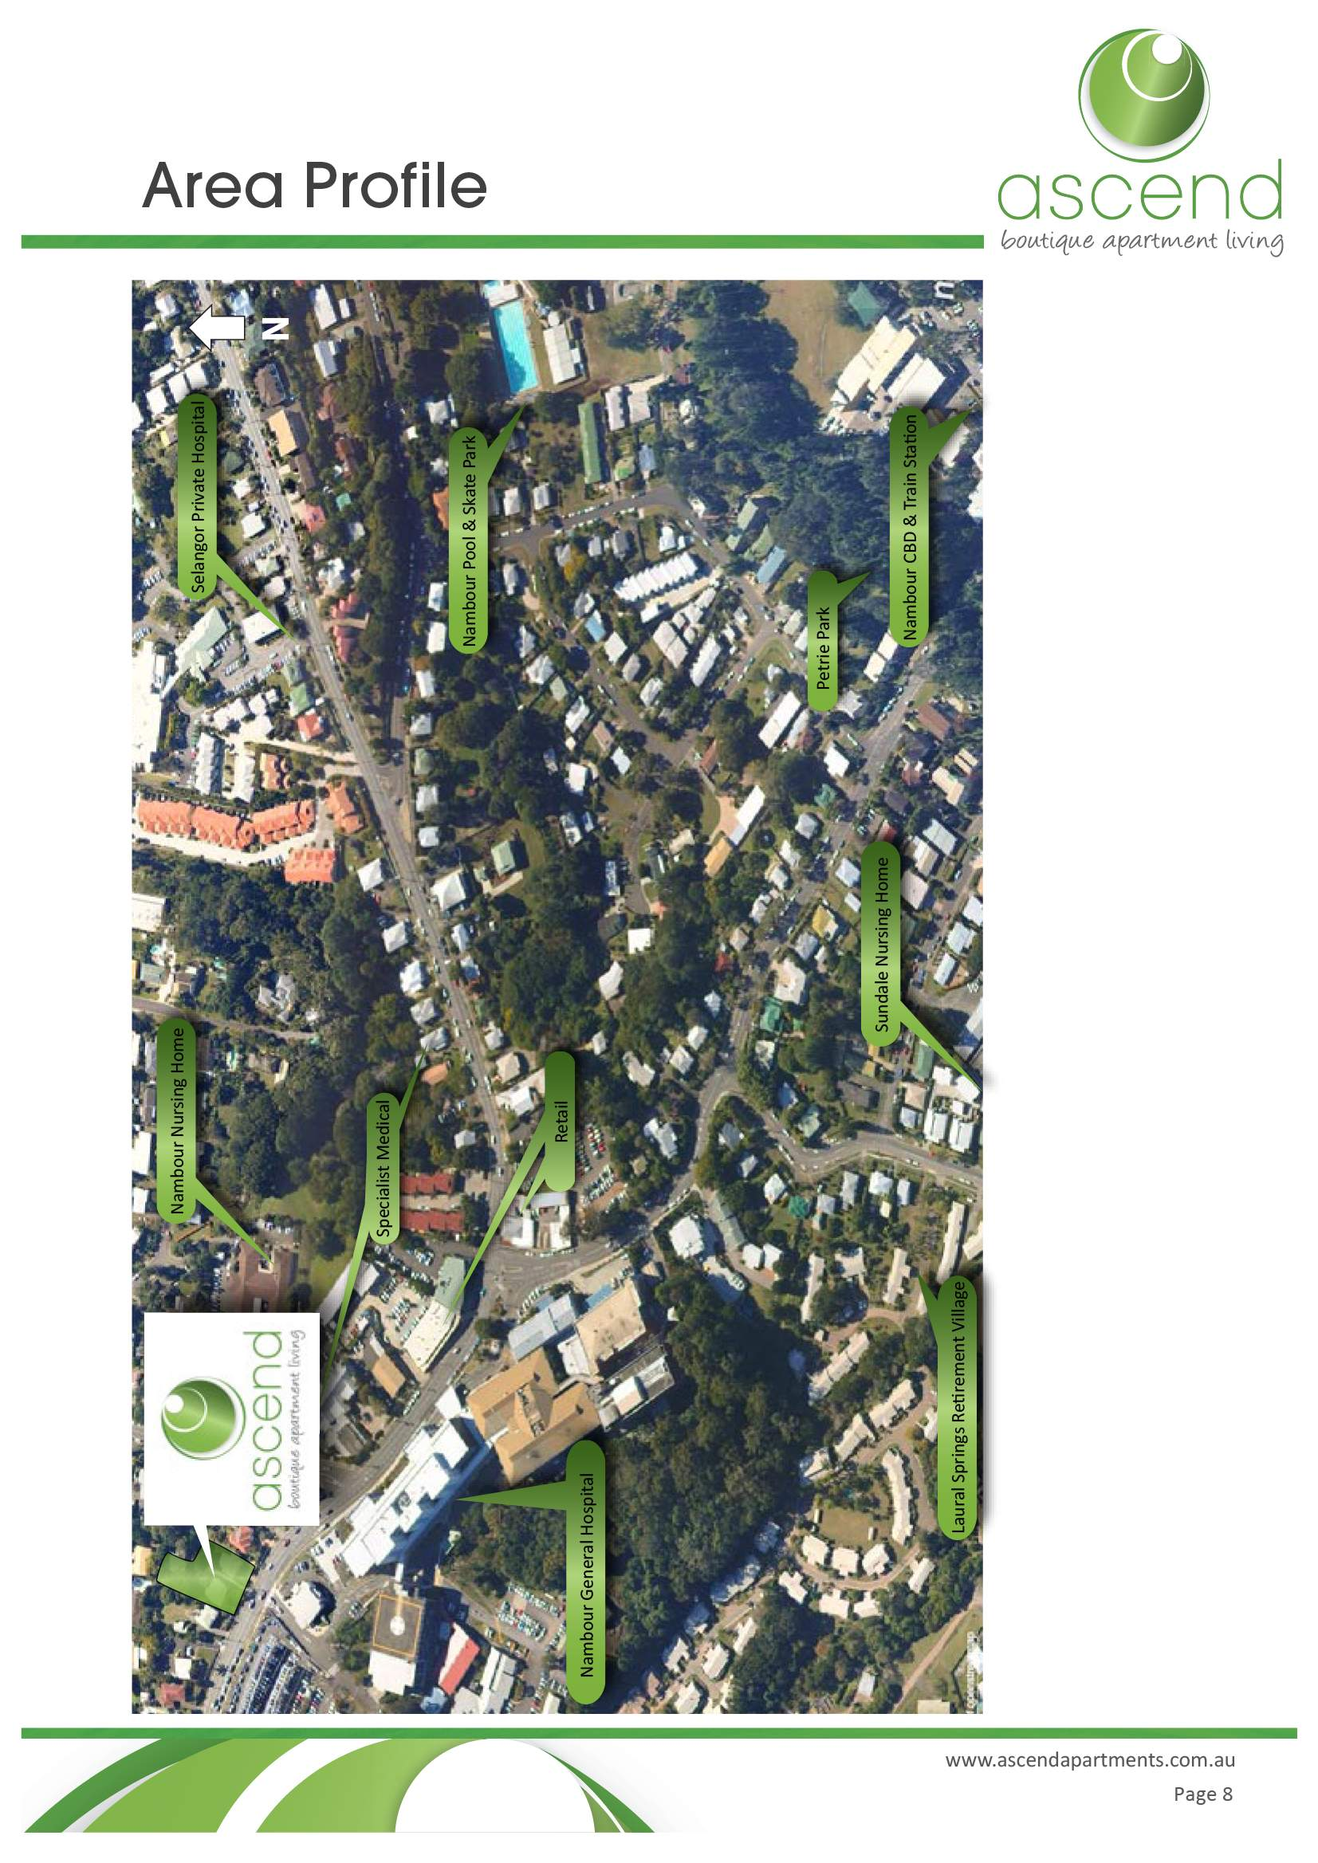
Example
B

Slide 83
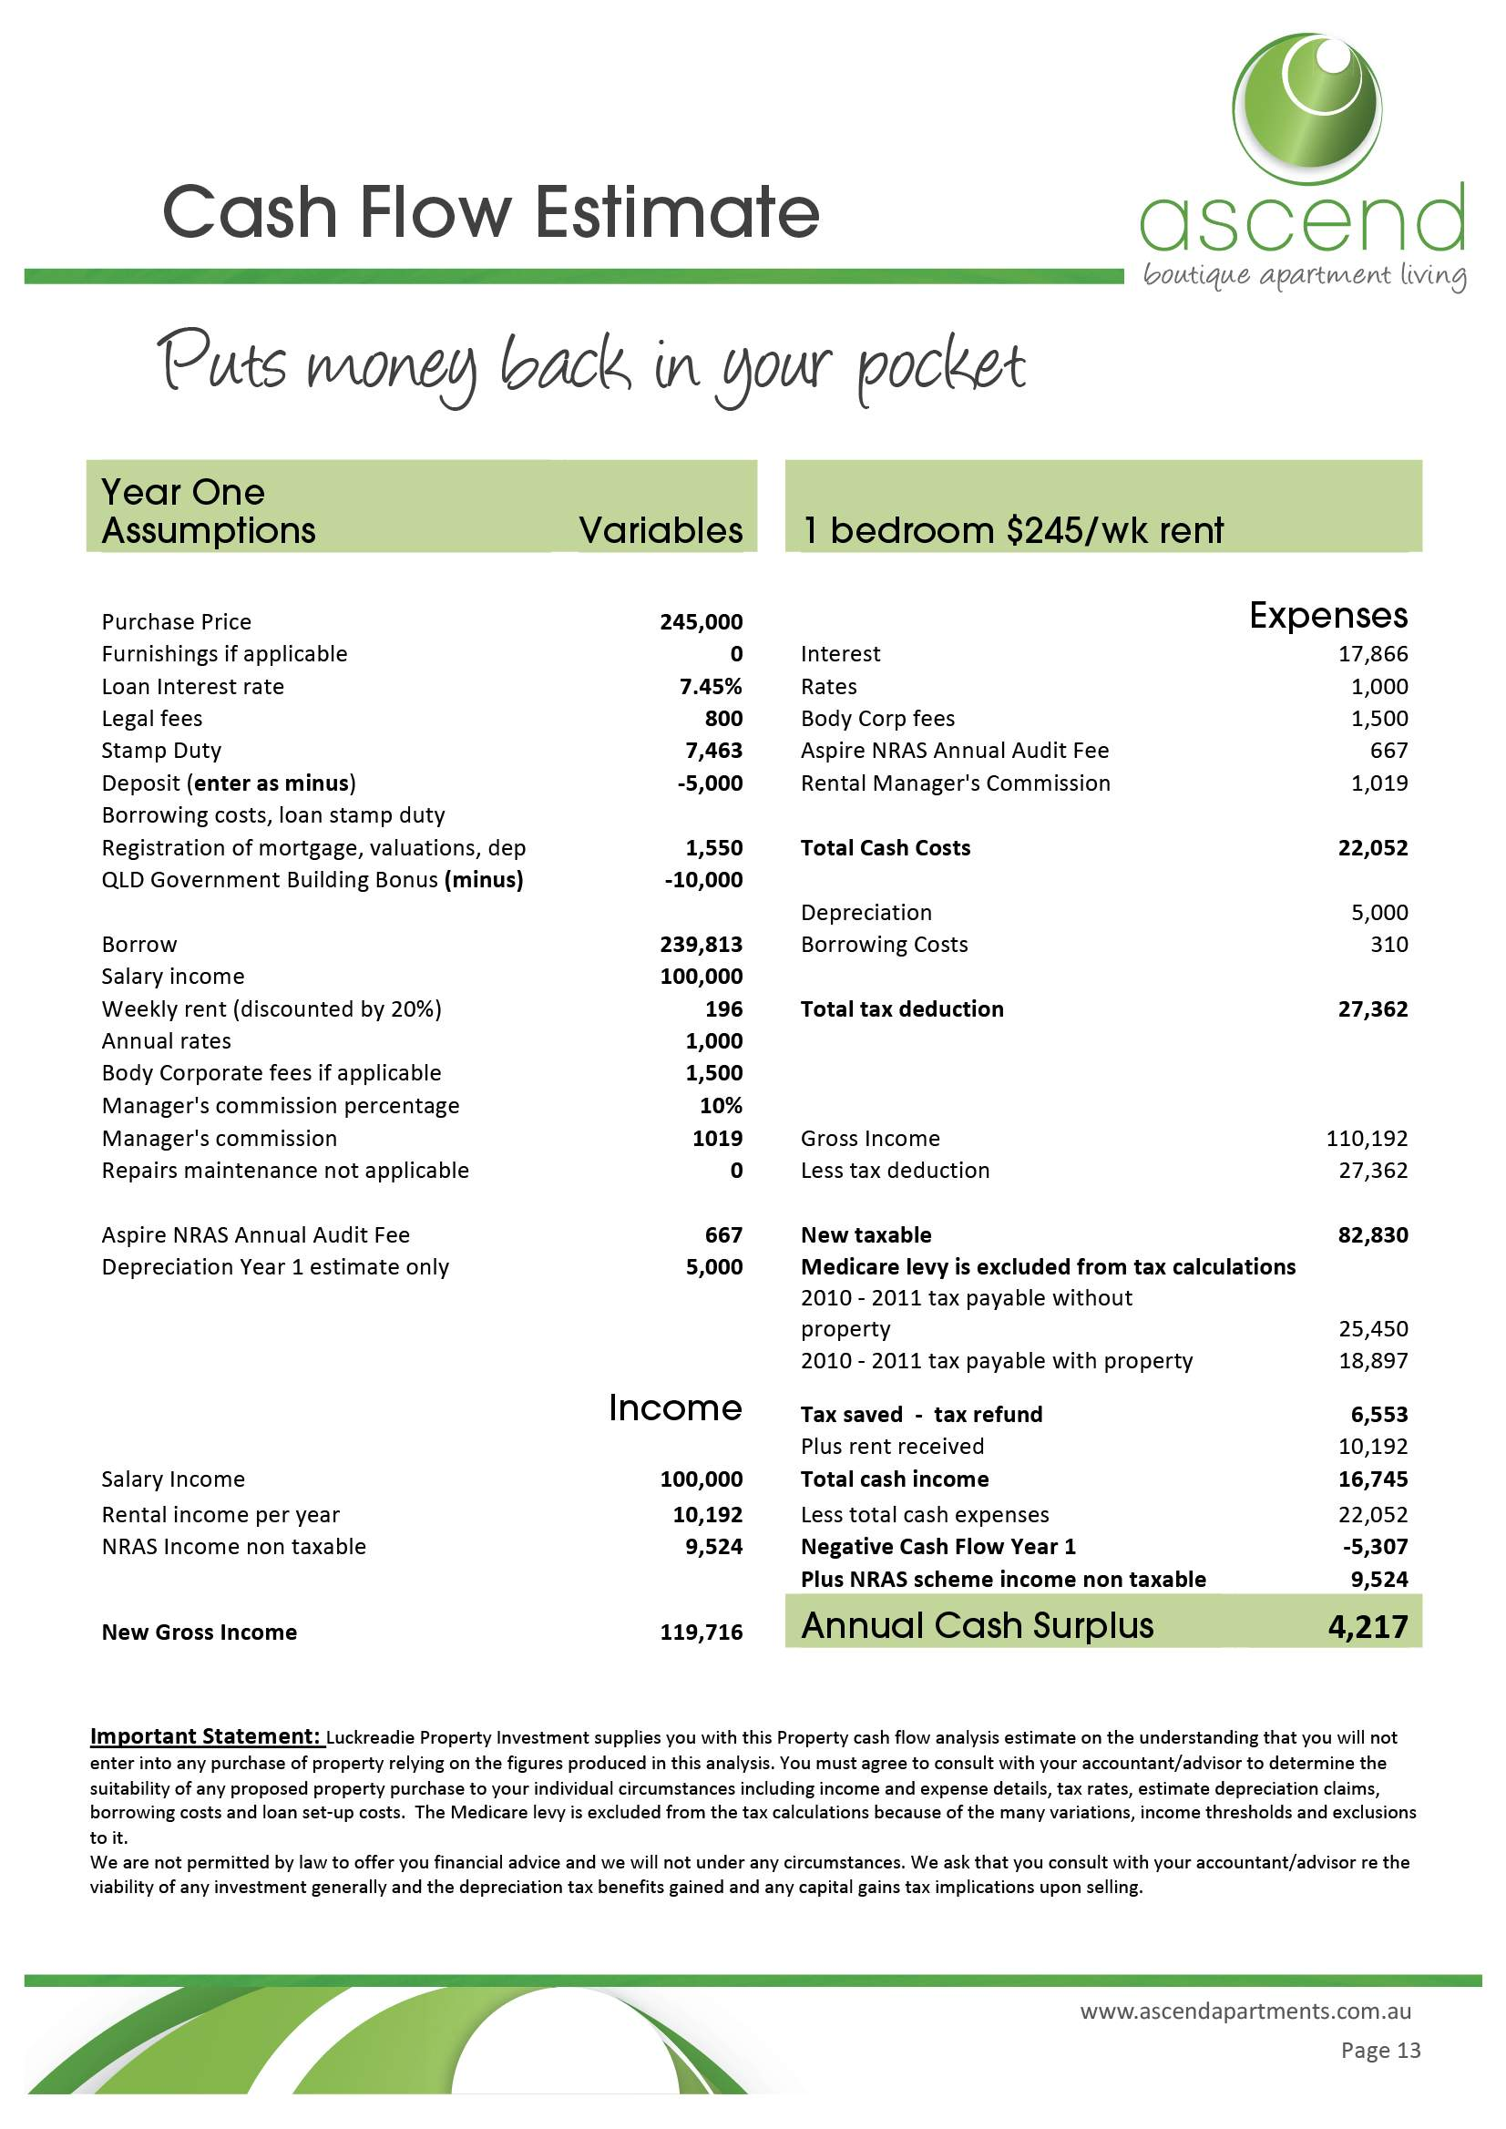
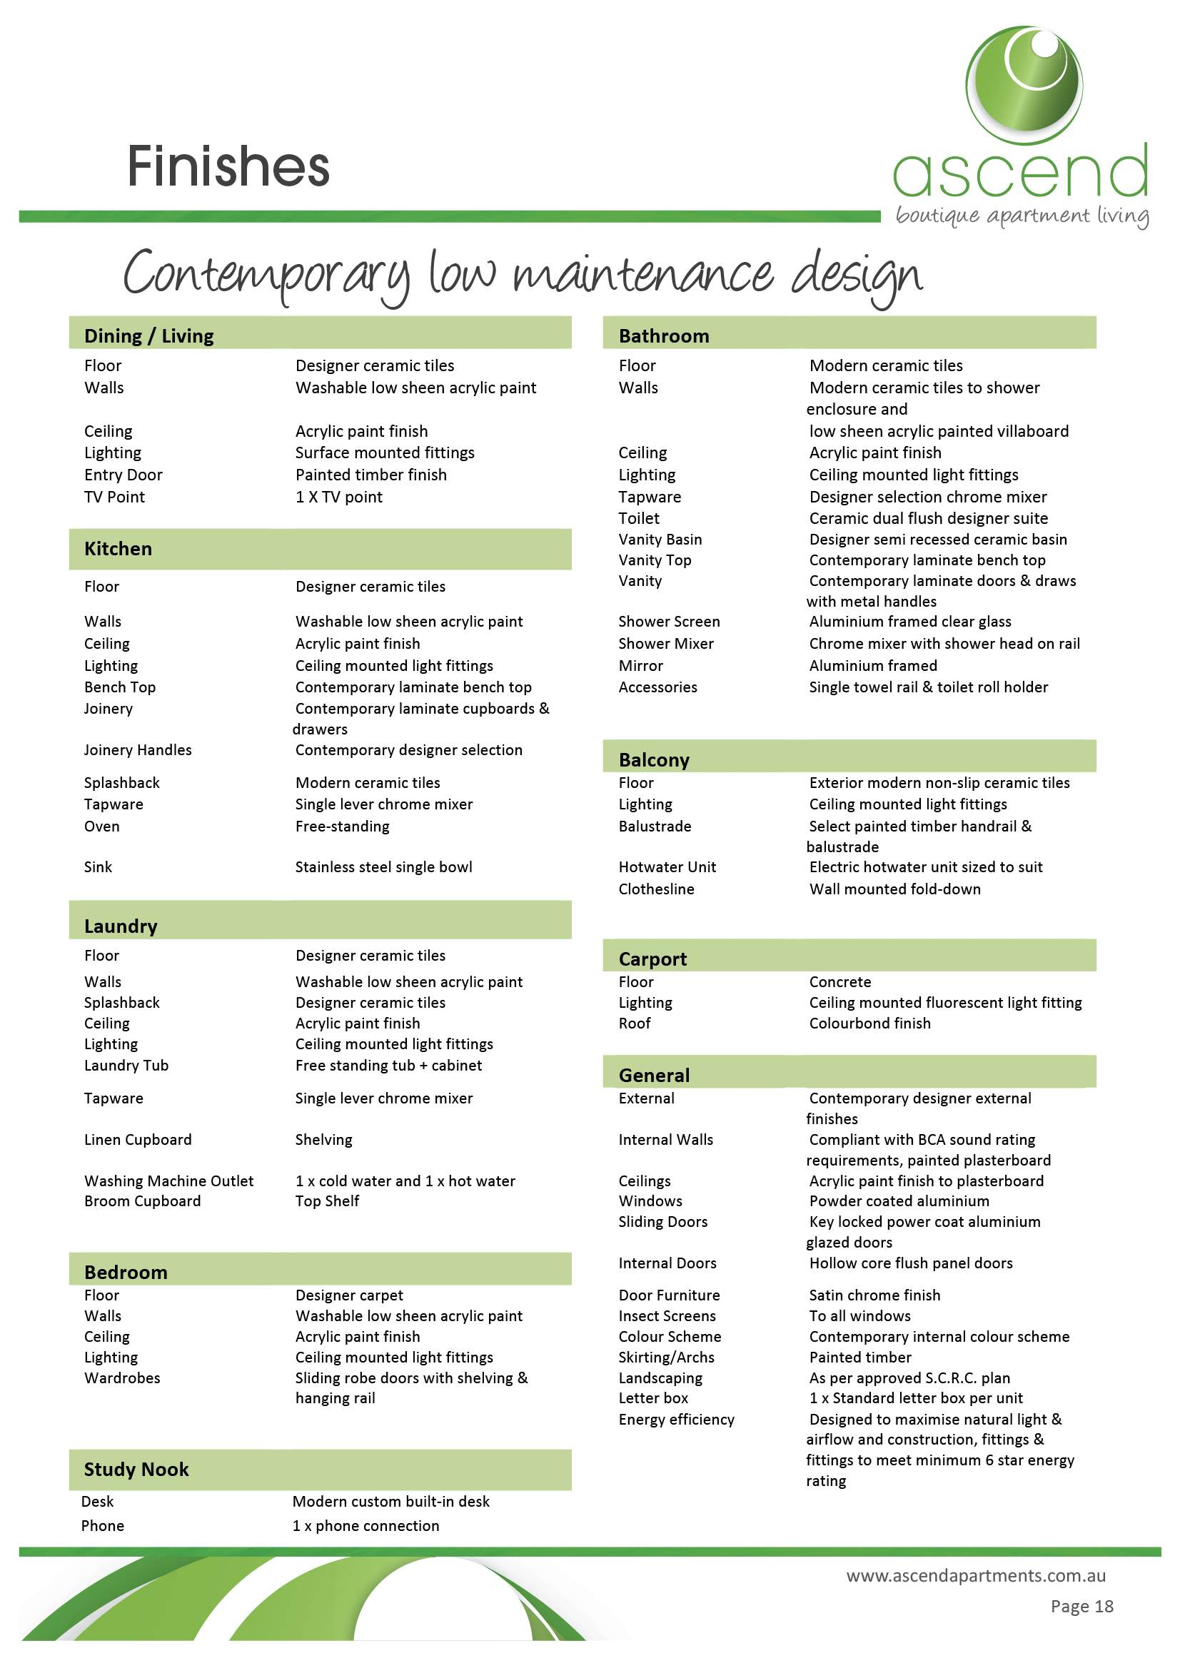
Example
B

Slide 84
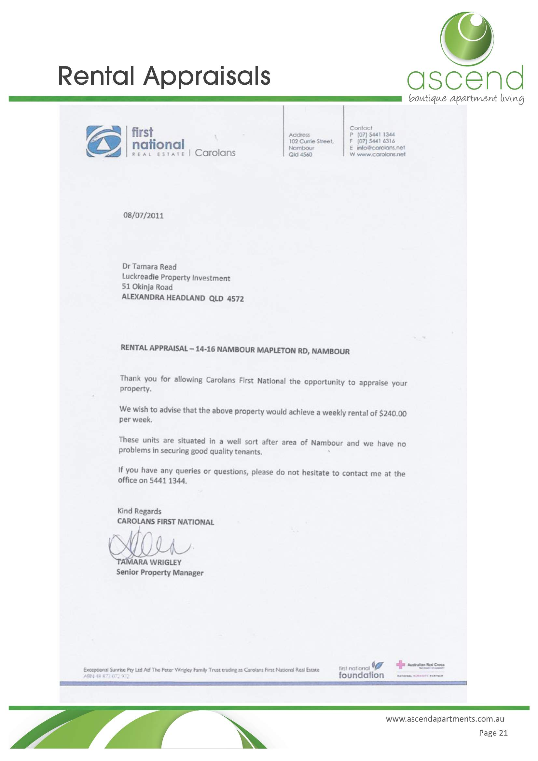

Example
B

Slide 85
Activity – Share Feedback on Your Table
______________________
______________________
______________________
______________________
______________________
______________________

Slide 86
Activity – Group Reflection
______________________
______________________
______________________
______________________
______________________
______________________

Slide 87
Example B – Verdict?
GOOD

Slide 88

Traits of a Good Off The Plan Sales Document
Photo quality artist impressions
Professional Presentation – layout, style, logo
Proof Read – no spelling errors or calculation errors
Photos, maps, dot points
Executive Summary - covering key points
Cash Flow Estimate
Specifications and Finishes
Floor plans

Slide 89

Traits of a Good Off The Plan Sales Document
Pricing
Rental Appraisal
Valuation / Depretiation?
Comparable Sales
Location Information – Why Town, why suburb, why street?
Team – Developer, Builder, Property Manager etc.
Contact Details

Slide 90
QUESTIONS?

