Slide 1

March 2018 Mastermind Event
Melbourne
Michael Tiemens
VIC State Coach

Slide 2
Event Outline -
6:00 – 6:30 Networking
6:30 - Start
6:30 – 6:45 Introductions
6:45 – 8:00 Accountability
8:00 – 8:30 Networking Break
8:30 – 10:00 Joint Ventures

Slide 3

Workshop Format
Use microphone
Involve everyone in the conversation
Be supportive

Slide 4
Housekeeping
Graduate Bali Retreat – Announced at National Conference
2018 Monthly Dates (Wednesday’s):
4th April; 9th May; 6th June; 4th July; 8th Aug; 5th Sept; 3rd Oct; 7th Nov, 5th Dec.
2018 National Conference Dates:
This Weekend!!!! 10 & 11th March – Melbourne MUST RSVP!!
4 & 5th August – Sunshine Coast
24 & 25th November - Sydney

Slide 5
Housekeeping
2018 Ultimate Bootcamp Dates:
Melbourne: 6-8th April
Gold Coast: 4-6th May
Perth: 26-28th Oct
2018 Other Ultimate Dates:
Realestate Millionaire Within – Brisbane: 13-15th July
I Love Realestate Super Conference – Melbourne: 9-11th Nov
2018 Quantum Events: Check Ultimate Website

Slide 6
Accountability

Slide 7


Notes:
Intro what we are going to cover in the workshop session tonight.

Slide 8
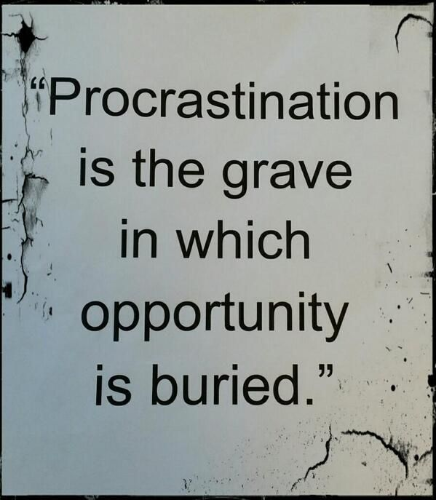

Slide 9


Slide 10

What is Procrastination?
Procrastination is the act of delaying or postponing a task or set of tasks
Greek philosophers like Socrates and Aristotle developed a word to describe this type of behavior: Akrasia
So, why do we procrastinate?

Slide 11
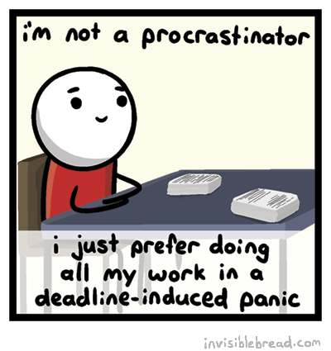
Behavioral Psychology Research Revealed
Phenomenon called
“time inconsistency,” which helps
explain why procrastination seems to pull us in despite our good intentions.
Time inconsistency refers to the tendency of the human brain to value immediate rewards more highly than future rewards.

Slide 12
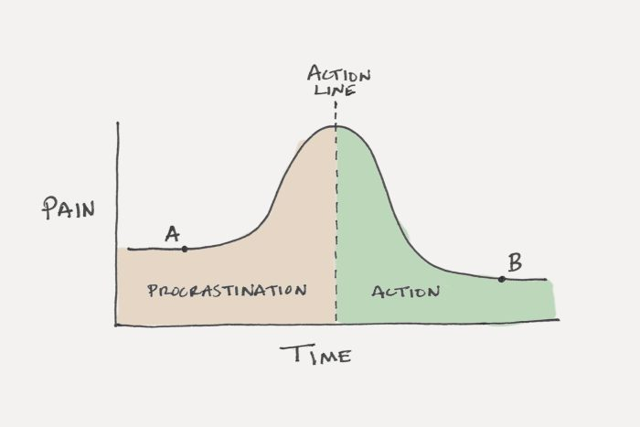

Slide 13

Best Way to Understand - Imagine You Have Two Selves -
Your Present Self, and
Your Future Self
When you set goals for yourself — like finishing off a renovation job — you are actually making plans for your Future Self.
You are envisioning what you want your life to be like in the future.

Slide 14

Research Has Found -
When thinking about your Future Self, it is quite easy for your brain to see the value in taking actions with long-term benefits.
The Future Self values long-term rewards.
However, while the Future Self can set goals, only the Present Self can take action.
EG. The Future Self wants to be trim and fit, but the Present Self wants a donut.

Slide 15

GOOD NEWS!!
Researchers have discovered that the Present Self really likes instant gratification, not long-term payoff.

Slide 16
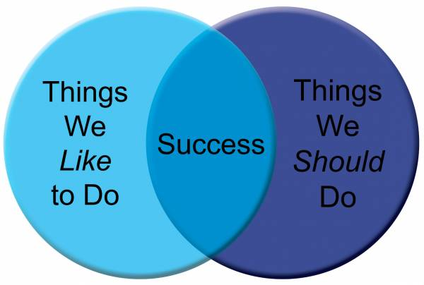
Six Scientific Tools for Eliminating Procrastination!
Reward Based Action
Temptation bundling - One of the best ways to bring future rewards into the present moment
Temptation bundling - concept from behavioral economics research performed by Katy Milkman at The University of Pennsylvania.
Strategy = bundling a behavior that is good for you in the long-run with a behavior that feels good in the short-run.

Slide 17

Temptation Bundling in Action:
Only listen to audiobooks or podcasts you love while exercising.
Only get a pedicure while processing overdue work emails.
Only go to the beach once you have done everything on your to do list.
Only eat at your favorite restaurant when you have lined up a business meeting.

Slide 18

2. Make the Consequences of Procrastination More Immediate
E.g. If exercising alone, skipping your workout next week won’t impact your life much at all. Your health won’t deteriorate immediately because you missed that one workout.
However, if you commit to working out with a friend at 7 a.m. next Monday, then the cost of skipping your workout becomes more immediate. Miss this one workout and you look like a jerk.
Another strategy - use a service like Stickk to place a bet. If you don't do what you say you'll do, then the money goes to a charity you dislike. The idea here is to put some skin in the game and create a new consequence that happens if you don't do the behavior right now.

Slide 19
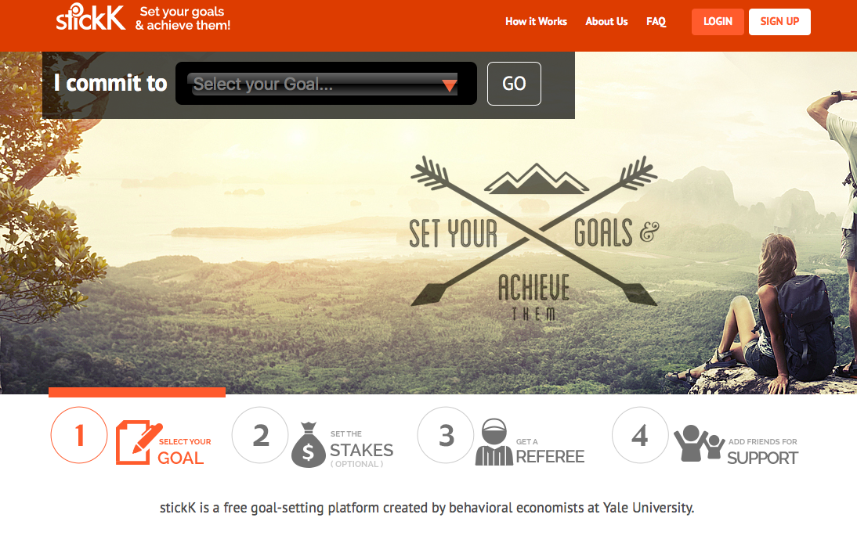

Slide 20

3. Design Your Future Actions
A favorite tool psychologists use to overcome procrastination = “commitment device.” – can help you stop procrastinating by designing your future actions ahead of time. E.g.
Stop wasting time on your phone by deleting games or social media apps. (You could also block them on your computer.)
Reduce the likelihood of mindless channel surfing by hiding your TV in a closet and only taking it out on big game days.
Build an emergency fund by setting up an automatic transfer of funds to your savings account.
Schedule in appointments with builders, agents, property sourcing agents etc. Makes you stay focused and on track.

Slide 21

4. Make the Task More Achievable
Small measures of progress help to maintain momentum over the long-run, which means you’re more likely to finish large tasks.
The faster you complete a productive task, the more quickly your day develops an attitude of productivity and effectiveness

Slide 22

5. Make Visual Cues to Remind you to Start a Behavior
This is why visual stimulus can be so useful. Much easier to stick with good habits when your environment nudges you in the right direction e.g.
A post it note
String on your finger
Rubber band on your wrist
Your vision board as your screen saver etc.

Slide 23

6. Visual Cues that Display Your Progress
A board that you mark off how much passive income you have created with a marker of where you want to get to – even have a holiday or an award next to the goal post for extra motivation.

Slide 24

What are you procrastinating on now and what are you going to do about it?
Notes:
Get students to make a list!!

Slide 25
Weekly & Monthly Goals

Slide 26

Buddy Process Follow-Up

Slide 27
Joint Venture

Slide 28

Joint Venture Workshop Process -
1) What’s Your JV Pitch?
2) What Makes a Good JV Proposal Document?
Notes:
Intro what we are going to cover in the workshop session tonight.

Slide 29

1) What’s Your JV Pitch?

Slide 30
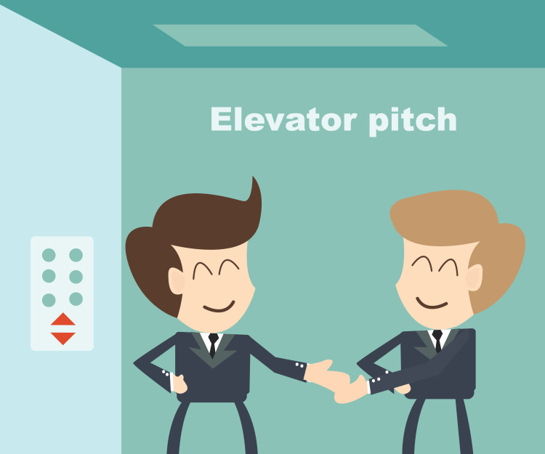
Your Elevator Pitch – What is it?
A short and punchy way to communicate your value to another person interested in property investing.
Pitch should only last for 30 seconds.
Can be used at networking events, meeting new people or in an elevator!
Do the Pre-Work!

Slide 31
Activity – Role Play Your Pitch
Decide on your role in the JV e.g. doing, money, serviceability party
Pair up and take turns to give your 30 second pitch
Notes:
Unstructured role play – 3 min each

Slide 32
Activity – Reflect in the Group
Share your experience –
How did it feel?
How effective was it?
What could you do better?
Notes:
5 min to reflect

Slide 33

How to Structure a Pitch -
Step One: Demonstrate Focus
What is it that you are seeking? i.e. money partner, deal finder etc.
Think about the type of strategy, location and price point.
* Be clear on what you are looking for?

Slide 34
For example….
Hi, my name is ………
I run a property development business that specialises in building affordable accommodation for disadvantaged youth that also attracts high yields for investors.
Or
Hi, my name is ……..
I’m a professional property investor. I specialise in ?????

Slide 35

Step Two: Establish Credibility
Establish your credibility i.e. skills, background, experiences in property or non property related areas.
Ask yourself, “what qualities do I possess that I can implement with property?”

Slide 36
For example….
Over the past four years, I’ve been able to create a real estate portfolio worth $11,000,000 while paying to my investors over $3,000,000 in profits
Or
Over the past 2 years, I’ve immersed myself into property education and mentoring and am entering into my first deal.
Or
I’ve spent the last ten years as a mechanical engineer & decided that my skills would transfer terrifically into property development.

Slide 37

Step Three: Pick a Side
Are you the “Doing” partner, or the ”Money” partner?
Do you have time / equity / knowledge / serviceability ?
* Establish this early in the conversation.

Slide 38
For example….
I partner with real estate investors who have lazy equity in their home or cash in their accounts and like to achieve much healthier returns than the banks can provide.
Or
I’m looking to invest money into projects that are safe, secure and set for fantastic profits!

Slide 39
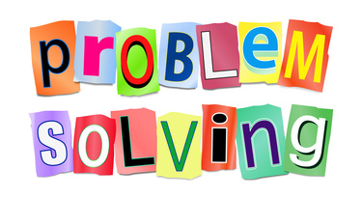
Step Four: What Problem Do You Solve?
What are your potential JV partners challenged or frustrated by?
And – how can you help them?

Slide 40
For example….
What I’ve noticed is that finding a deal that stacks up, in a great location, is harder than it seems. I’ve got great relationships with people who bring me deals all the time.
Or
One of the largest frustrations that my JV partners face is that they have no serviceability to purchase a deal, even though they are experienced and knowledgeable investors…

Slide 41

Step Five: Why People Love Working With You?
What is it about you that people love?
What can you bring to the table that other’s can’t?
Why do people come back and continue working with you?

Slide 42
For example….
People love working with me because I communicate regularly, I’ve got a stable track record and I make investing fun!
Or
People love working with me because I’m reliable and show integrity in all facets of my business.

Slide 43
Activity – Prepare a Structured Pitch
Individually write a structured 30 second pitch:
1 – Demonstrate Focus – What are you seeking?
2 – Establish Credibility – Your skills, background, experience
3 – Pick a Side – Are you the doing, equity, serviceability?
4 – What Problems You Solve – Partners challenges & your solution
5 – Why People Love Working With You – What you bring to table
Notes:
10 min to prepare their own structured pitch

Slide 44

Activity – Role Play Structured Pitch
Pair up (same partner) & take turns to give your 30 second structured pitch
Notes:
3 min each

Slide 45

Activity – Reflect in the Group
Share your experience –
How did it feel?
How effective was it?
What could you do better?
Notes:
5 min to reflect

Slide 46

Notes:
5 min to reflect

Slide 47

2) JV Proposal Document – Presenting a Deal

Slide 48

2) JV Proposal Document – Presenting a Deal
A reflection of YOU
First impressions count!
Attention to detail important
Straight to the point
Creating doc vs. receiving role

Slide 49
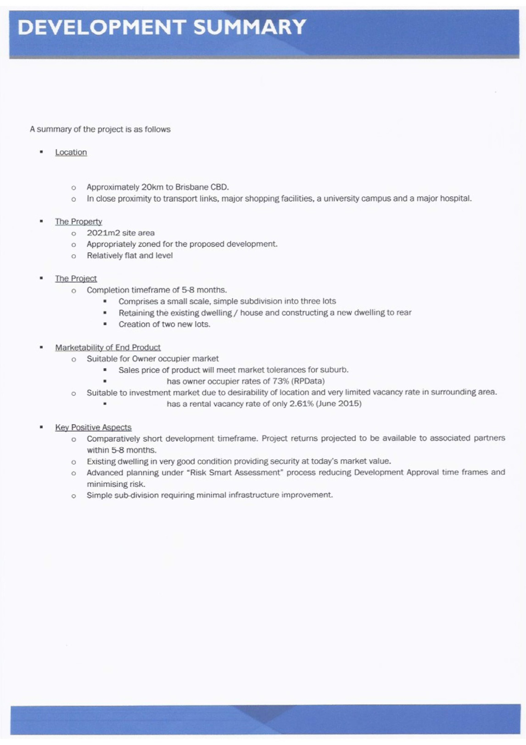
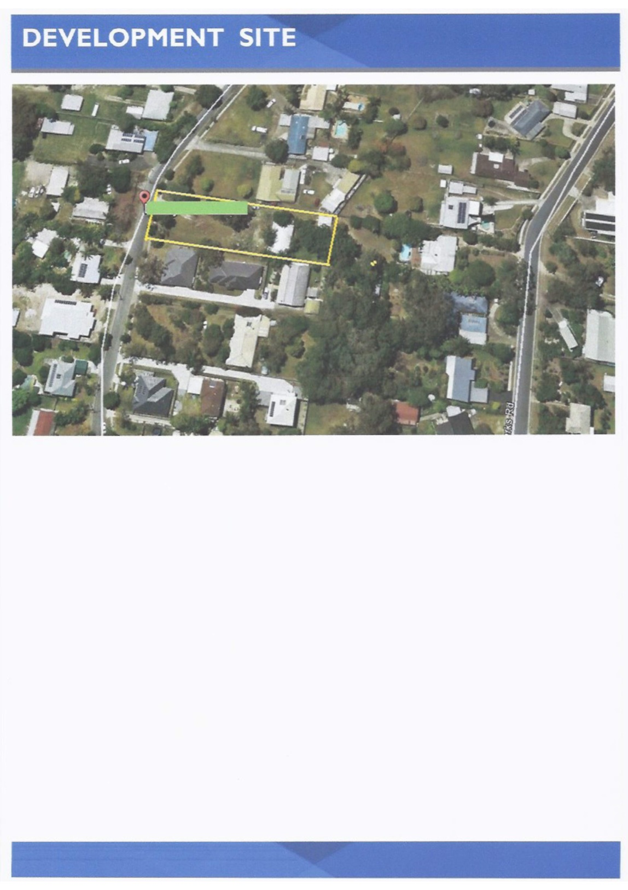
Example
A
Notes:
POOR EXAMPLE – 5 min to look over

Slide 50
Activity – Share Feedback on Your Table
______________________
______________________
______________________
______________________
______________________
______________________
Notes:
2 min

Slide 51
Activity – Group Reflection
______________________
______________________
______________________
______________________
______________________
______________________
Notes:
5 min

Slide 52
Example A – Verdict?
POOR
Notes:
5 min

Slide 53
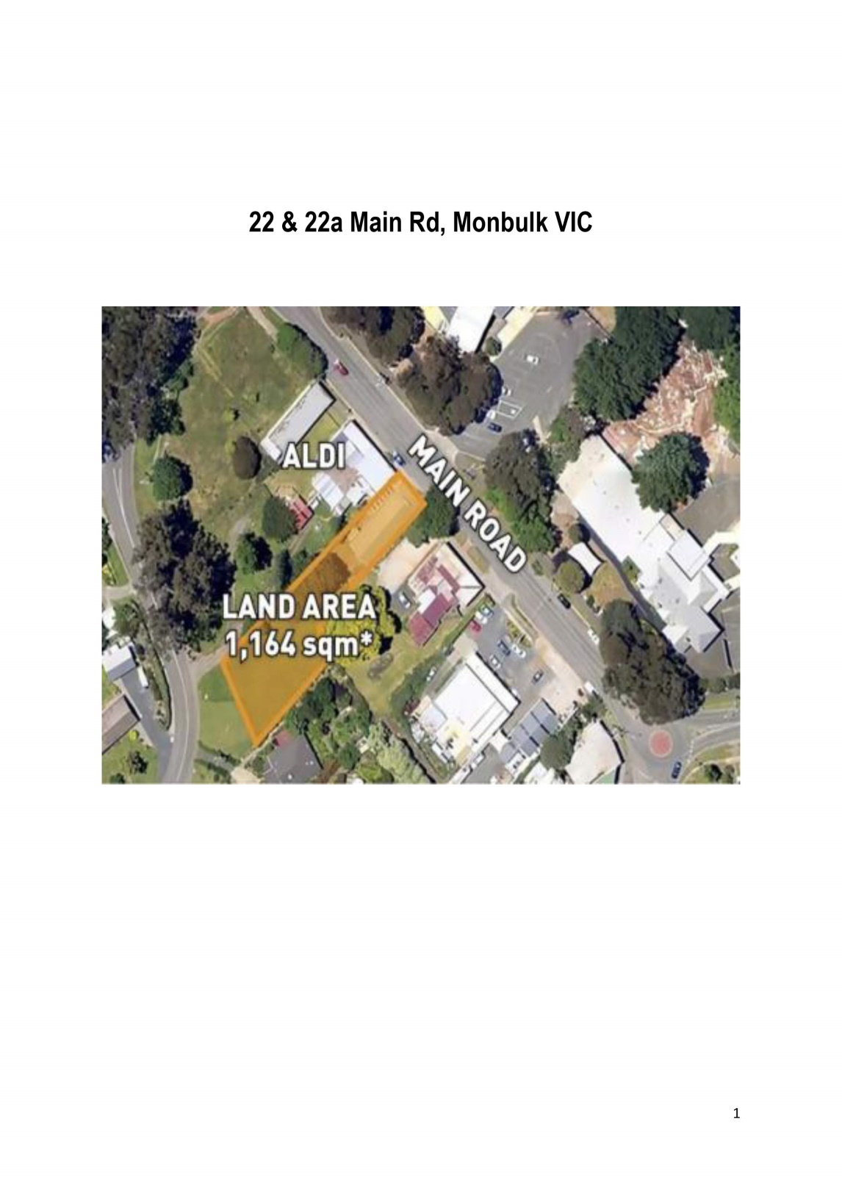
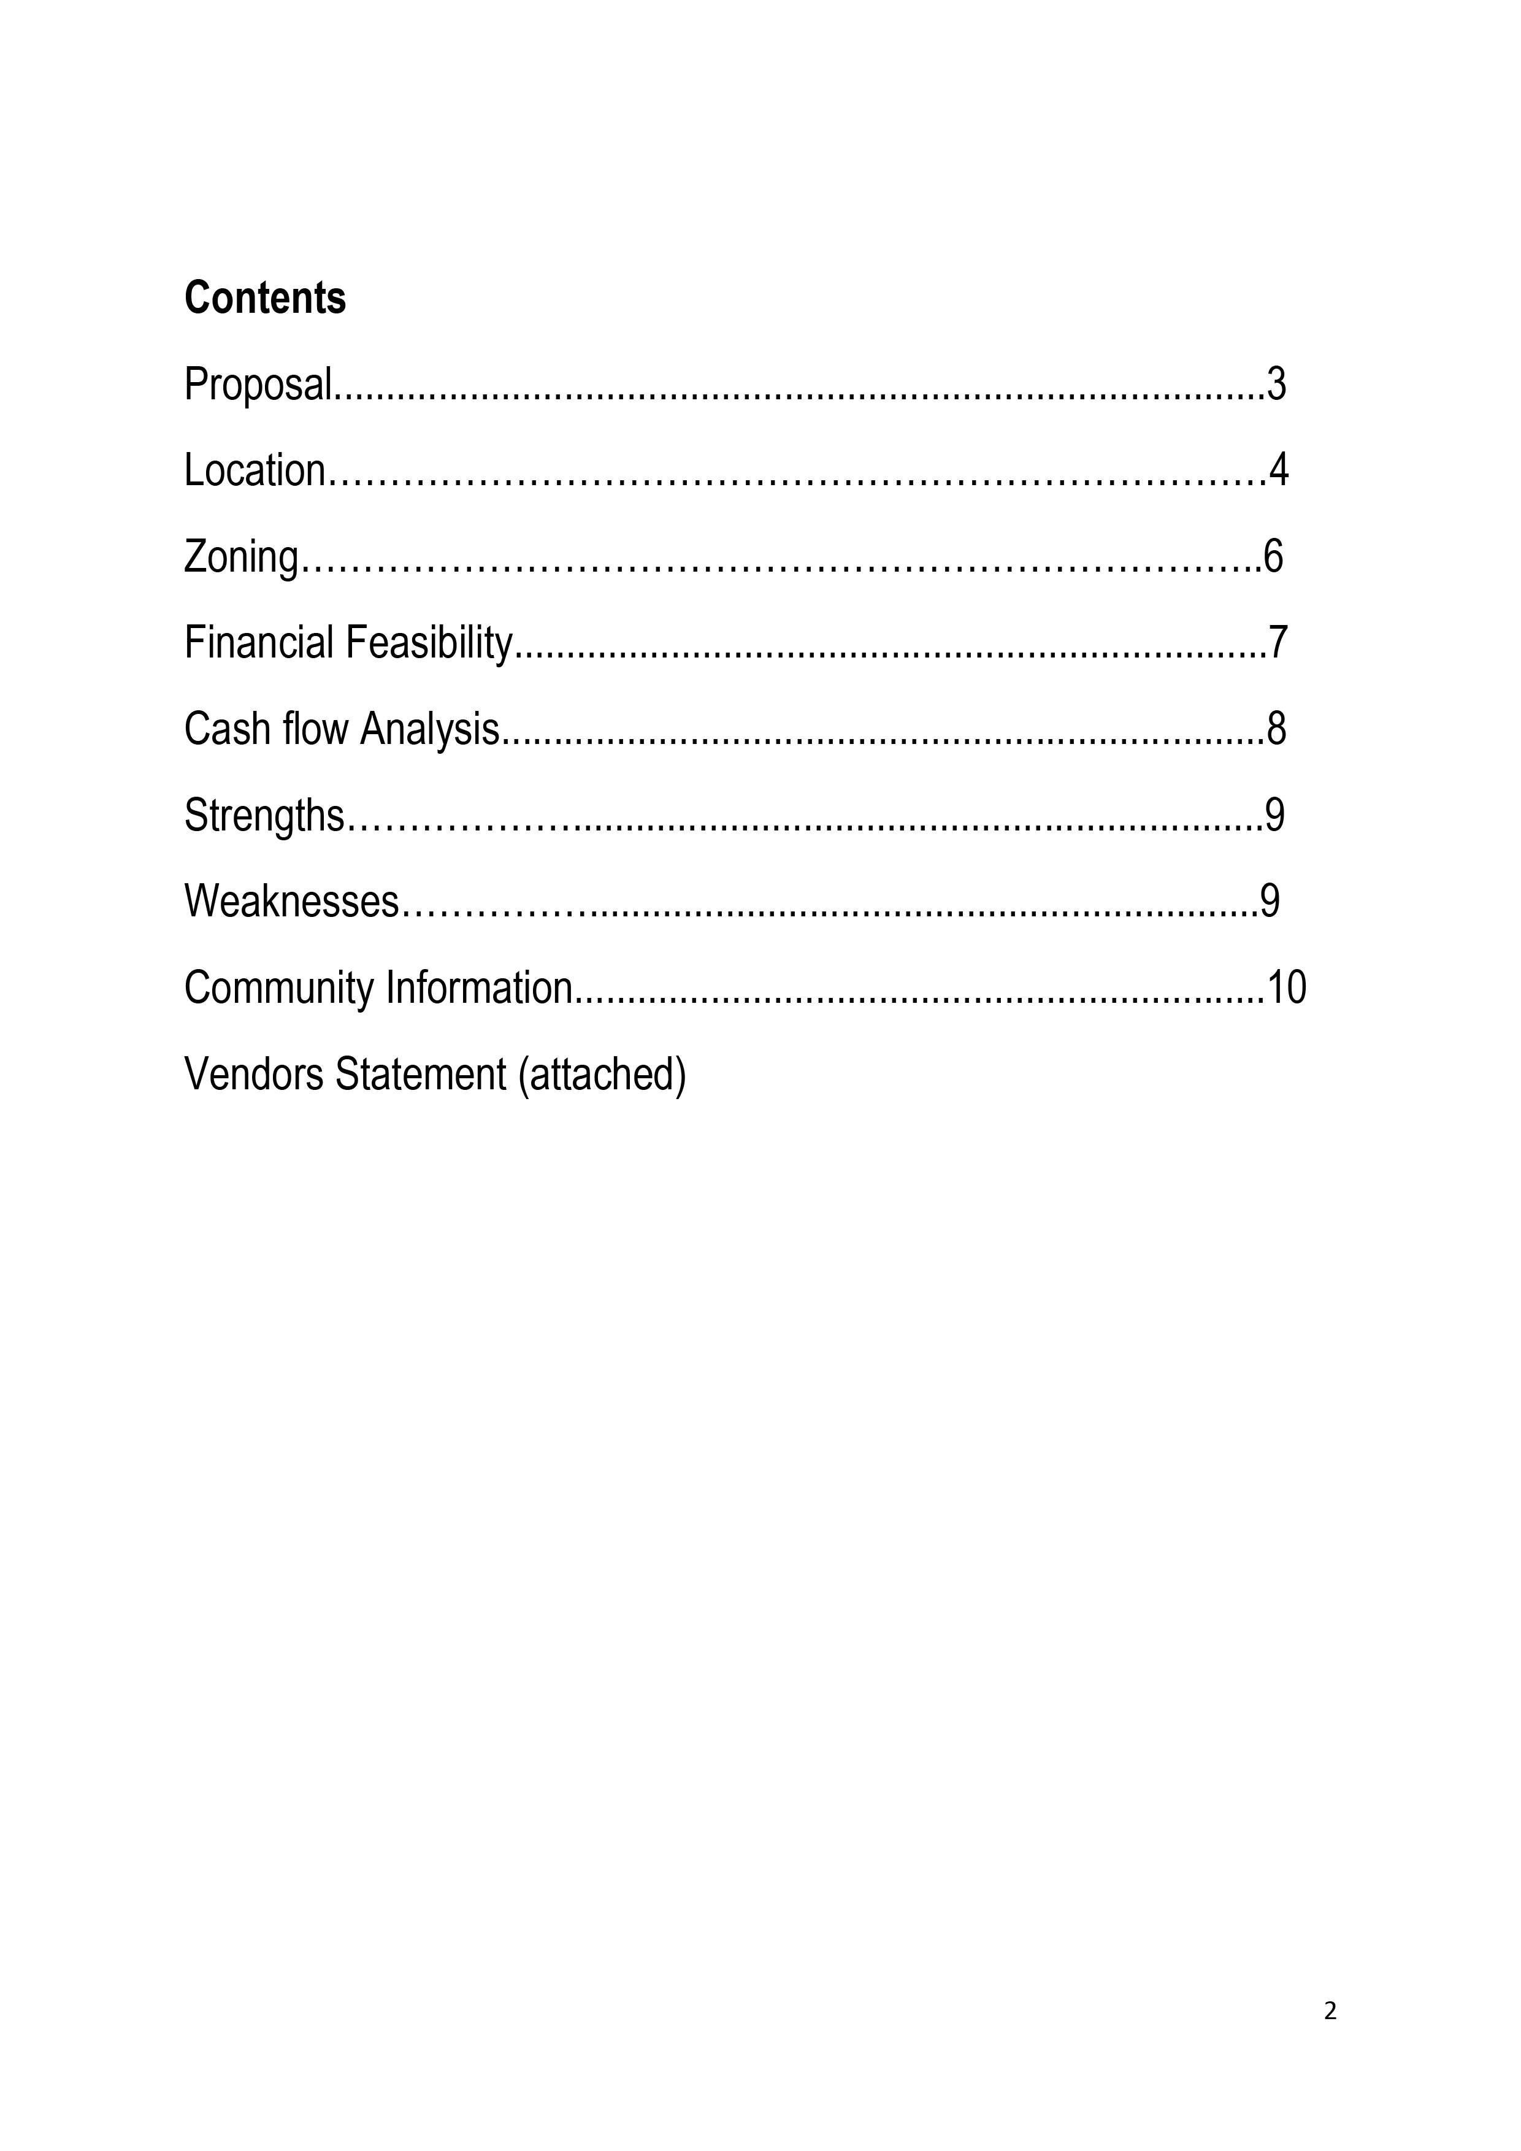
Example
B
Notes:
AVERAGE EXAMPLE – 10 min

Slide 54
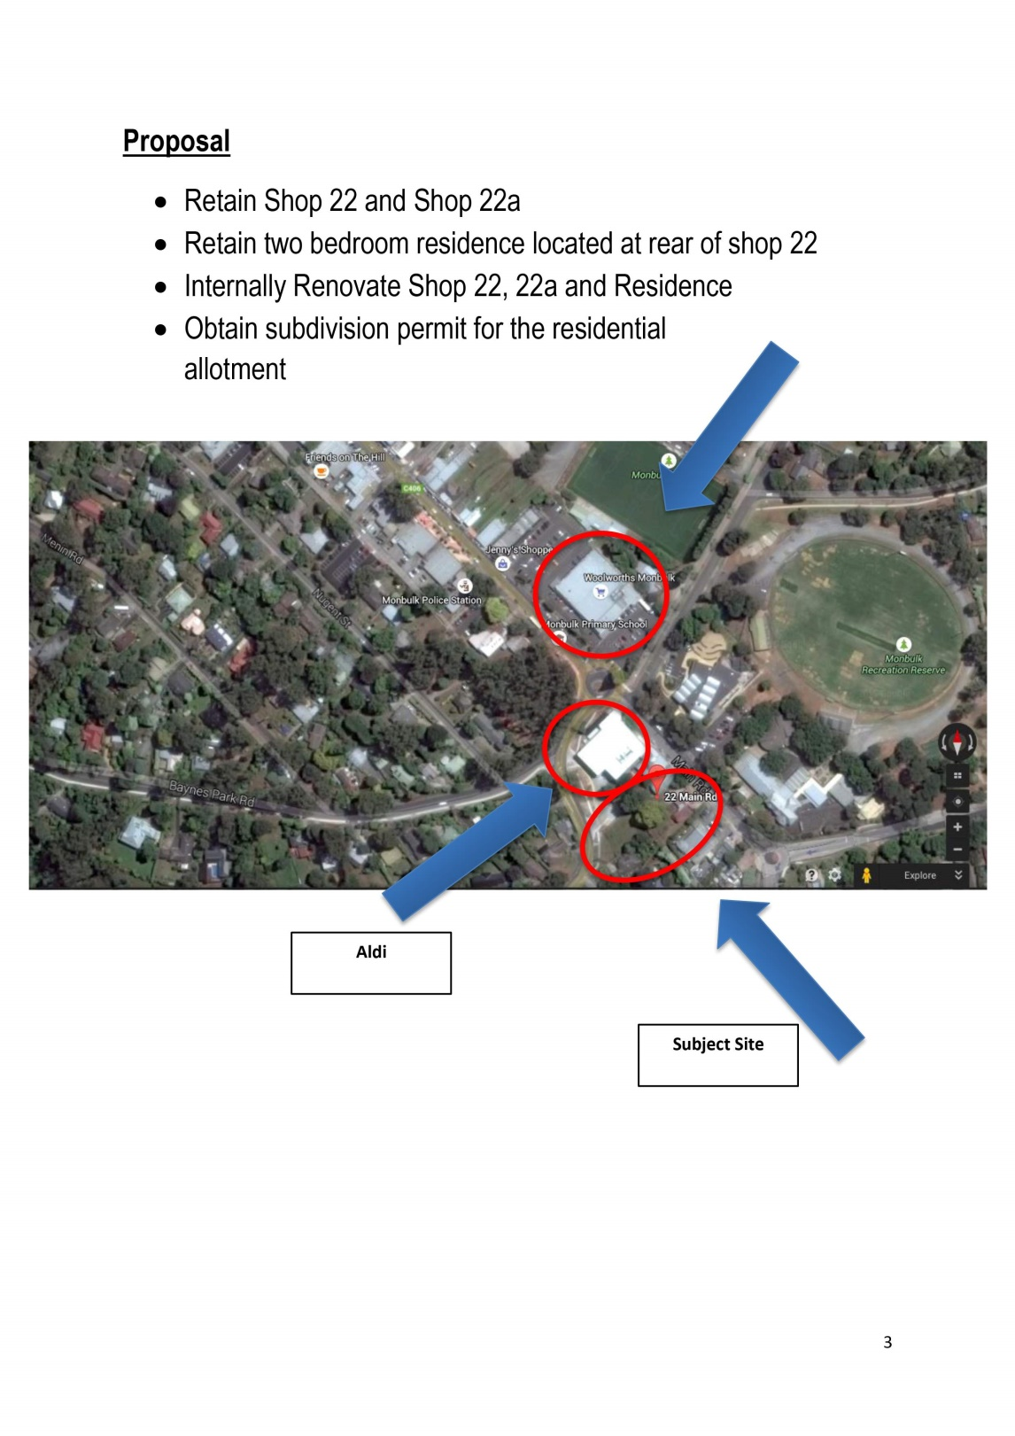
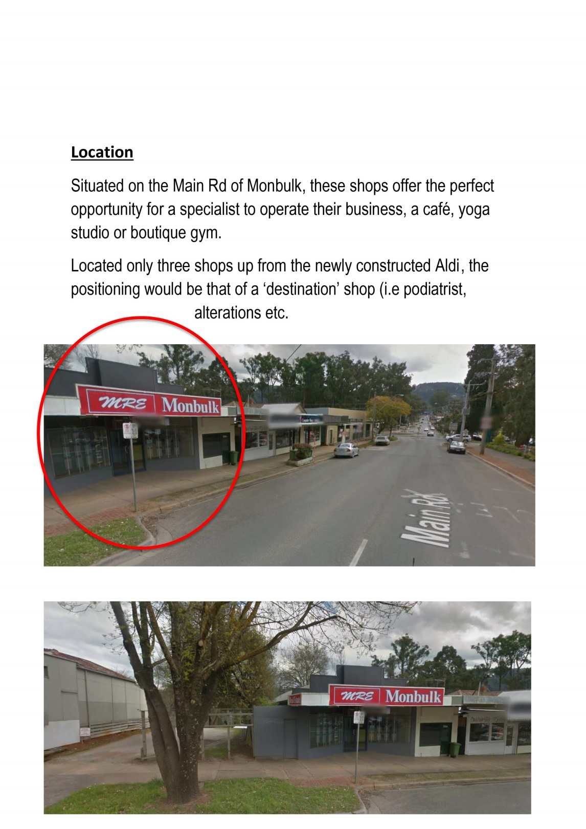
Example
B
Notes:
AVERAGE EXAMPLE

Slide 55
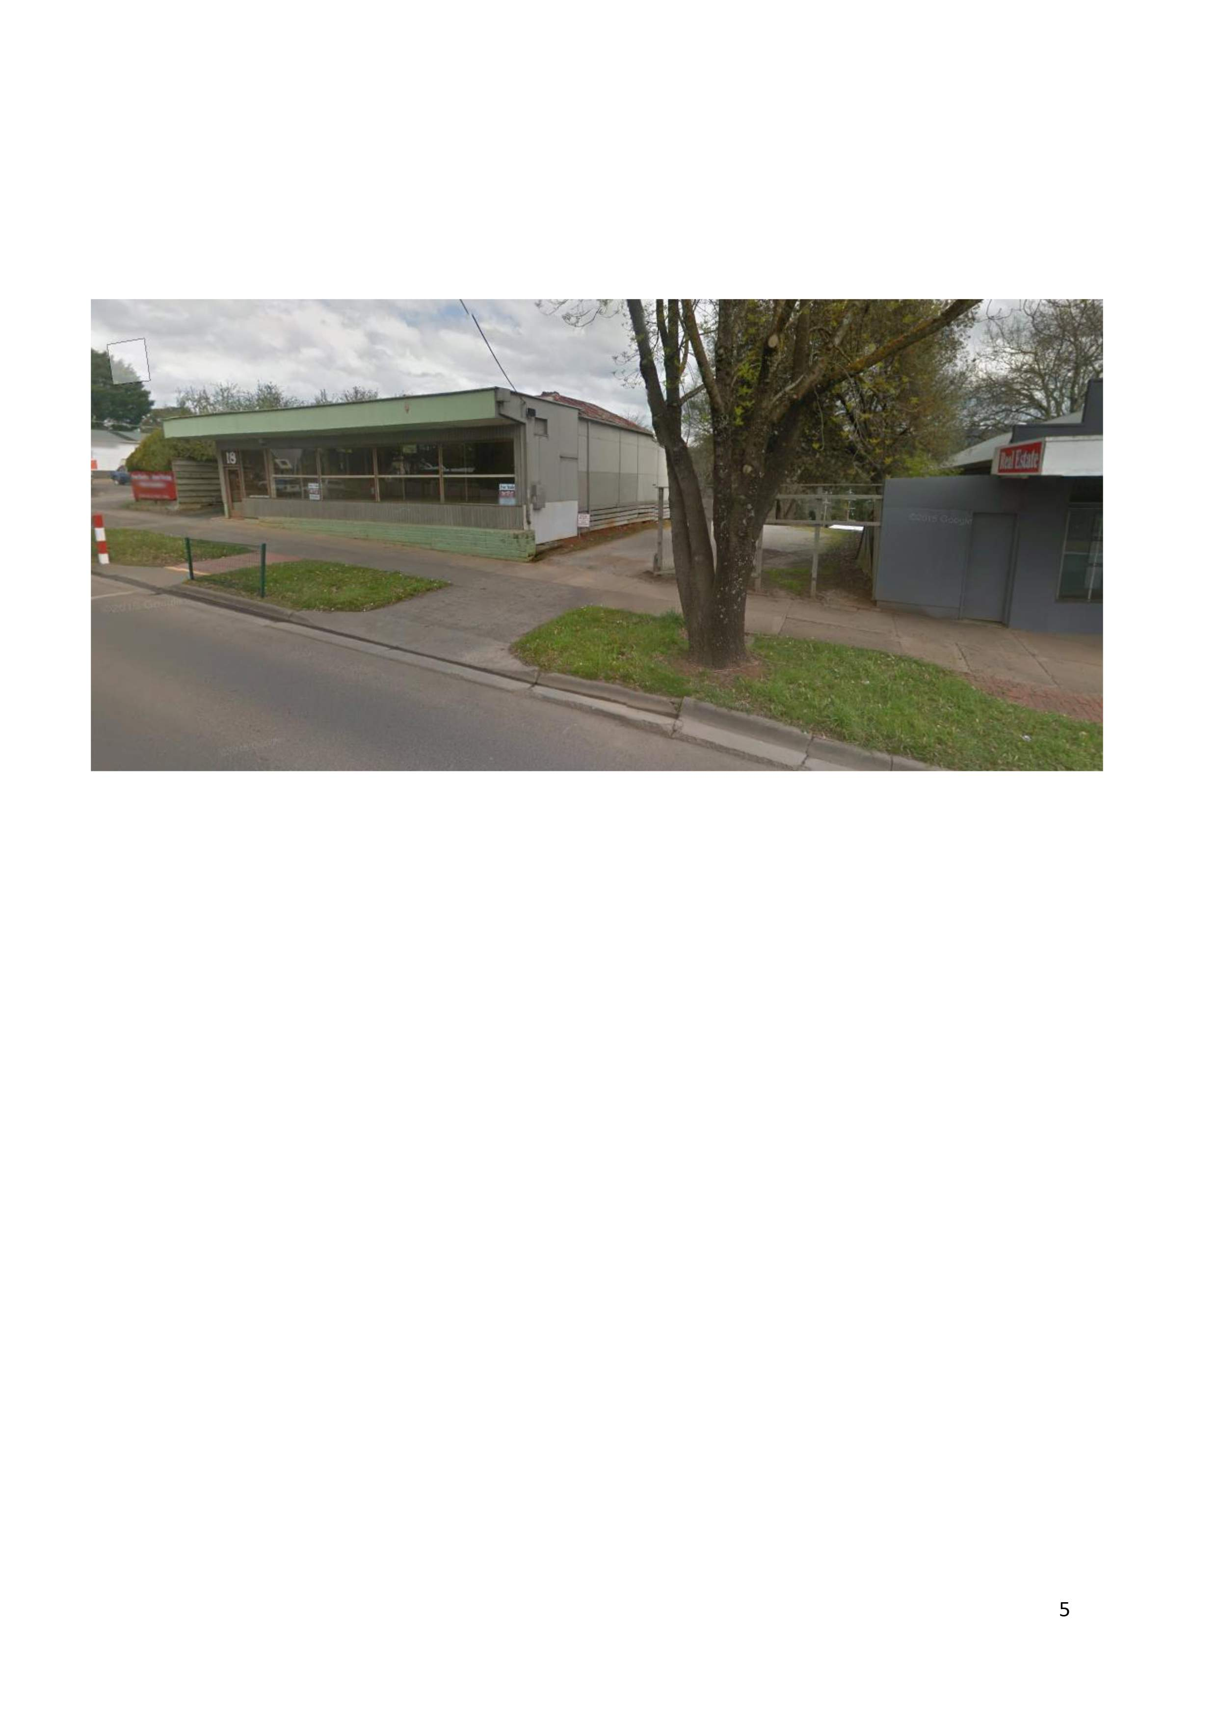
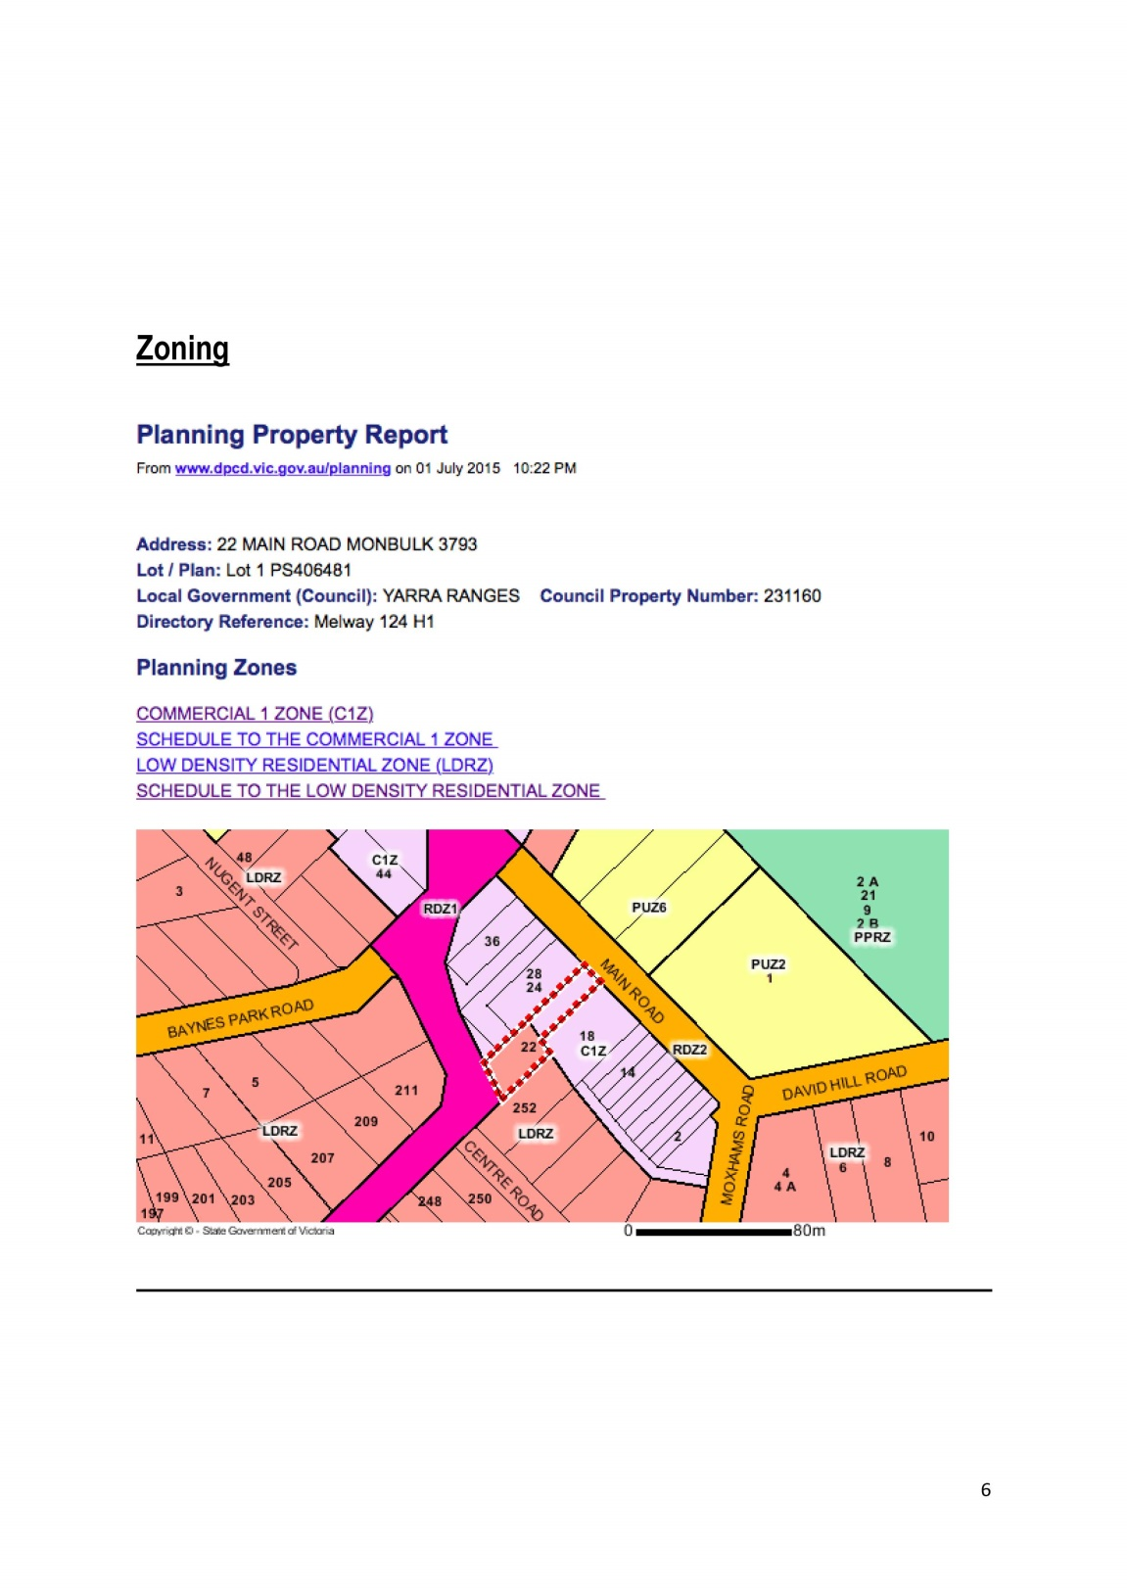
Example
B
Notes:
AVERAGE EXAMPLE

Slide 56

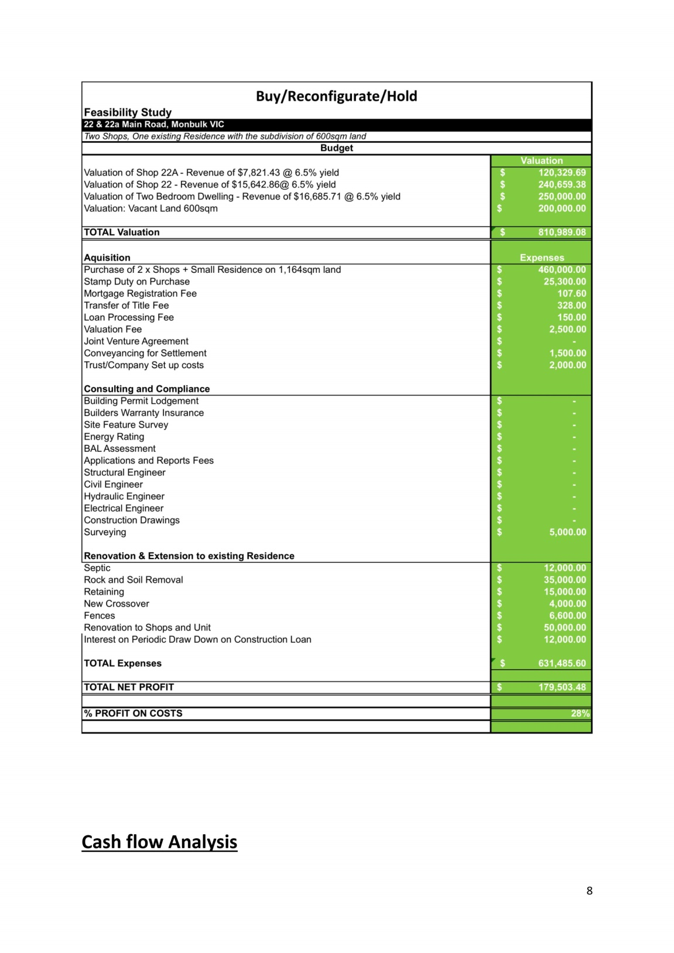
Example
B
Notes:
AVERAGE EXAMPLE

Slide 57
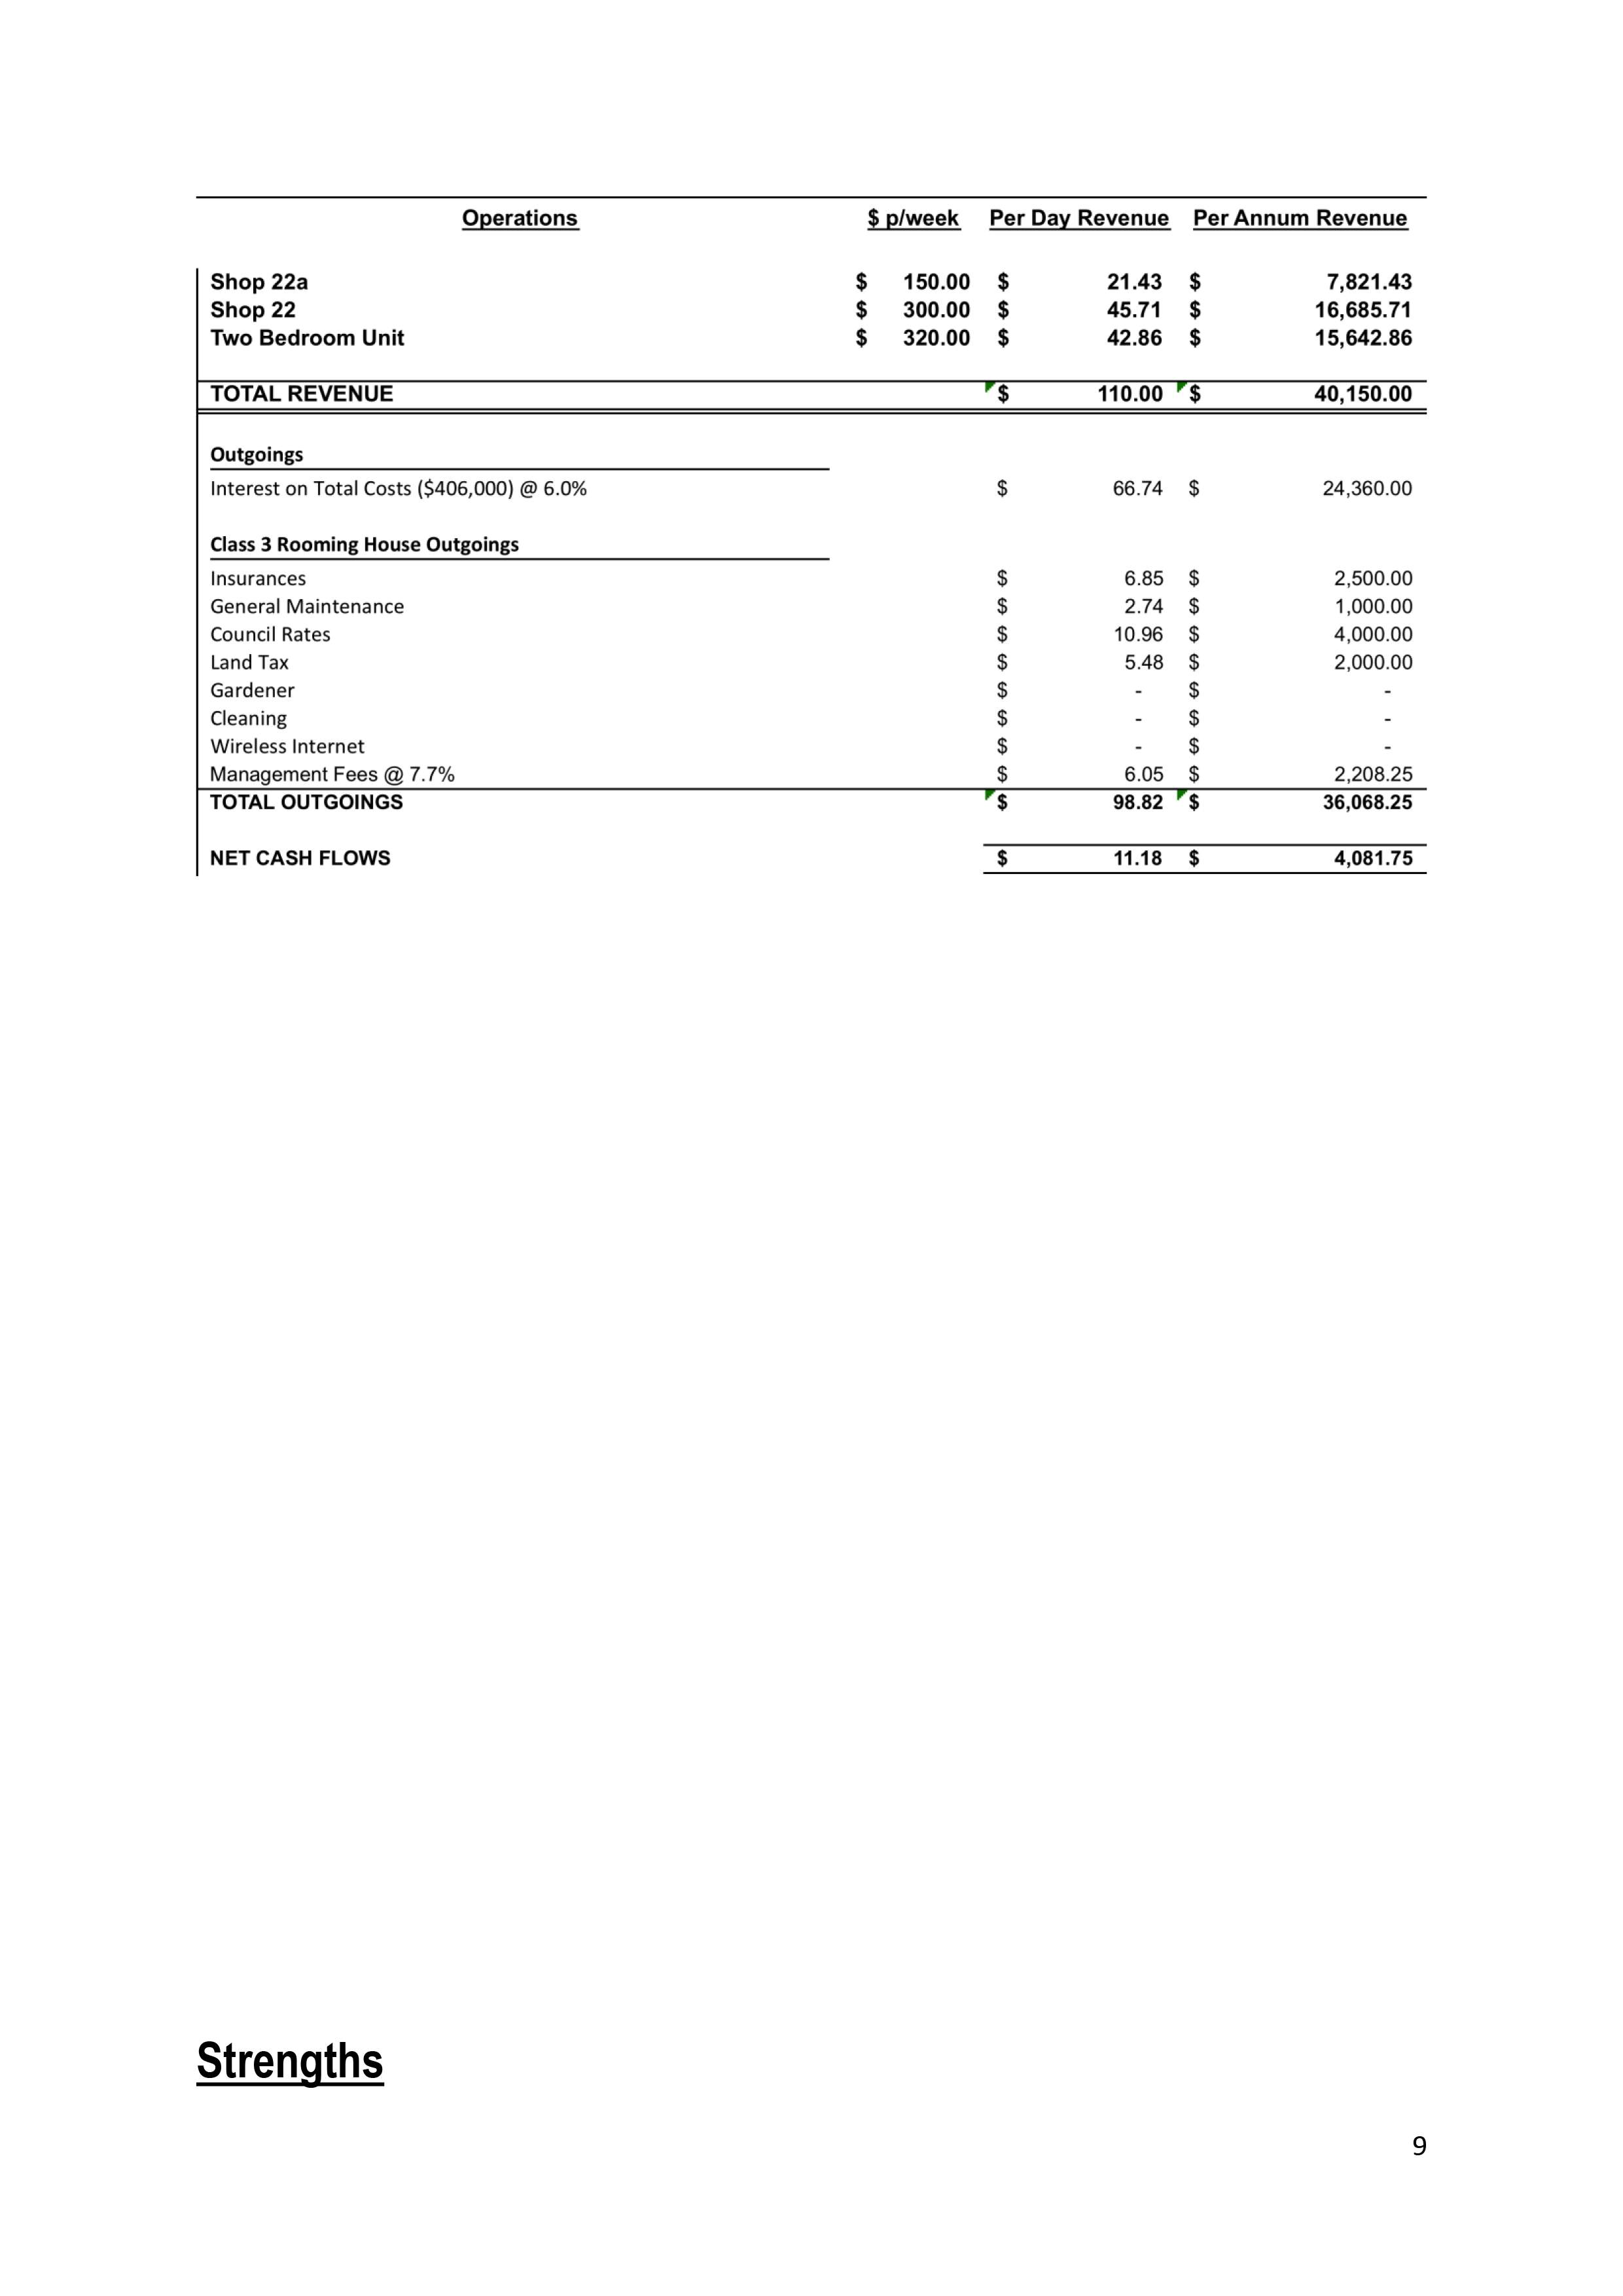
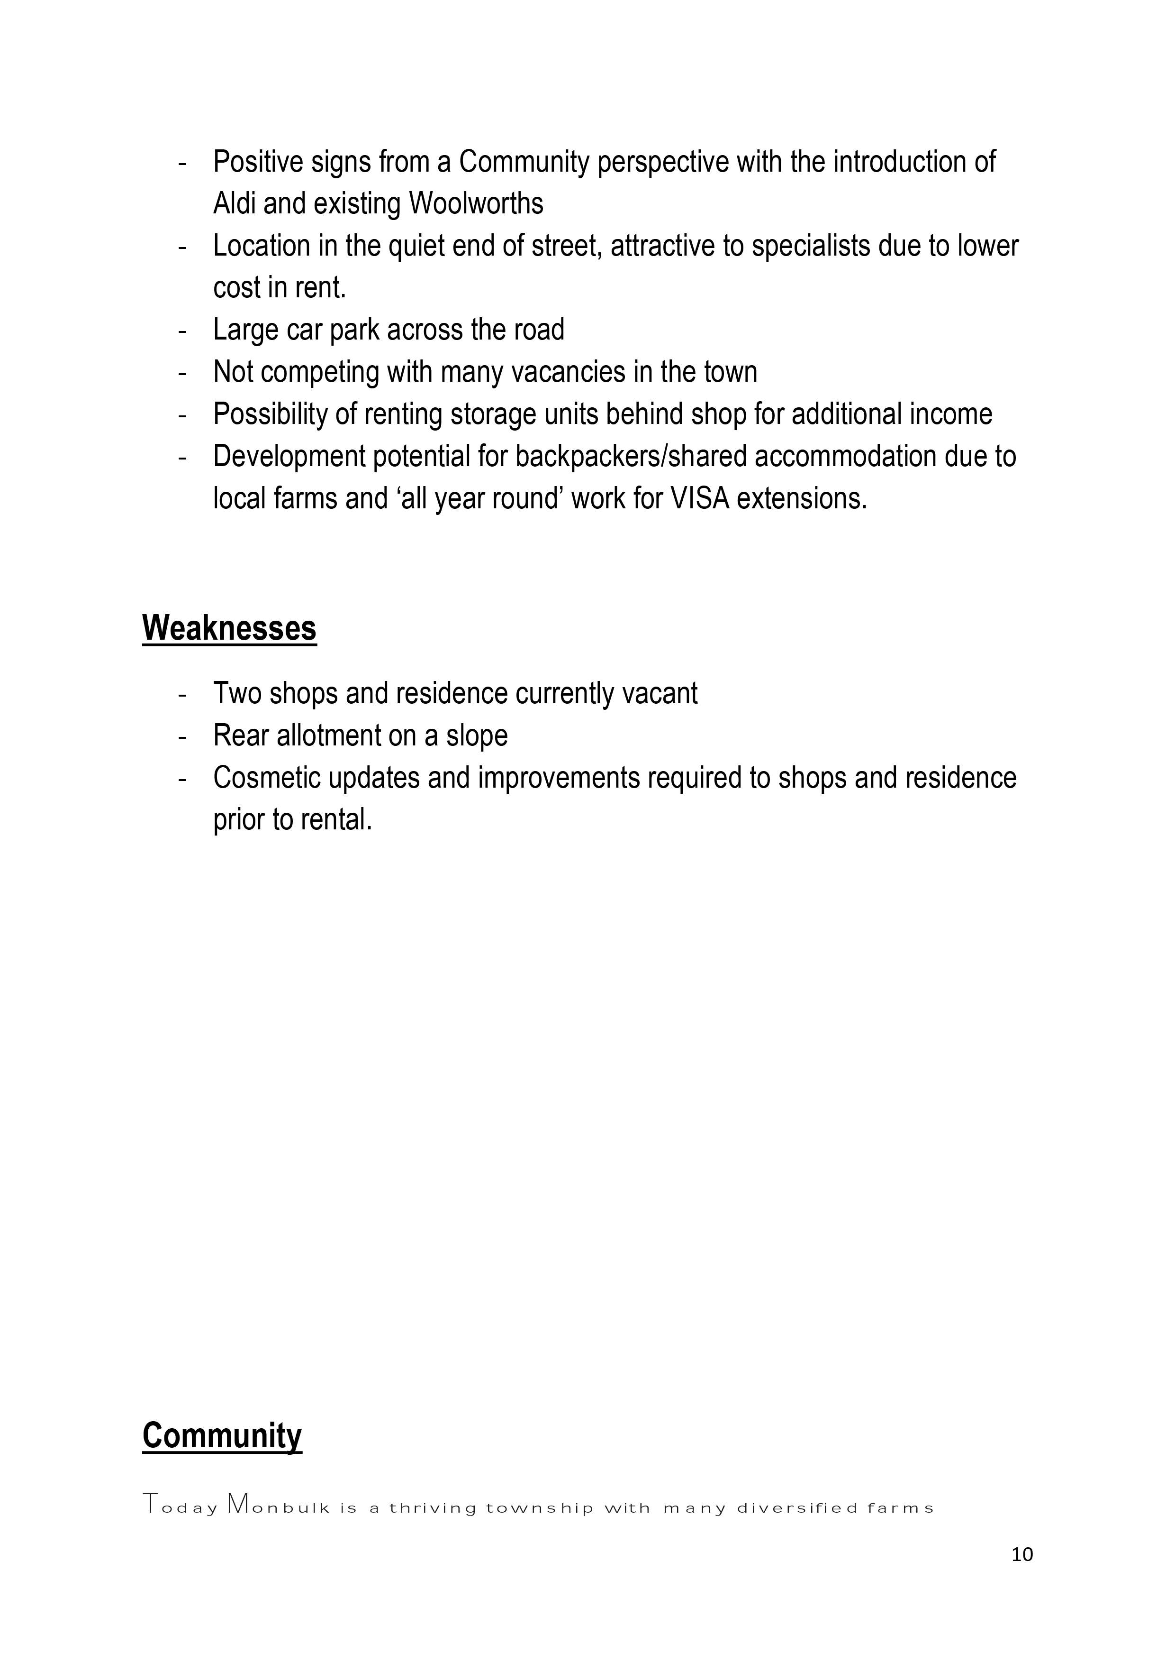
Example
B
Notes:
AVERAGE EXAMPLE

Slide 58
Activity – Share Feedback on Your Table
______________________
______________________
______________________
______________________
______________________
______________________
Notes:
2 min

Slide 59
Activity – Group Reflection
______________________
______________________
______________________
______________________
______________________
______________________
Notes:
5 min

Slide 60
Example B - Reflection
More detailed but still info missing
No info on what required from the JV partner - $, serviceability ??
Layout & formatting doesn’t reflect attention to detail – proof read!
“Weaknesses” requires comment on mitigation
Photos not well labeled
Summary Feaso – more detail on request
Is deal under contract?
Who is the doing party & what’s their credentials?
Notes:
5 min

Slide 61
Example B – Verdict?
AVERAGE
Notes:
5 min

Slide 62
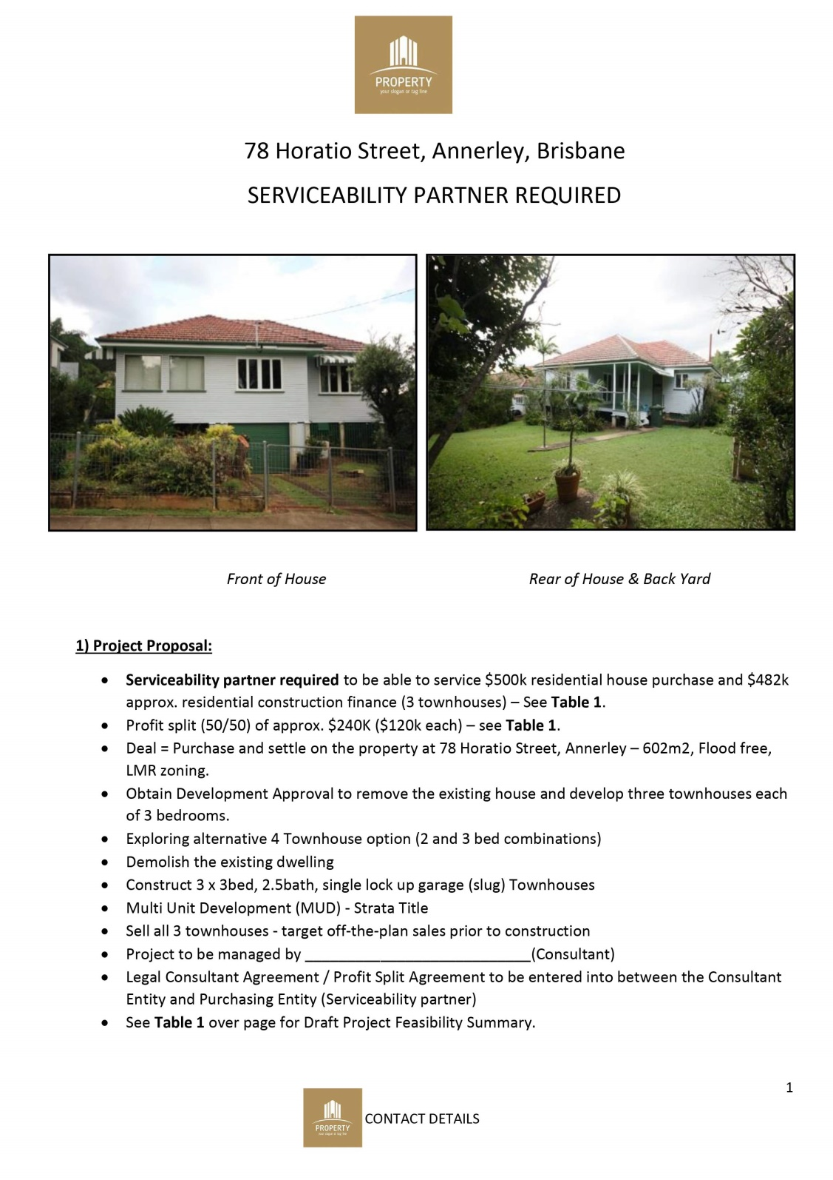
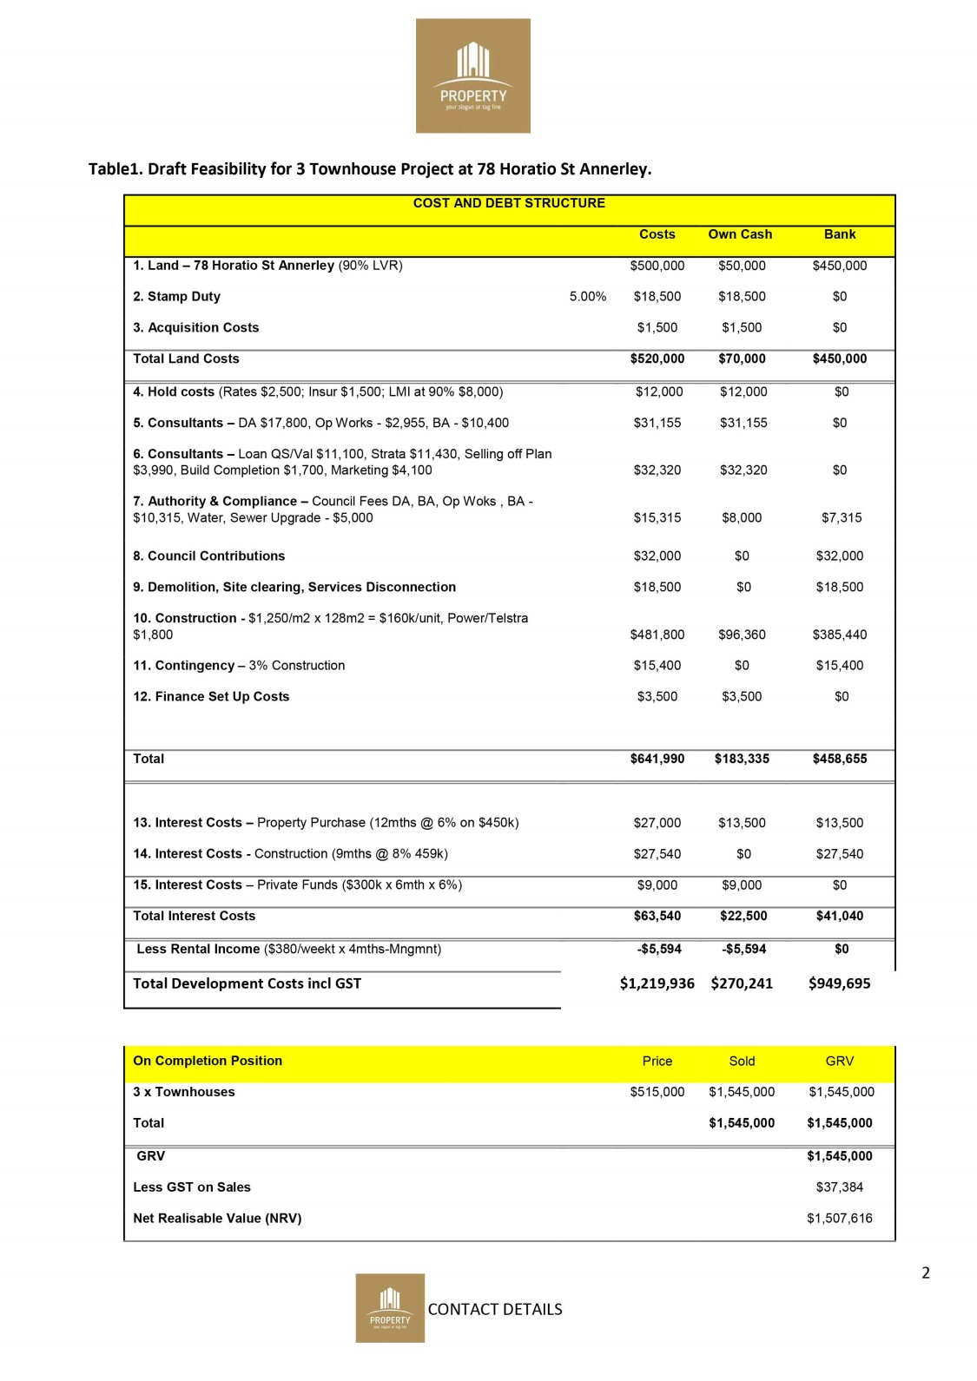
Example
C
Notes:
GOOD EXAMPLE

Slide 63

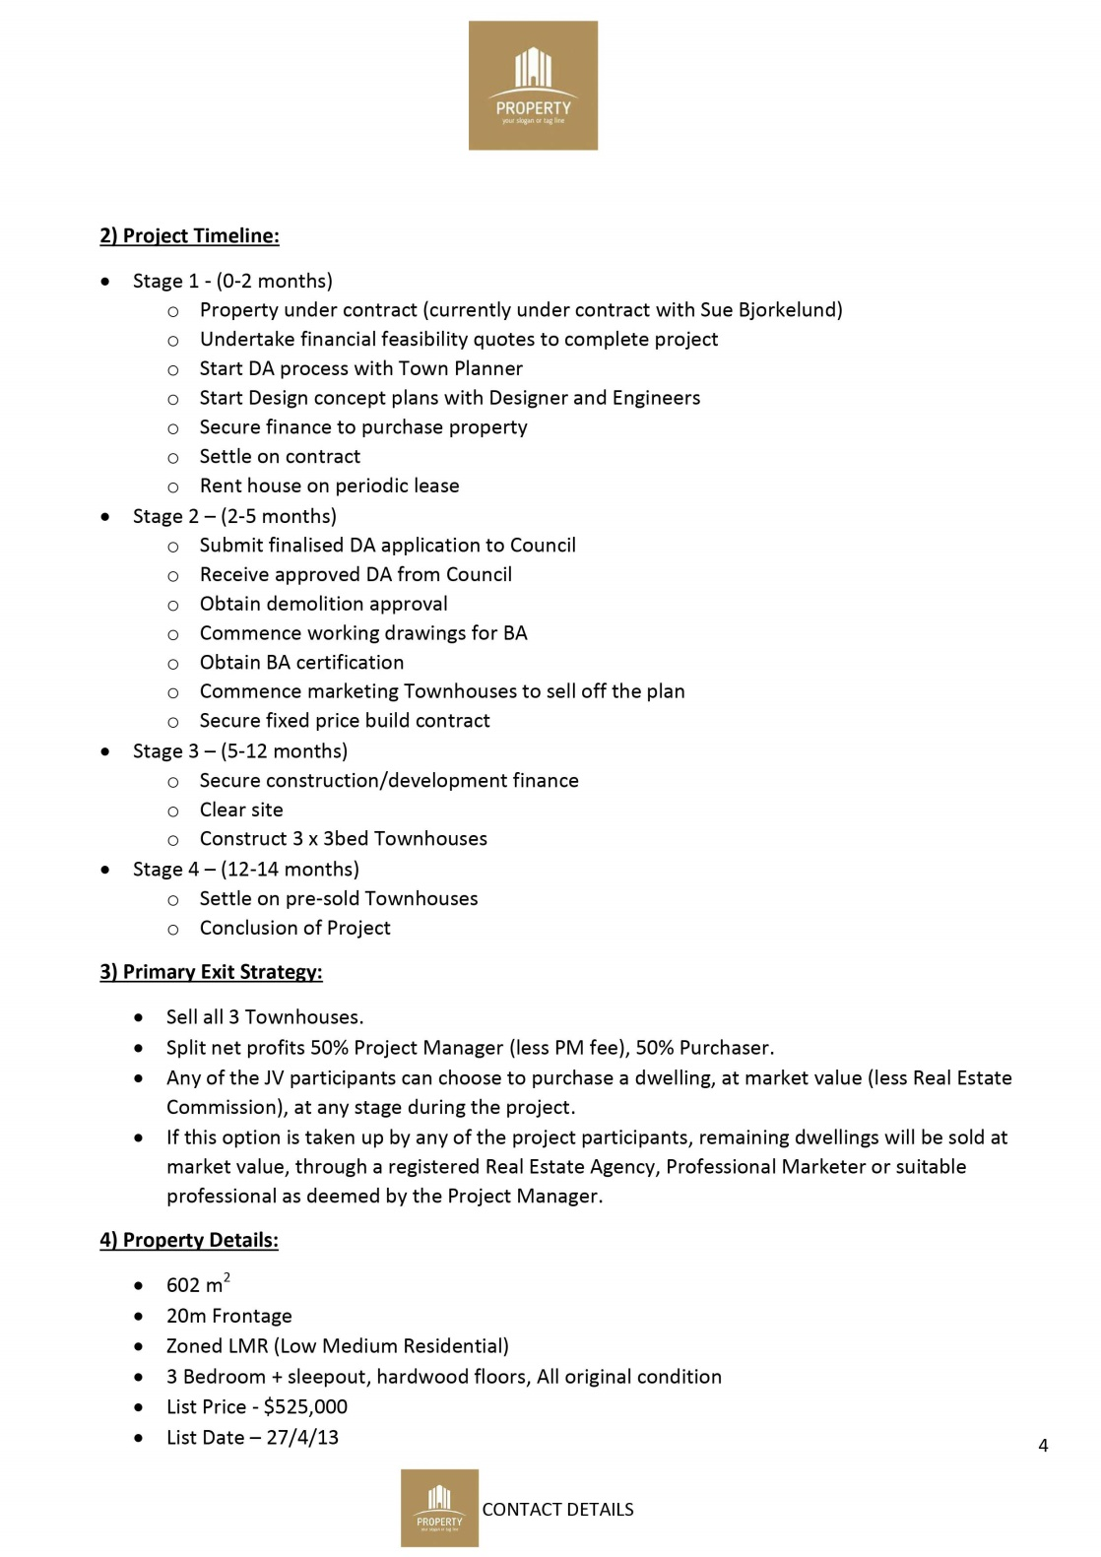
Example
C
Notes:
GOOD EXAMPLE

Slide 64

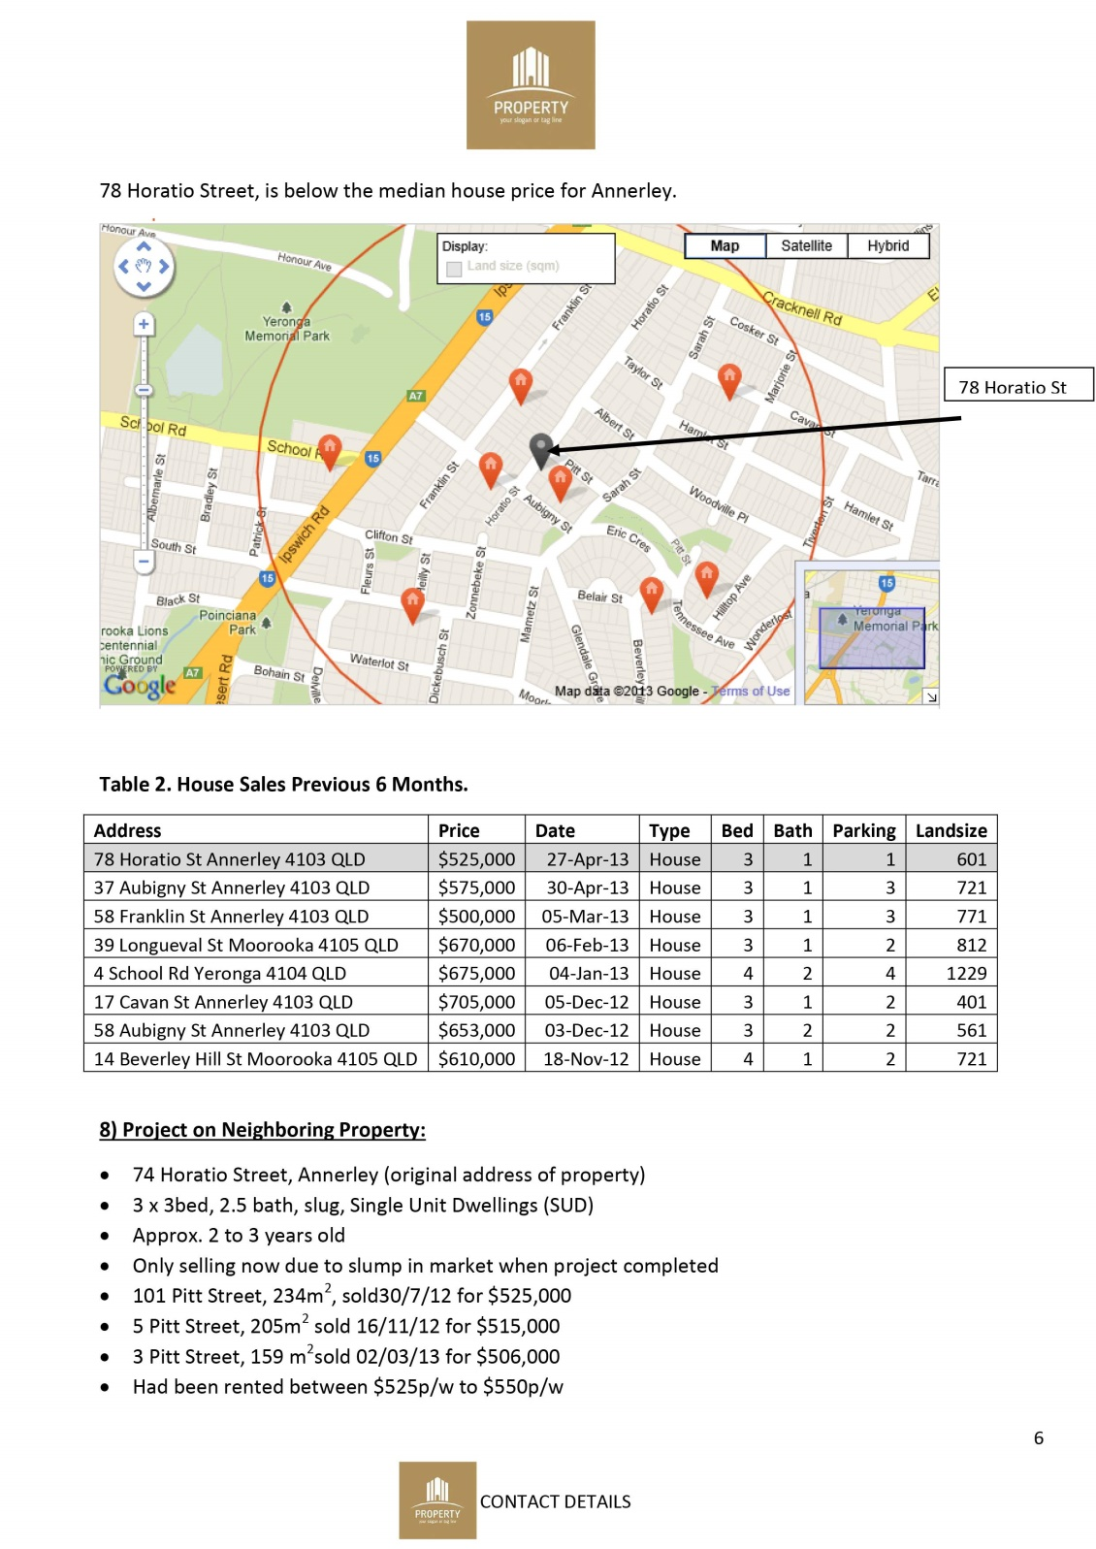
Example
C
Notes:
GOOD EXAMPLE

Slide 65

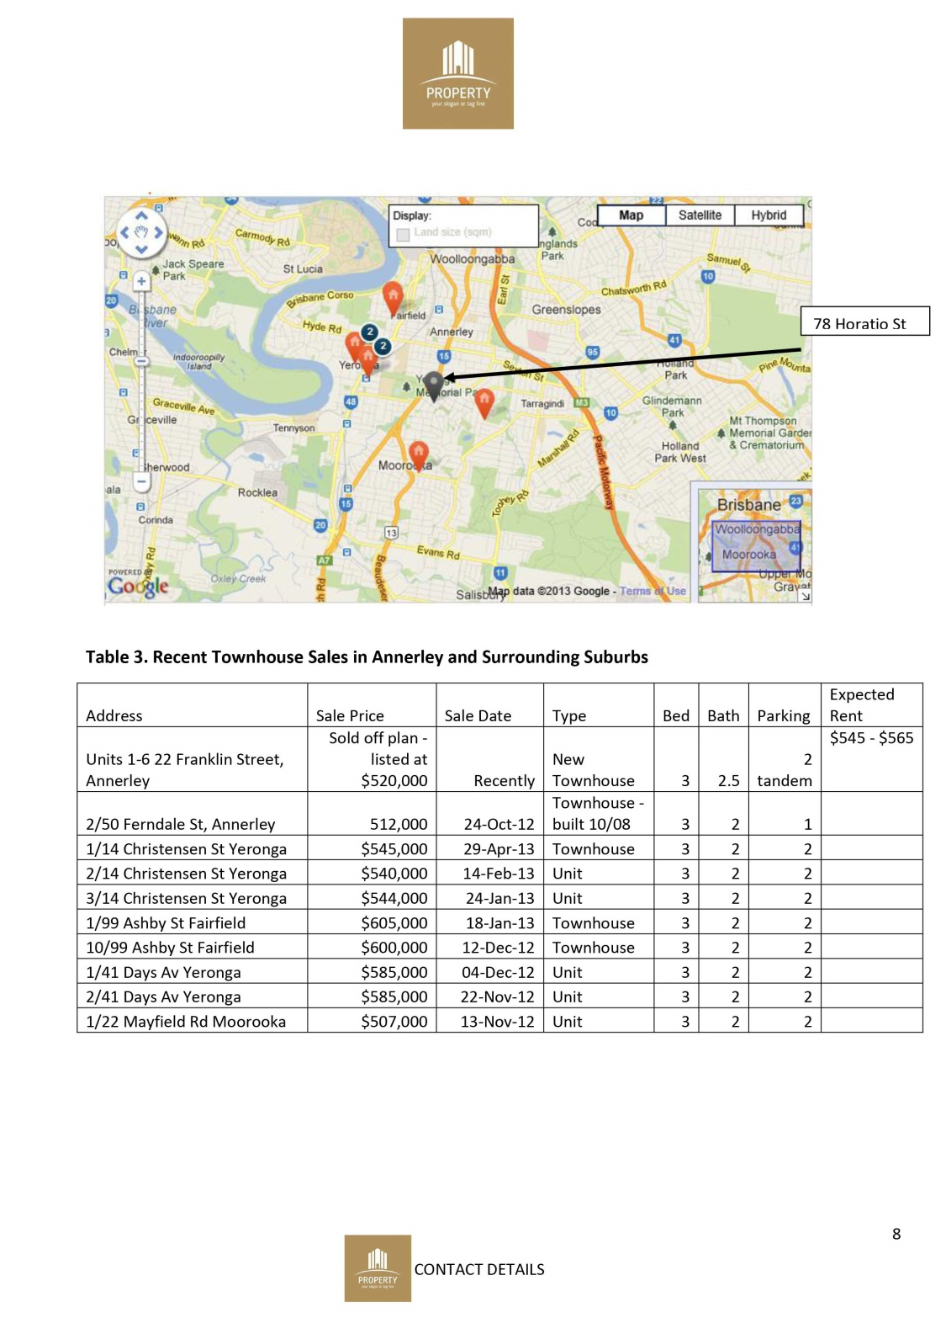
Example
C
Notes:
GOOD EXAMPLE

Slide 66
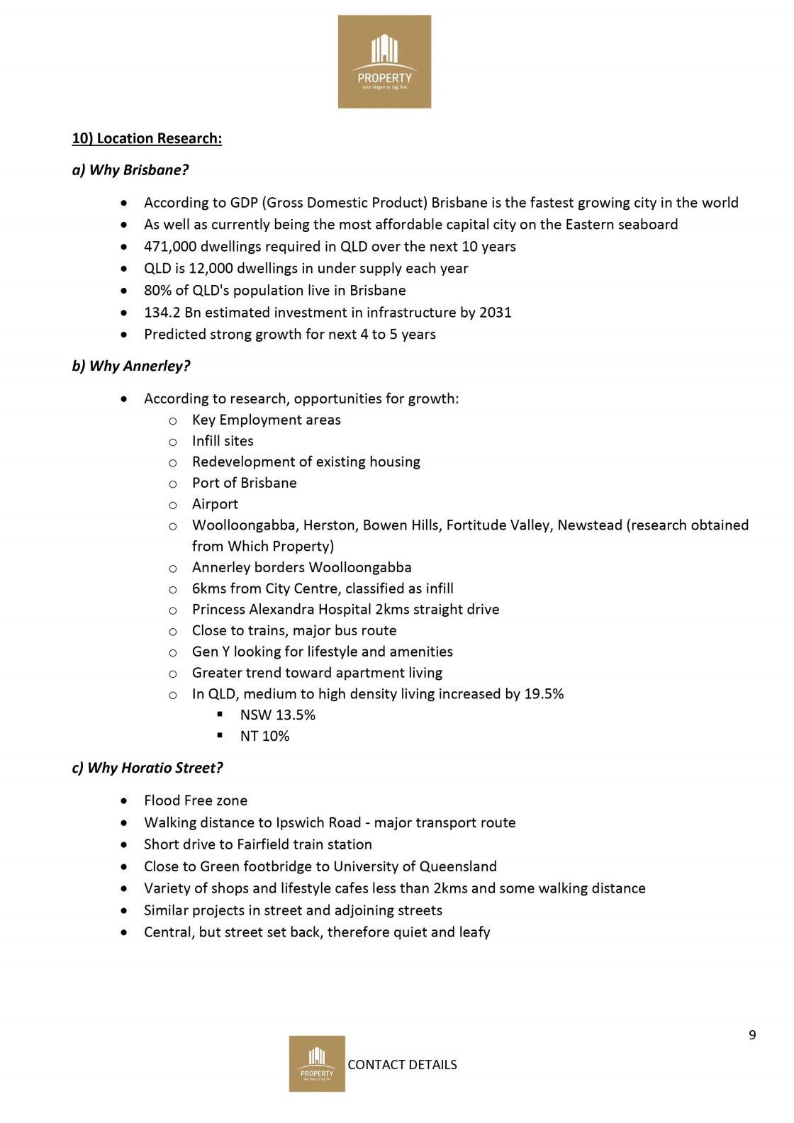

Example
C
Notes:
GOOD EXAMPLE

Slide 67
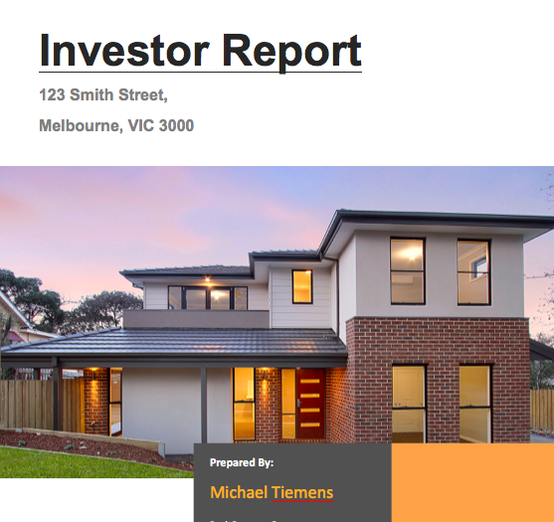

Example
D
Notes:
GOOD EXAMPLE

Slide 68
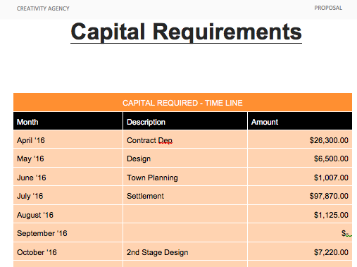
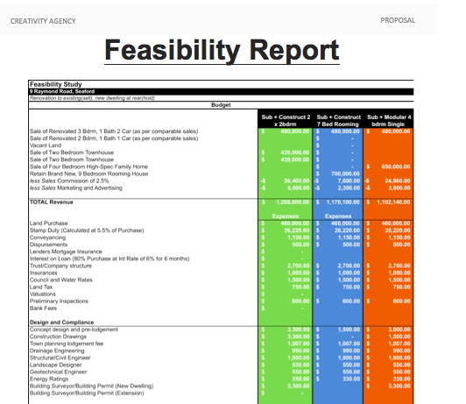
Example
D
Notes:
GOOD EXAMPLE

Slide 69


Example
D
Notes:
GOOD EXAMPLE

Slide 70

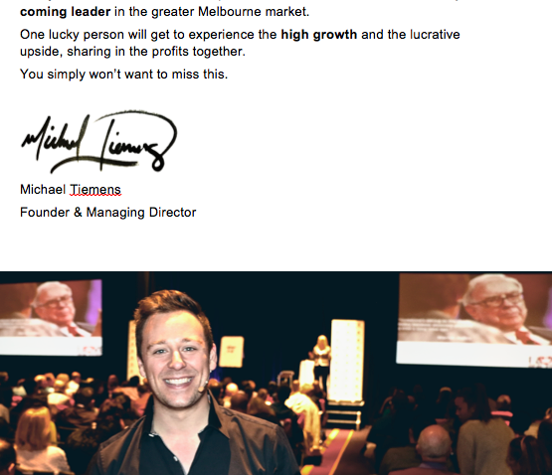
Example
D
Notes:
GOOD EXAMPLE

Slide 71
Activity – Share Feedback on Your Table
______________________
______________________
______________________
______________________
______________________
______________________

Slide 72
Activity – Group Reflection
______________________
______________________
______________________
______________________
______________________
______________________

Slide 73

Traits of a Good JV Deal Proposal
Confidentiality Agreement
Professional Presentation – layout, style, logo
Proof Read – no spelling errors or calculation errors
Photos, maps, dot points
Executive Summary / Project Proposal - covering key points
Draft Feaso
Project Timeline
Primary & Secondary Exit Strategies
Property Details

Slide 74

Traits of a Good JV Deal Proposal
Contract Details
Comparable Sales – Initial Purchase (undeveloped) & End Product
(+ photos / maps)
Surrounding Projects
Location Research – Why Town, why suburb, why street?
Realestate Agents Feedback
Risk & Mitigation Strategies
Your Role, Credentials, Testimonials
Your Contact Details

Slide 75
QUESTIONS?

