Slide 1

Dual Lot Single Title, Boundary Realignment & House Relocation
September 2018
Mastermind Event
Sydney
Greg Miller & Brad Cassidy
NSW State Coaches

Slide 2
Event Outline -
6:00 – 6:30 Networking
6:30 - Start
6:30 – 6:45 Introductions
6:45 – 8:00 Accountability
8:00 – 8:30 Networking Break
8:30 – 10:00 Dual Lot Single Title, Boundary Re-alignment, House Relocation

Slide 3

Workshop Format
Use microphone
Involve everyone in the conversation
Be supportive

Slide 4
Housekeeping –
Ultimate Bootcamps (See Ultimate Website):
Adelaide 14th -16th September
Sydney 21st – 23rd September
Perth 26th -28th October
Gold Coast 2nd – 4th November
Melbourne 16th – 18th November
Fast Profits & Extreme Income: Quantum – 4th – 7th Oct
I Love Super Conference – Annual Success Story Competition: 9th – 11th Nov Melbourne – Platinum Accelerator students are encouraged to submit their story. Awesome prizes on offer!!
Platinum National Conference: 24th – 25th Nov Sydney

Slide 5

Housekeeping
Platinum Namaste Bali – Graduate Only Event:
29th Nov – 2nd Dec 2018 (inclusive) Leave 3rd Dec onward
The Royal Beach Seminyak Bali – Mgallery By Sofitel
RSVP 15th Oct
1 on 1 Session with Dymphna!!
Graduate Revisit Fee = $12,995;
Partner = $4,995
Part payment option on primary student if revisit within 30 days of expiry

Slide 6
40 Years of Stanford Research Found That People With This One Quality Are More Likely to Succeed
Notes:
Buy bags of marshmallows equivalent to 2 marshmallows for each person attending
At the beginning of the event hand out one marshmallow with the following note
You have a choice
Eat the marshmallow – enjoy
Don’t eat the marshmallow and if you still have it at the end of the accountability session I will give you a second marshmallow
Your choice !
Then when the goal session starts present the following

Slide 7
RESEARCH STUDY
In the 1960s, a Stanford professor named Walter Mischel began conducting a series of important psychological studies.
During his experiments, Mischel and his team tested hundreds of children — most of them around the ages of 4 and 5 years old — and revealed what is now believed to be one of the most important characteristics for success in health, work, and life.
Published in 1972, this popular study became known as The Marshmallow Experiment, but it wasn't the treat that made it famous. The interesting part came years later.

Slide 8
The Marshmallow Experience
The experiment began by bringing each child into a private room, sitting them down in a chair, and placing a marshmallow on the table in front of them.
At this point, the researcher offered a deal to the child.
The researcher told the child that he was going to leave the room and that if the child did not eat the marshmallow while he was away, then they would be rewarded with a second marshmallow. However, if the child decided to eat the first one before the researcher came back, then they would not get a second marshmallow.
So the choice was simple: one treat right now or two treats later.
The researcher left the room for 15 minutes.
As you can imagine, the footage of the children waiting alone in the room was rather entertaining. Some kids jumped up and ate the first marshmallow as soon as the researcher closed the door. Others wiggled and bounced and scooted in their chairs as they tried to restrain themselves, but eventually gave in to temptation a few minutes later. And finally, a few of the children did manage to wait the entire time.

Slide 9
The Power of Delayed Gratification
As the years rolled on and the children grew up, the researchers conducted follow up studies and tracked each child's progress in a number of areas. What they found was surprising.
The children who were willing to delay gratification and waited to receive the second marshmallow ended up having higher SAT scores, lower levels of substance abuse, lower likelihood of obesity, better responses to stress, better social skills as reported by their parents, and generally better scores in a range of other life measures
The researchers followed each child for more than 40 years and over and over again, the group who waited patiently for the second marshmallow succeeded in whatever capacity they were measuring. In other words, this series of experiments proved that the ability to delay gratification was critical for success in life.

Slide 10
Examples of this are everywhere
If you delay the gratification of watching television and get your research done now, then you are more likely find a deal.
If you delay the gratification of buying desserts and chips at the stops, then you’ll eat healthier when you get home.
If you delay the gratification of finishing your workout early and put in a few more reps, then you’ll be stronger.
Success usually comes down to choosing the pain of discipline over the ease of distraction. And that’s exactly what delayed gratification is all about.

Slide 11
Did some children naturally have more self-control, and thus were destined for success? Or can you learn to develop this important trait?

Slide 12
What Determines Your Ability to Delay Gratification?
Researchers at the University of Rochester decided to replicate the marshmallow experiment, but with an important twist.
Before offering the child the marshmallow, the researchers split the children into two groups.
The first group was exposed to a series of unreliable experiences. For example, the researcher gave the child a small box of crayons and promised to bring a bigger one, but never did. Then the researcher gave the child a small sticker and promised to bring a better selection of stickers, but never did.
Meanwhile, the second group had very reliable experiences. They were promised better crayons and got them. They were told about the better stickers and then they received them.

Slide 13
You can imagine the impact these experiences had on the marshmallow test. The children in the unreliable group had no reason to trust that the researchers would bring a second marshmallow and thus they didn’t wait very long to eat the first one.
Meanwhile, the children in the second group were training their brains to see delayed gratification as a positive. Every time the researcher made a promise and then delivered on it, the child's brain registered two things: 1) waiting for gratification is worth it and 2) I have the capability to wait.
As a result, the second group waited an average of four times longer than the first group.

Slide 14
In other words, the child's ability to delay gratification and display self-control was not a predetermined trait, but rather was impacted by the experiences and environment that surrounded them.
In fact, the effects of the environment were almost instantaneous. Just a few minutes of reliable or unreliable experiences were enough to push the actions of each child in one direction or another.

Slide 15
So What Is The Meaning Of All This?
1. If you want to succeed at something, at some point you will need to find the ability to be disciplined and take action instead of becoming distracted and doing what's easy.
Success in nearly every field requires you to ignore doing something easier (delaying gratification) in favor of doing something harder.
Even if you don't feel like you're good at delaying gratification now, you can train yourself to become better simply by making a few small improvements. Just like in the children’s experiment, we can train our ability to delay gratification, just like we can train our muscles in the gym: by promising something small and then delivering. Over and over again until your brain says, 1) yes, it's worth it to wait, and 2) yes, I have the capability to do this.

Slide 16

Here are 4 simple ways to do exactly that:
Start Incredibly small. Make your new habit “so easy you can't say no.”
Improve one thing by one percent. Do it again tomorrow.
Maintain consistency.
Find a way to get started in less than two minutes.
How did you fair? – Did you eat the first fantail?
What can you do to train your delayed gratification muscle?

Slide 17
Accountability

Slide 18

Buddy Process Follow-Up

Slide 19

Process Outline
Individually review & / or complete your monthly goals for August 5 mins
Share with a buddy – What you are intending on achieving & why 5 mins
Changeover – other person shares their monthly intentions 5 mins
Share with the wider group – monthly goals (x3) 10 mins
Share with you buddy your challenges & wins from the previous month 5 mins
Changeover – other person shares challenges & wins 5 mins
*** MUST HAVE AT LEAST ONE WIN TO SHARE – DOESN’T MATTER HOW BIG OR SMALL ***
Share with the wider group - challenges & wins (x3) 10 mins

Slide 20
Dual Lot Single Title, Boundary Realignment & House Relocation
SCALING OFF AERIAL PHOTOGRAPHS

Slide 21
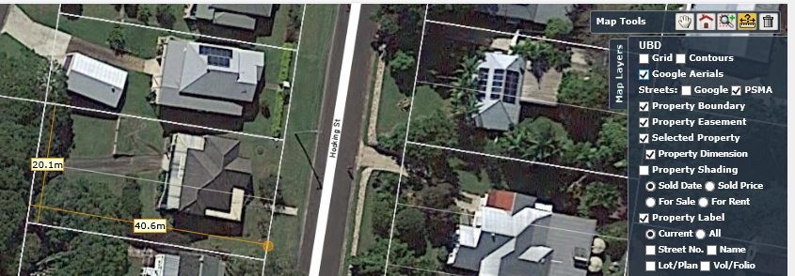
Scaling Off Aerial Photographs -
1) Electronic Method Using Mapping Tools “Ruler” Function
(Investar – My Valuer / Pricefinder; RP Data etc.)
2) Manual Method – Our focus!!!

Slide 22
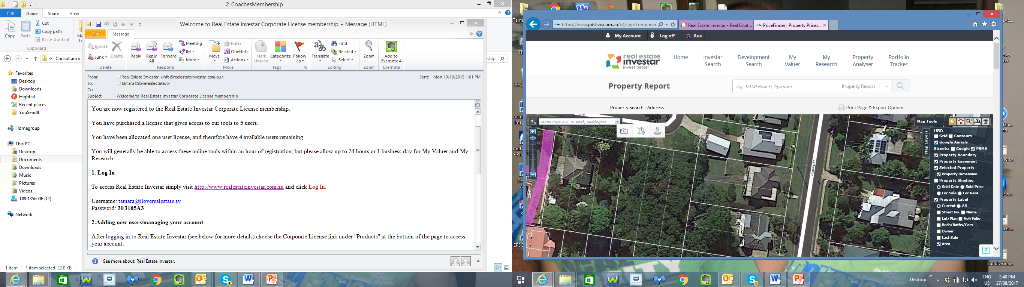
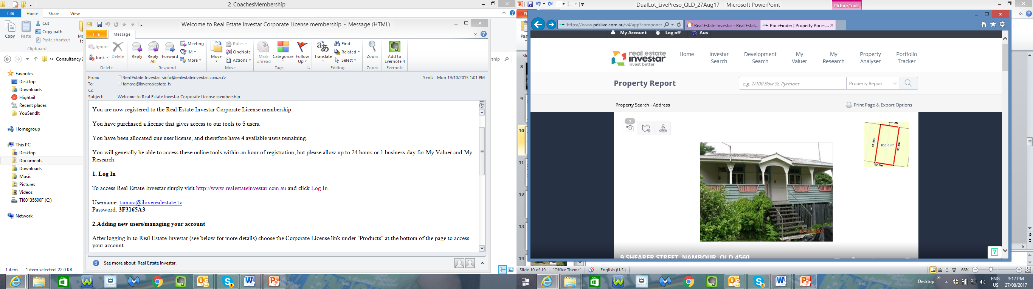
Manually Scaling Off Aerial Photographs -
Very useful & practical skill for many aspects of property:
Subdivision, Multi-unit, Reno, Construction, House move etc.
Use in due diligence prior to site inspection
Use in planning - post inspection & on-site measurement
Tools required:
Aerial photo – (printed A4)
Dimensioned site plan
(source: RP Data, PriceFinder etc)
Clear ruler
Calculator

Slide 23
Tips -
Be aware of shadows in aerial photos
Be aware of angle of photo – not necessarily 100% over rooftop
Line thickness can have an effect - Be consistent e.g. measure from centre of line
Measure accurately to the millimeter
Results are indicative measurements only – must be ground-truthed or surveyed to confirm

Slide 24
Example – Manually Calculating Scale
Distance
on ground
Distance
on map

Slide 25
Example- Calculating Scale
Measure Boundaries on Printout
Calc Scale (1cm on map = X m on ground)
Formula: length on ground / length on map
a) 20m / 10.3cm = 1.94
b) 40.5m / 20.8cm = 1.95
Scale =
1 cm on map = 1.95 m on ground
10.3cm
20.8cm
ROAD
10.3cm
20.8cm

Slide 26

Example- Calculating Scale
4) Test 1 –
If 1 cm on map = 1.95 m on ground
Then 10.3 cm on map = ?? m on ground
10.3 x 1.95 scale = 20.0 m on ground
CORRECT
10.3cm
20.8cm
ROAD
10.3cm
20.8cm

Slide 27
Example- Calculating Scale
5) Test 2 –
If 1 cm on map = 1.95 m on ground
Then 20.8 cm on map = ?? m on ground
20.8 x 1.95 scale = 40.5 m on ground
CORRECT
10.3cm
20.8cm
ROAD
10.3cm
20.8cm

Slide 28
6) Modify Scale
(1 m on ground = Y cm on map)
Formula: length on map / length on ground
a) 10.3 cm / 20 m = 0.52
b) 20.8 cm / 40.5 m = 0.51
Scale =
1 m on ground = 0.51 cm on map
Example- Calculating Scale
10.3cm
20.8cm
ROAD
10.3cm
20.8cm

Slide 29
Example- Calculating Scale
7) Test 1 –
If 1 m on ground = 0.51 cm on map
Then 20 m on ground = ?? cm on map
20 x 0.51 = 10.2 cm on map
CORRECT
10.3cm
20.8cm
ROAD
10.3cm
20.8cm

Slide 30
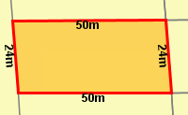
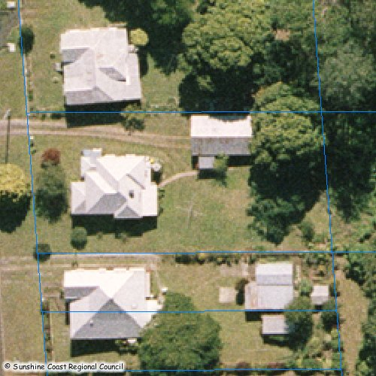
Activity
ROAD

Slide 31
Phase 1 - Calculate Scale
Measure Boundaries on Printout
Calc Scale (1cm on map = X m on ground)
Formula: length on ground / length on map
a) 24m / 10.5cm = 2.29
b) 50m / 21.9cm = 2.28
Scale =
1 cm on map = 2.3 m on ground
21.9cm
10.5cm
10.5cm
ROAD
21.9cm

Slide 32
Phase 1 - Calculate Scale
4) Test 1 –
If 1 cm on map = 2.3 m on ground
Then 10.5 cm on map = ?? m on ground
10.5 x 2.3 scale = 24.15 m on ground
CORRECT
21.9cm
10.5cm
10.5cm
ROAD
21.9cm

Slide 33
Phase 1 - Calculate Scale
5) Test 2 –
If 1 cm on map = 2.3 m on ground
Then 21.9 cm on map = ?? m on ground
21.9 x 2.3 scale = 50.37 m on ground
CORRECT
21.9cm
10.5cm
10.5cm
ROAD
21.9cm

Slide 34
Phase 1 - Calculate Scale
6) Modify Scale
(1 m on ground = Y cm on map)
Formula: length on map / length on ground
a) 10.5 cm / 24 m = 0.438
b) 21.9 cm / 50 m = 0.438
Scale =
1 m on ground = 0.44 cm on map
21.9cm
10.5cm
10.5cm
ROAD
21.9cm

Slide 35
Phase 1 - Calculate Scale
7) Test 1 –
If 1 m on ground = 0.44 cm on map
Then 24 m on ground = ?? cm on map
24 x 0.44 = 10.56 cm on map
CORRECT
21.9cm
10.5cm
10.5cm
ROAD
21.9cm

Slide 36
Phase 2a – Review Town Planning Requirements for Subdivision & Dwelling Position
Front lot minimum area: 400 m²
Battle-axe lot min. area: 600 m²
Battle-axe driveway min. width: 4 m
Site cover max: 50%
End product min. frontage:
10 m if < 450 m²
15 m if ≥ 450 m²
House - side setback:
Lowset = 1.5 m
Highset = 2 m
House - rear setback: 3 m
ROAD
Car parking min: 1 per lot (6m front setback)
Turn in car park setback min: 6m off side boundary

Slide 37
Phase 2b – Measure & Mark on Map Town Planning Requirements for Subdivision
Measure & mark driveway width
Measure & confirm side setback from house to driveway boundary
Measure front lot frontage
Measure rear setback off existing house
Calculate front lot area off min. requirements & mark boundary
Measure footprint off existing house & calculate % site cover
Calculate rear lot area (excl. driveway) off min. requirements
Mark carpark on front lot
ROAD

Slide 38
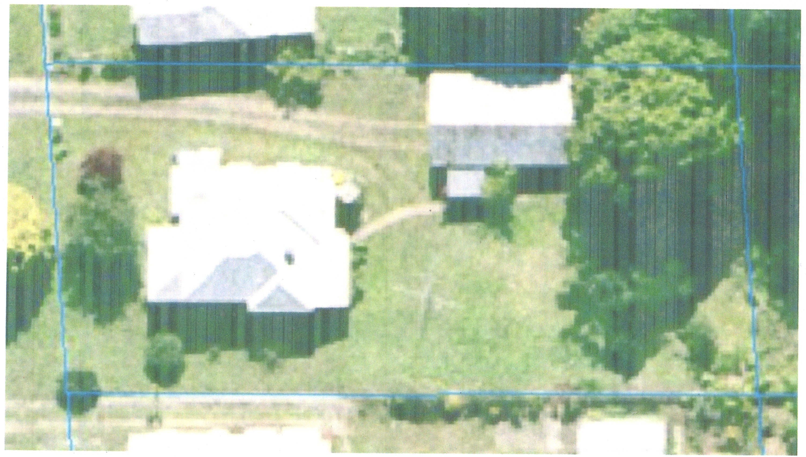
1) Measure & Mark Driveway Width
Require min 4 m wide battle-axe driveway width
Scale: 1 m on ground = 0.44 cm on map
4 m driveway width =
4 x 0.44 Scale = 1.76 cm on map
Draw on Plan
4m

Slide 39
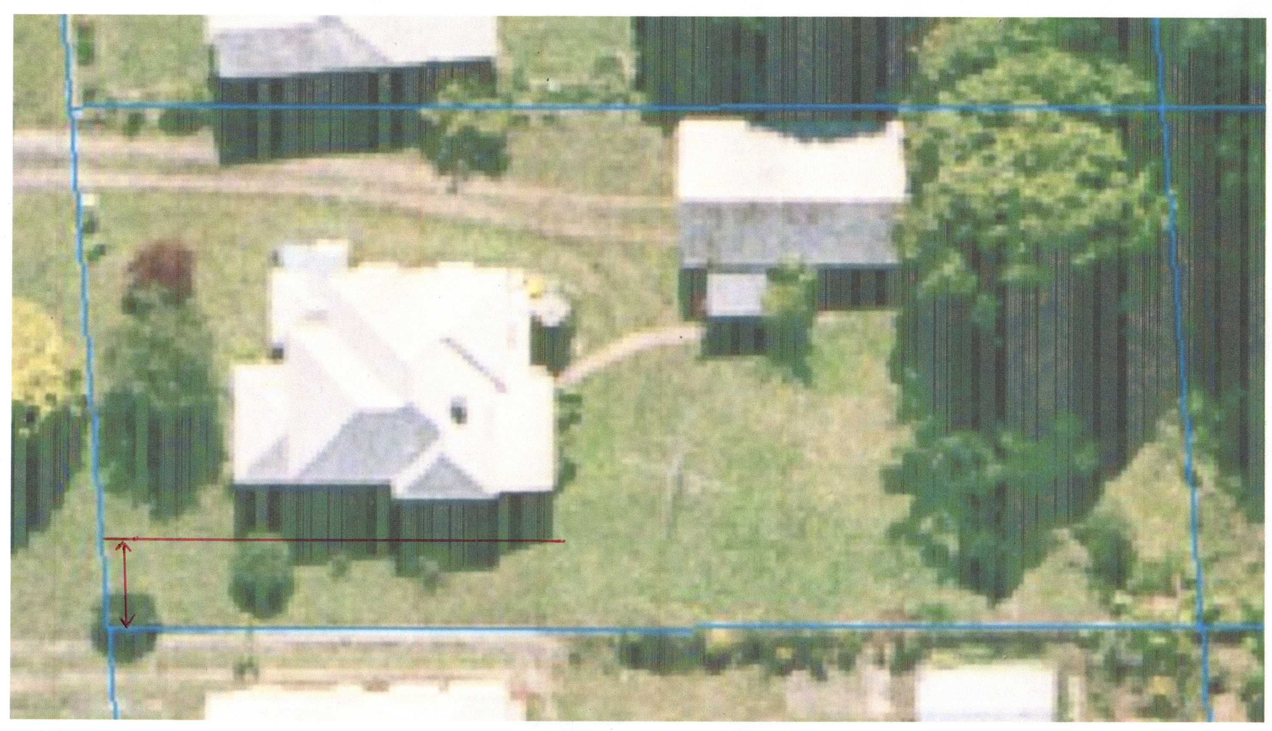
1) Measure & Mark Driveway Width
Require min 4 m wide battle-axe driveway width
Scale: 1 m on ground = 0.44 cm on map
4 m driveway width =
4 x 0.44 Scale = 1.76 cm on map
Draw on plan
4m

Slide 40
2) Measure & Confirm Side Setback from House to Driveway Boundary
Measure setback off plan
Scale: 1 cm on map = 2.3 m on ground
0.8 cm on map =
0.8 x 2.3 Scale = 1.84 m on ground
Meets requirement of min. 1.5 m side setback for lowset house?
1.8m
4m

Slide 41
3) Measure Front Lot Frontage
Measure frontage off plan
Scale: 1 cm on map = 2.3 m on ground
8.7 cm on map =
8.7 x 2.3 Scale = 20 m on ground
20m
Meets requirement of min. 15 m frontage if lot ≥ 450 m²?
1.8m
4m

Slide 42
4) Measure Rear Setback Off Existing House
Require min 3 m rear setback
Scale: 1 m on ground = 0.44 cm on map
3 m on ground =
3 x 0.44 Scale = 1.3 cm on map
Draw subdivision line on map
20m
3m
1.8m
4m

Slide 43
5) Calculate Front Lot Area Off Min. Requirements & Mark Boundary
Measure front lot side boundaries =
10.3 cm & 10.8 cm
Scale: 1 cm on map = 2.3 m on ground
10.3 cm x 2.3 scale = 23.7 m & 10.8 cm x 2.3 scale = 24.8 m
Area =
(23.7 + 24.8)/2 = Avg 24.3 m x 20 m = 486 m² front lot
24.8m
486m²
^{Front lot land}
20m
3m
1.8m
4m
23.7m

Slide 44
6a) Measure Footprint of Existing House
Measure existing house on map =
5.7 cm x 4.5 cm
Scale: 1 cm on map = 2.3 m on ground
5.7 cm x 2.3 scale = 13.1 m
4.5 cm x 2.3 scale = 10.4 m
House area =
13.1 m x 10.4 m = 136.2 m²
24.8 m
136.2m²
^{house}
10.4m
20m
13.1m
3m
1.8m
4m

Slide 45
6b) Calculate % Site Cover of Existing House
24.8m
% Site Cover = (house area / land area) x 100
Calc =
House @ 136.2 m² / 486 m² land = 28% site cover
486m²
^{Front lot land}
20m
136.2m²
^{house}
Meets requirement of max. 50% site cover of dwelling?
3m
1.8m
4m
23.7m

Slide 46
Rear lot side boundaries measure =
11 cm & 11.7 cm
Scale: 1 cm on map = 2.3 m on ground
11 cm x 2.3 scale = 25.3 m
11.7 cm x 2.3 scale = 26.9 m
Area =
(25.3 + 26.9)/2 = Avg 26.1 m x 24 m = 626.4 m² rear lot (Excl. driveway)
7) Calculate Rear Lot Area
(Excl. Driveway) Off Min. Requirements
24.8m
25.3m
20m
626.4m²
^{Rear} ^{Lot Land (Excl Driveway)}
3m
1.8m
4m
23.7m
26.9m
Meets requirement of min. 600 m² rear lot?

Slide 47
Require min. 1 carpark per lot = 3m x 6m
Scale: 1 m on ground = 0.44 cm on map
3 m on ground =
3 x 0.44 Scale = 1.3 cm on map
6 m on ground =
6 x 0.44 Scale = 2.64 cm on map
Draw on map
8) Mark Carpark on Front Lot
24.8m
3m
6m
20m
3m
1.8m
4m
23.7m
Meets carpark requirement?

Slide 48
Phase 3 – Compliance with Planning Requirements & Potential Modifications
Where do we have extra capacity?
What can we modify?
Widen battle-axe driveway by approx. 0.3 m to 4.3 m wide
Widen rear setback off existing house e.g. 4.5 m
Consider rear lot size to allow dual occupancy at rear,
> 700 m² of medium density = dual occ. potential

Slide 49
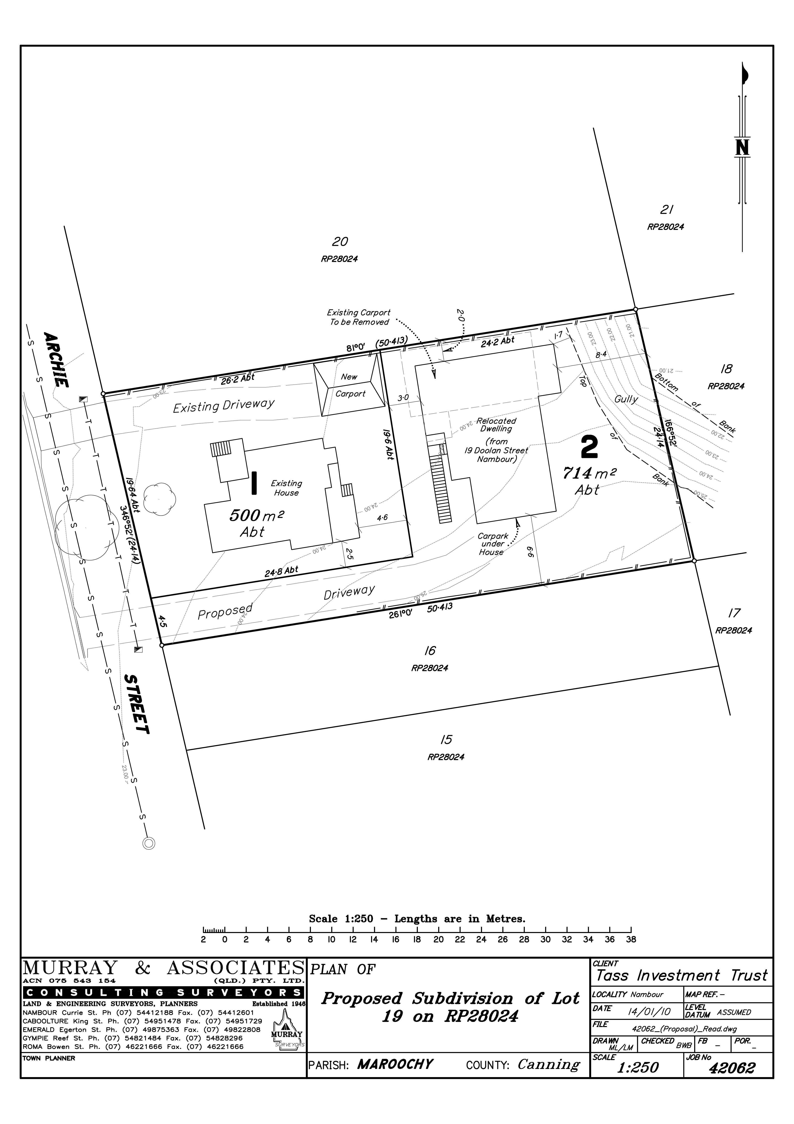
Final Version

Slide 50
What if Minimum Front Lot Width Requirement = 600 m²?
What can we do?

Slide 51
Driveway Access Easement Alternative -
New Lot 2 = 714 - 111 = 613 m²
Make driveway owned by Lot 1
Easement over driveway gives Lot 2 access
New Lot 1 = 500 + 111 = 611 m²
Access Easement
4.5 m x 24.8 m = 111.6 m2

Slide 52
Phase 4 – House Relocation Review
Determine Lot 2 building area for relocatable house
Measure & mark out setbacks on Lot 2
Which of the 3 relocatable house designs fit Lot 2?

Slide 53
Lot 2 Build Area - Mark Gully Top Bank
Gully top bank = 9.4 m off rear boundary
Scale:1 m on ground = 0.44 cm on map
9.4 m on ground = 9.4 x 0.44 scale = 4.1 cm off rear boundary
24.8m
9.4m
20m
3m
1.8m
4m
23.7m

Slide 54
Lot 2 Building Area -
Require 2 m side set -back for 2 story dwelling
7.8 cm on map = 7.8 x 2.3 scale = 17.9 m
6.0 cm on map = 6 x 2.3 scale = 13.8m
Lot 2 build area = 13.8 m x 17.9 m
24.8m
2m
13.8m
20m
2m
3m
17.9m
1.8m
4m
23.7m

Slide 55
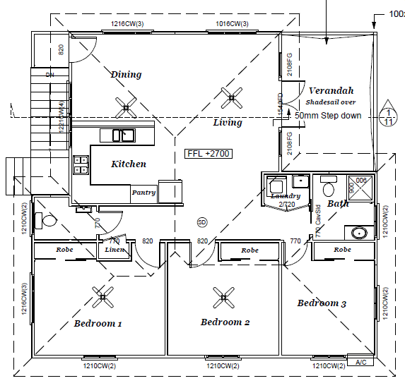
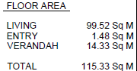
11.17 m
House 1
Measurements to outer most projection (Incl. 600 mm eaves)
11.87 m
11.87 m
12.37 m

Slide 56
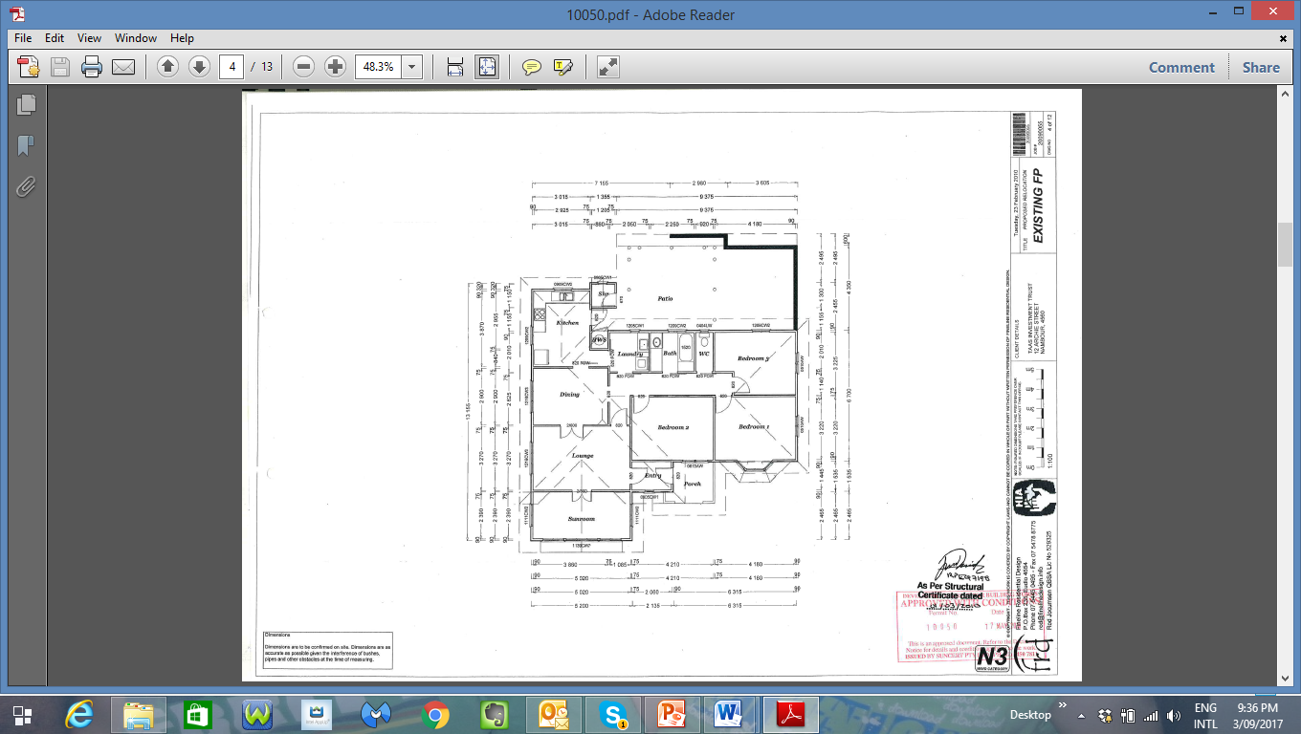
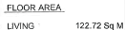
14.94 m
House 2
Measurements to outer most projection (Incl. 600 mm eaves)
14.06 m
7.90 m
14.94 m

Slide 57
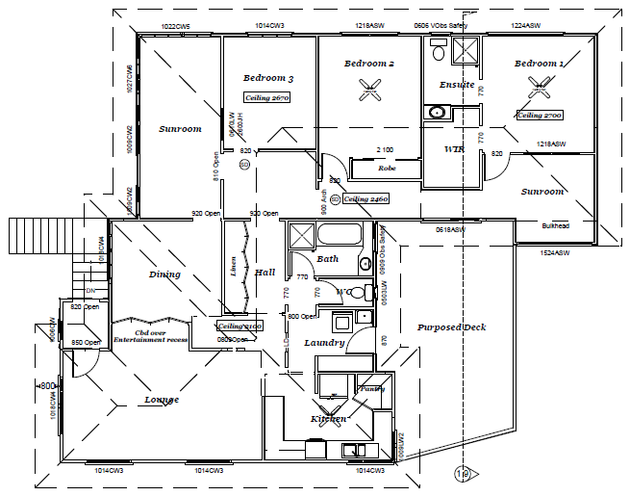
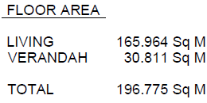
18.09 m
House 3
Measurements to outer most projection (Incl. 920 mm eaves)
15.54 m
15.54 m
15.41 m

Slide 58
Lot 2 Building Area – (13.8 m x 17.9 m)
House 1 – Fits
(12.4 m x 11.9 m)
House 2 – Footprint fits with eaves hanging over gully
(14.1 m x 14.9 m)
House 3 – Doesn’t fit
(18.1 m x 15.5 m)
24.8m
2m
13.8m
20m
2m
3m
17.9m
1.8m
4m
23.7m

Slide 59
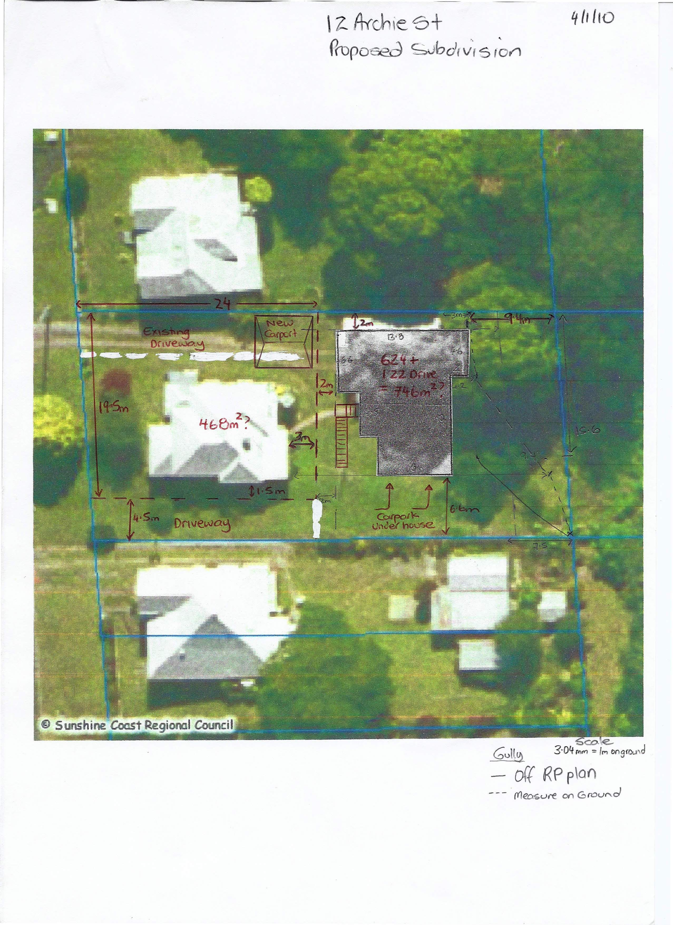
Draft 1 – Manually drawn subdivision & House 2 floor plan - provided to surveyor

Slide 60
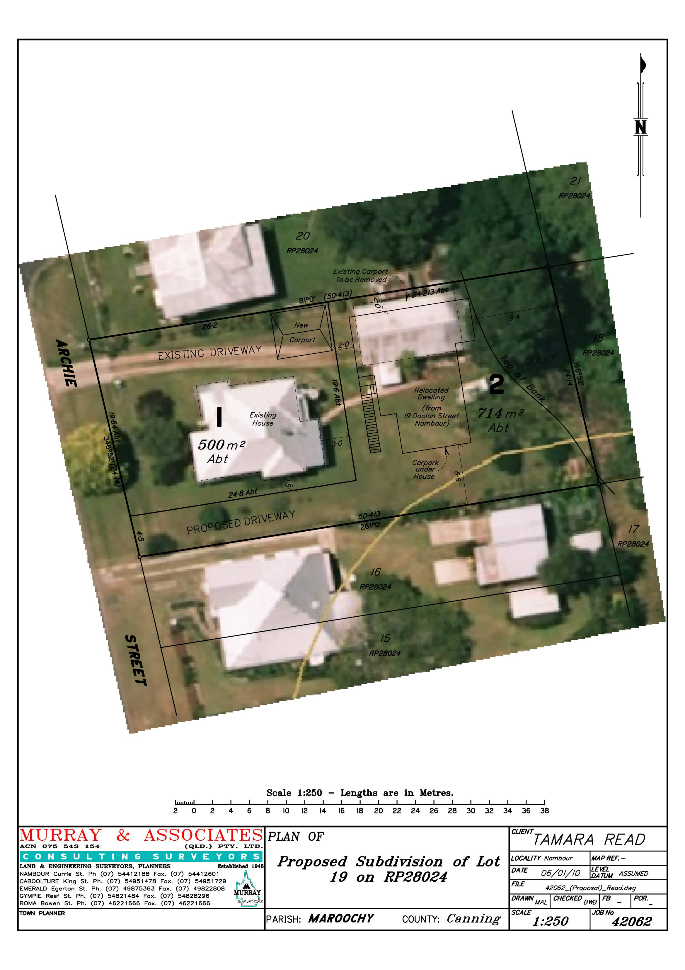
Draft 2 – Surveyor Draft Plan

Slide 61
Final – Subdivision Plan & House 2 Relocation Position

Slide 62
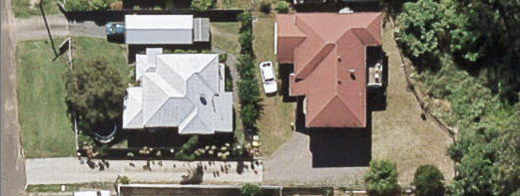
Completed Subdivision & House 2 Relocation

Slide 63
QUESTIONS?

